Slide 1

FACULTY OF FISHERIES AND PROTECTION OF WATERS
Martin Pšenička
Vice-Dean for International Relations at FFPW
M/ +420 725 787 925
E/ psenicka@frov.jcu.cz
www.frov.jcu.cz

Slide 2


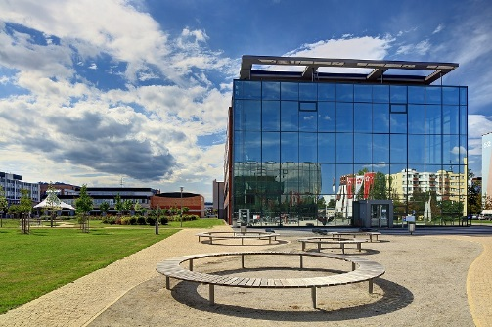

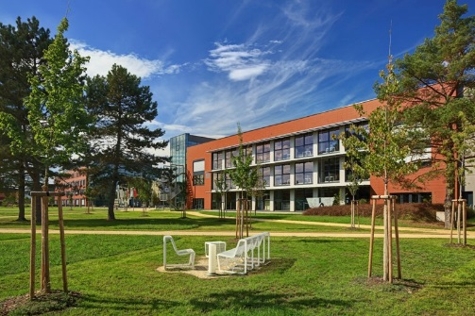
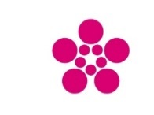






University of South Bohemia
Founded in 1991
9 000 students – 200 study fields (25 in English) – eight faculties
According to THE Young University Rankings, the best university in the CR
Faculty of Economics
Faculty of Arts
Faculty of Education
Faculty of Fisheries and Protection of Waters
Faculty of Science
Faculty of Theology
Faculty of Health and Social Sciences
Faculty of Agriculture and Technology

Slide 3
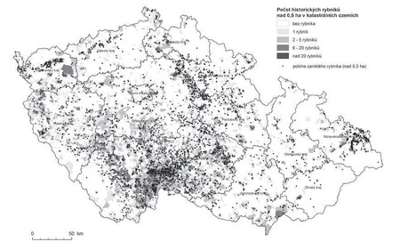
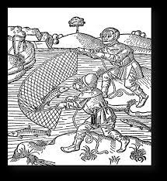
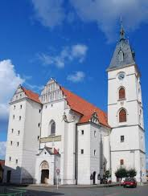
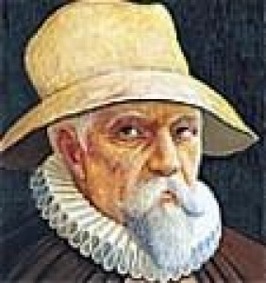
South Bohemia – Aquaculture tradition
South Bohemia has been a freshwater aquaculture hub since the Middle Ages.
Třeboň pond system, dating back to the 14th century, is one of Europe's oldest and largest.
Rožmberk pond, the largest in the Czech Republic (489 ha), was built by Jakub Krčín in the 16th century.
The region produces most of the fish in Czech (in total 20 000 t), mainly carp (90%).
Jakub Krčín

Slide 4
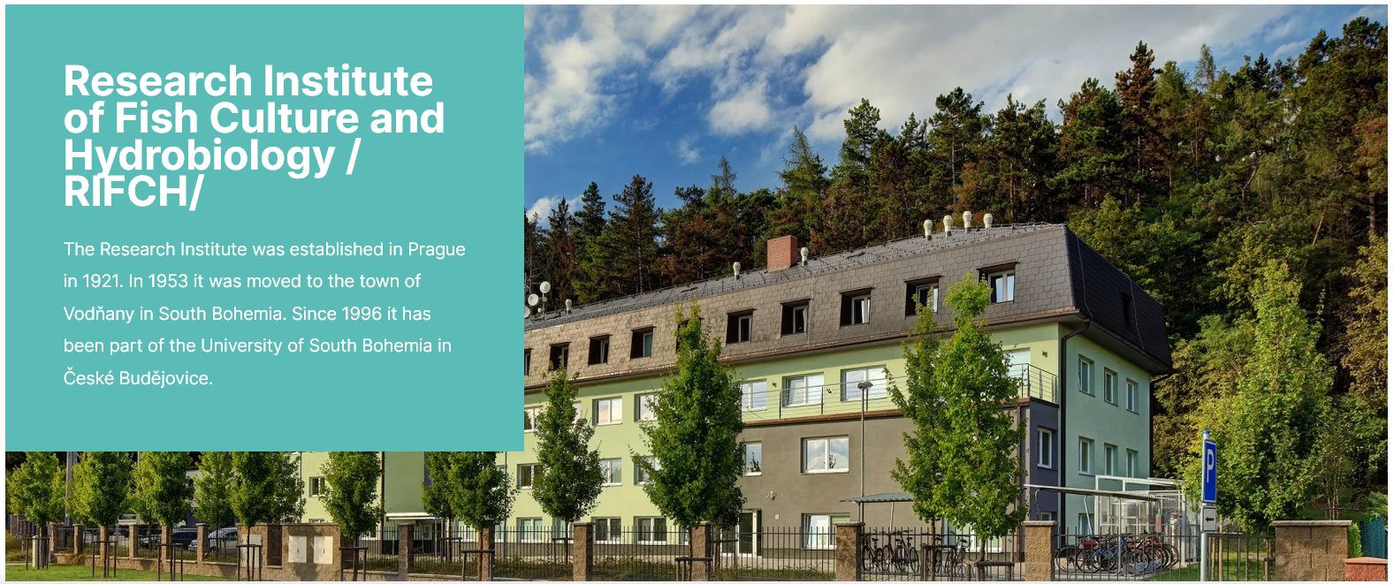

Slide 5
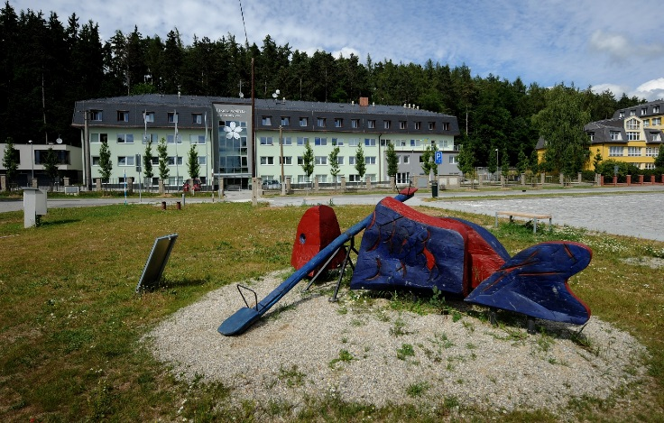
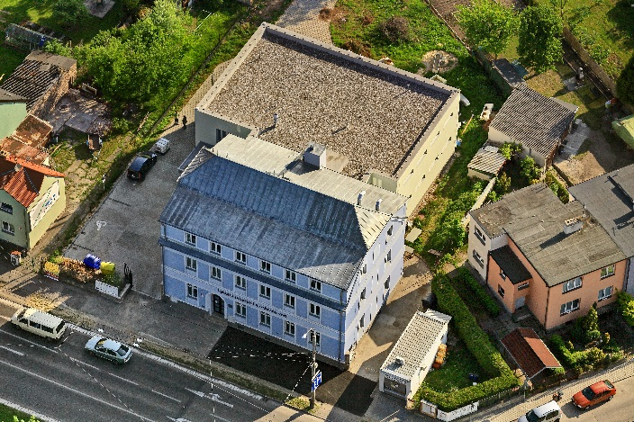
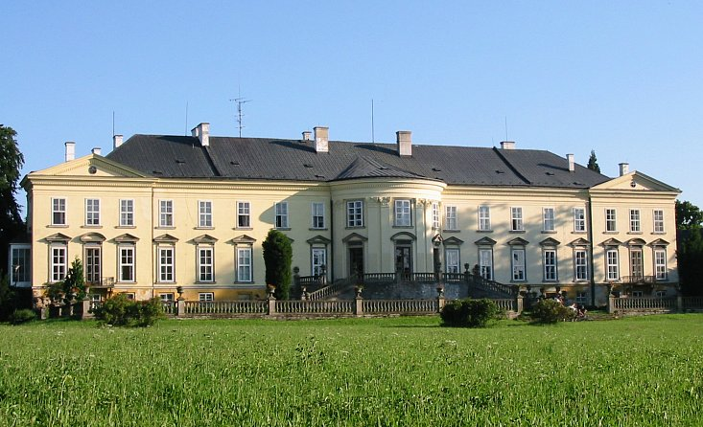
Faculty of Fisheries and Protection of Waters (since 2009)
VODŇANY
ČESKÉ BUDĚJOVICE
NOVÉ HRADY
DEAN´S OFFICE
INSTITUTE OF AQUACULTURE AND PROTECTION OF WATERS
INSTITUTE OF COMPLEX SYSTEMS
RESEARCH INSTITUTE OF FISH CULTURE AND HYDROBIOLOGY
INTERNATIONAL ENVIRONMENTAL EDUCATIONAL, ADVISORY AND INFORMATION
CENTRE OF WATER PROTECTION
CENAKVA
SOUTH BOHEMIAN RESEARCH CENTER OF AQUACULTURE AND BIODIVERSITY OF HYDROCENOSES

Slide 6
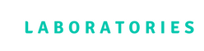
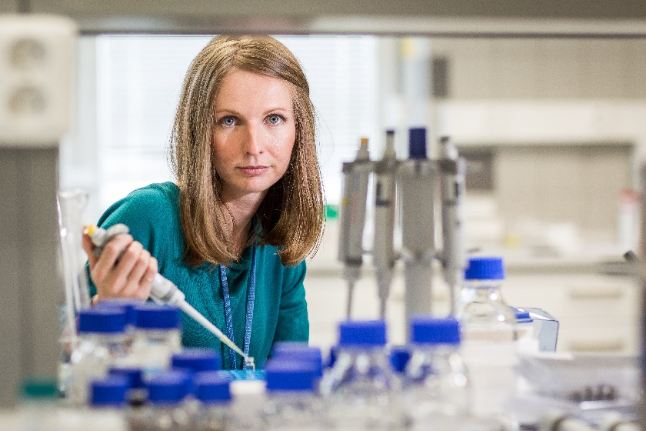
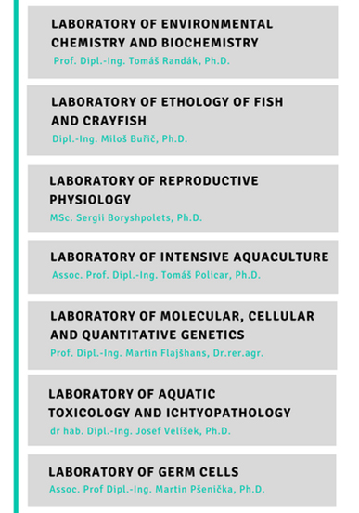
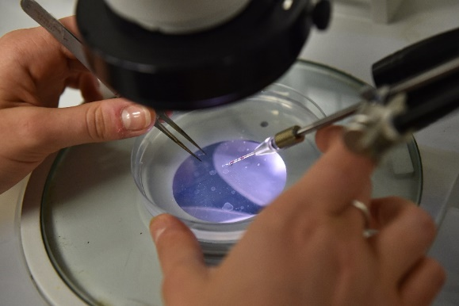
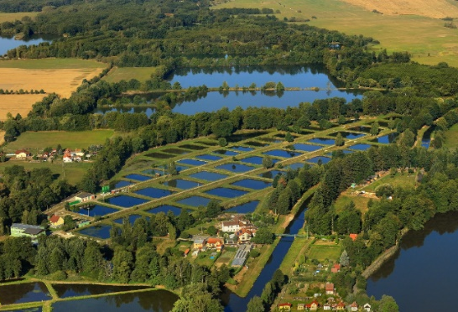
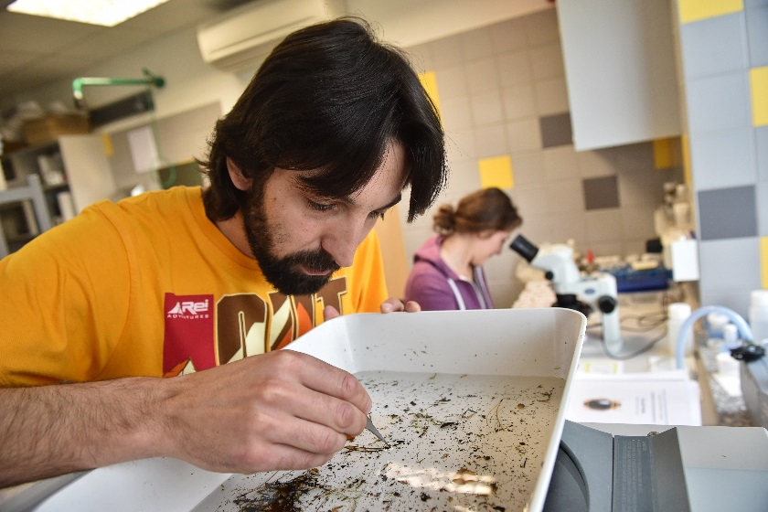
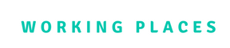

RESEARCH INSTITUTE OF FISH
CULTURE AND HYDROBIOLOGY
LABORATORY OF ENVIRONMENTAL CHEMISTRY AND BIOCHEMISTRY
Prof. Tomáš Randák, Ph.D.
LABORATORY OF FRESHWATER ECOSYSTEMS
Assoc. Prof. Miloš Buřič, Ph.D.
LABORATORY OF REPRODUCTIVE PHYSIOLOGY
Sergii Boryshpolets, Ph.D.
LABORATORY OF INTENSIVE AQUACULTURE
Oleksandr Malinovskyi, Ph.D.
LABORATORY OF MOLECULAR, CELLULAR AND QUANTITATIVE GENETICS
Prof. Martin Flajšhans, Dr.rer.agr.
LABORATORY OF AQUATIC TOXICOLOGY AND ICHTYOPATHOLOGY
dr. hab. Josef Velíšek, Ph.D.
LABORATORY OF GERM CELLS
Assoc. Prof. Martin Pšenička, Ph.D.

Slide 7

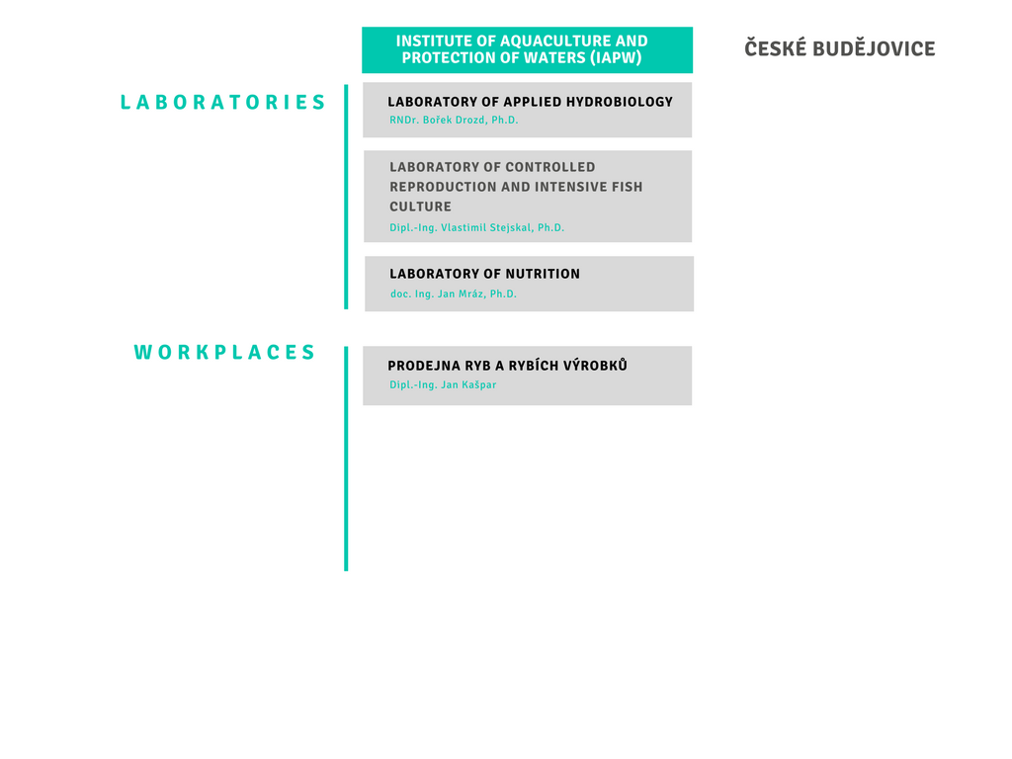
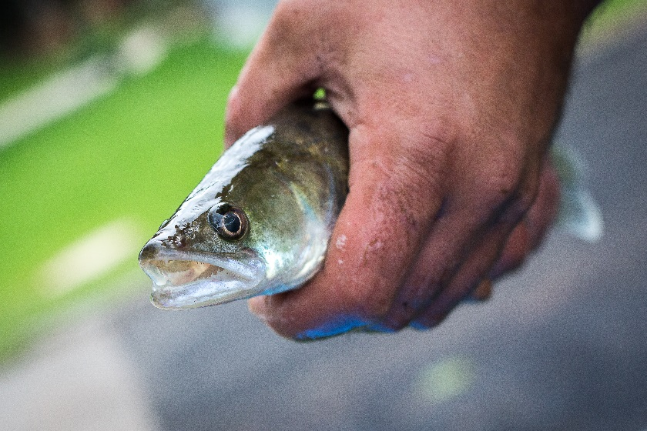
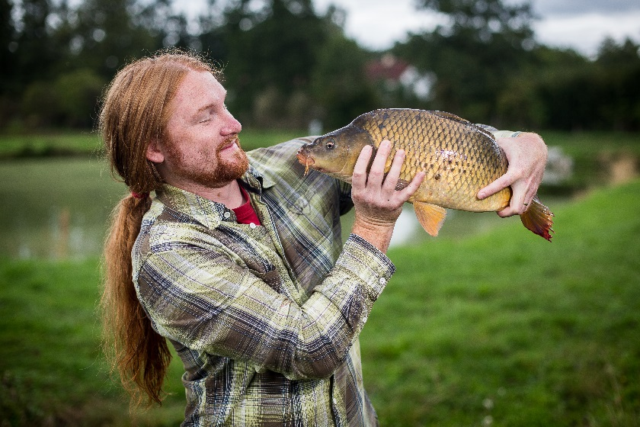
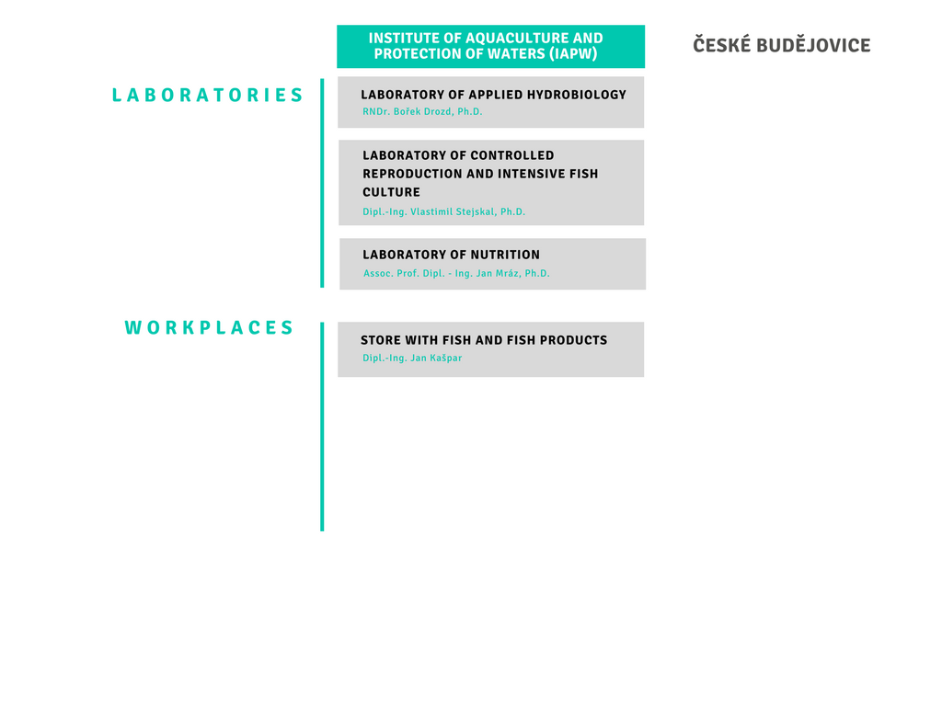
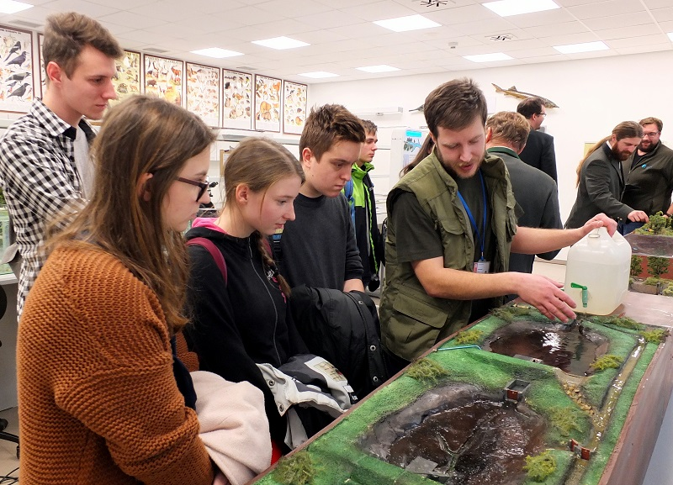
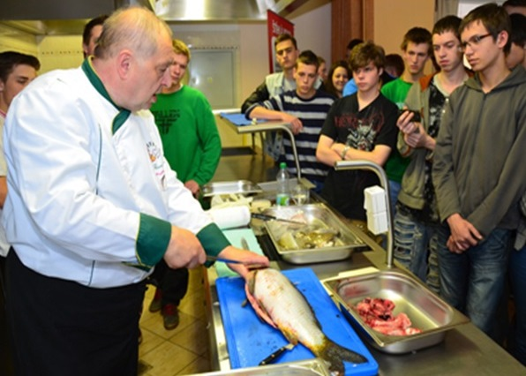
INSTITUTE OF AQUACULTURE AND PROTECTION OF WATERS
LABORATORY OF CONTROLLED REPRODUCTION AND INTENSIVE FISH CULTURE
Assoc. Prof. Vlastimil Stejskal, Ph.D.
LABORATORY OF NUTRITION
Assoc. Prof. Jan Mráz, Ph.D.
PROCESSING UNIT AND SHOP WITH FISH AND AQUACULTURE PRODUCTS
Jan Kašpar

Slide 8
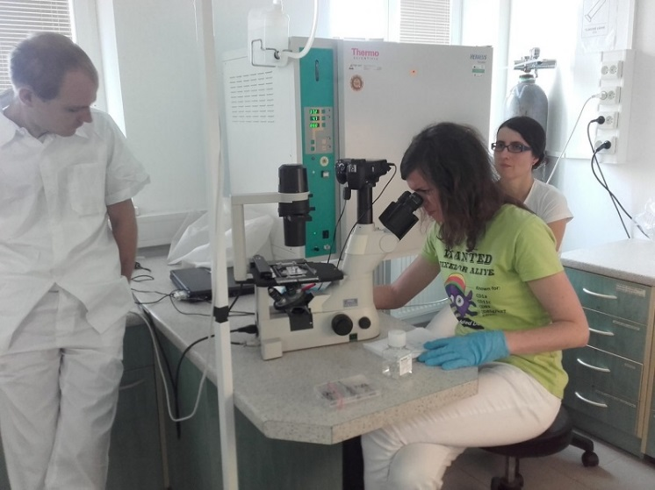
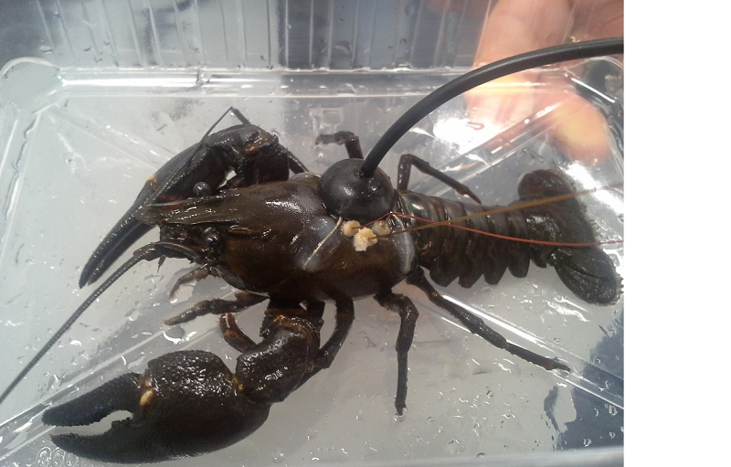
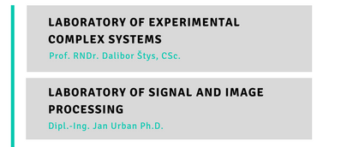
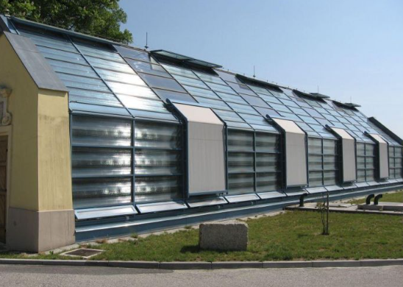
INSTITUTE OF COMPLEX SYSTEMS

Slide 9

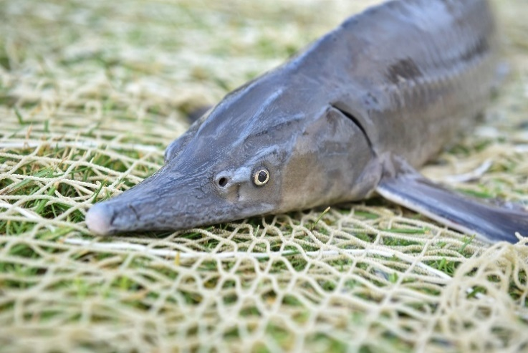
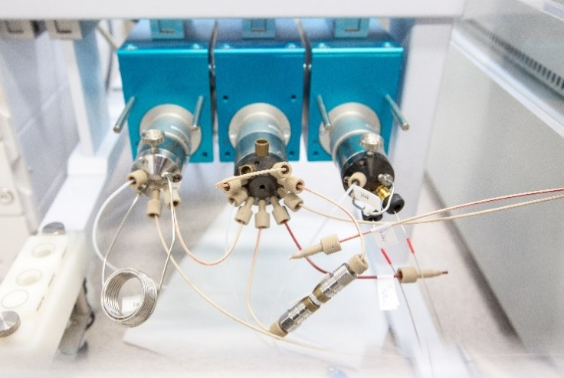

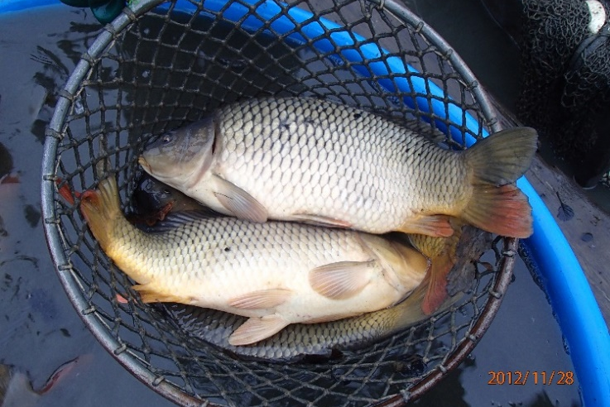
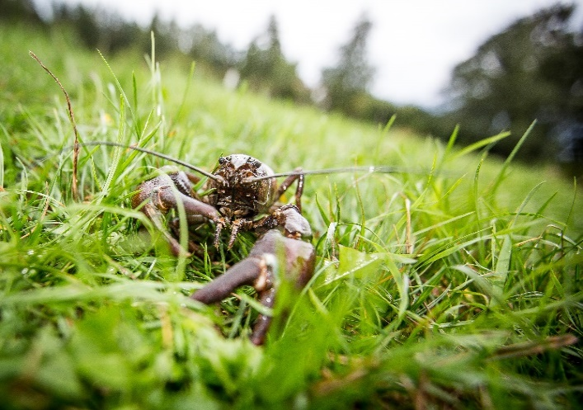
REPRODUCTIVE AND GENETIC PROCEDURES FOR FISH BIODIVERSITY CONSERVATION AND AQUACULTURE
“NEW” POLLUTANTS IN THE ENVIRONMENT AND THEIR EFFECT ON FRESHWATER ECOSYSTEMS
is a research facility necessary for comprehensive research and development with high financial and technological intensity, which is approved by the government and established for use by other research organisations.
SUSTAINABLE AQUACULTURE WITH A RESPONSIBLE WATER AND NUTRIENT MANAGEMENT
FRESHWATER ECOSYSTEMS IN THE ERA OF GLOBAL CHANGE

Slide 10
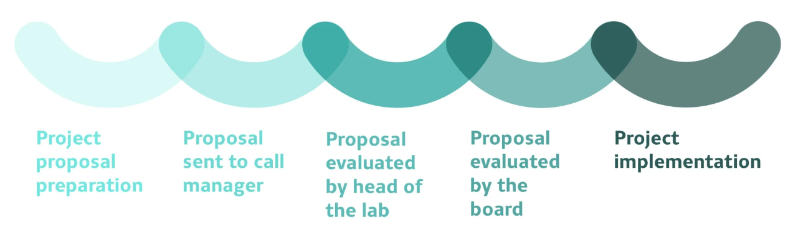
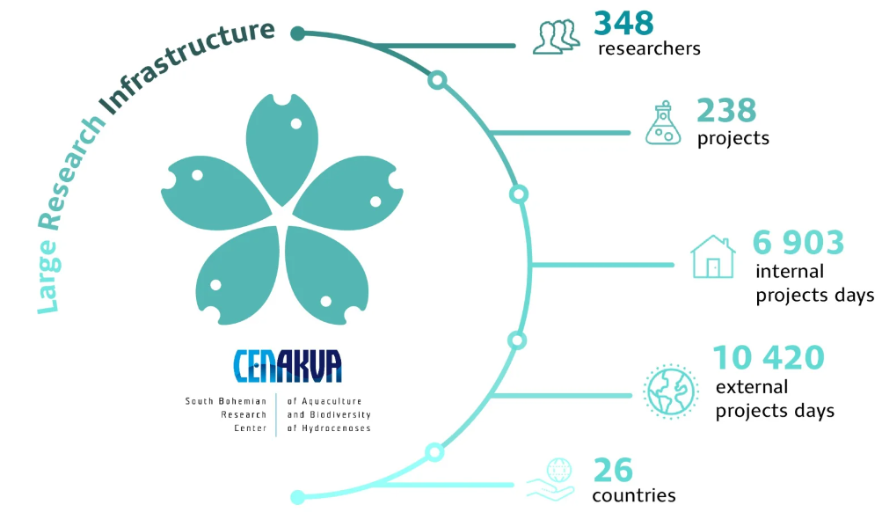
Open access infrastructure – External projects enabled

Slide 11
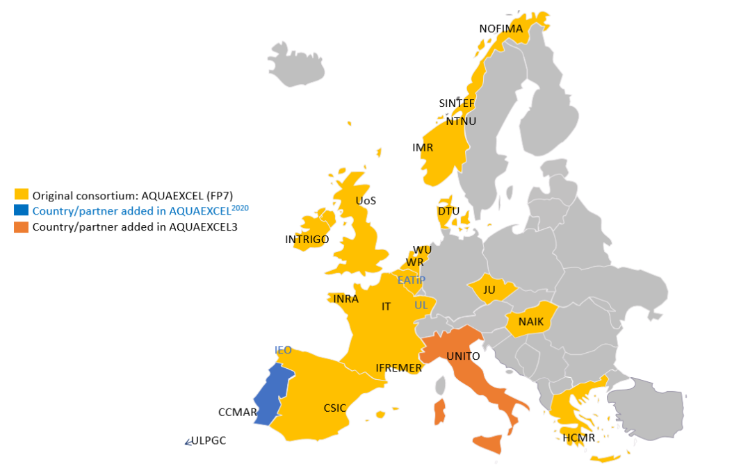

AQUAEXCEL makes available 40 Research Installations provided by 22 partner organisations across Europe

Slide 12
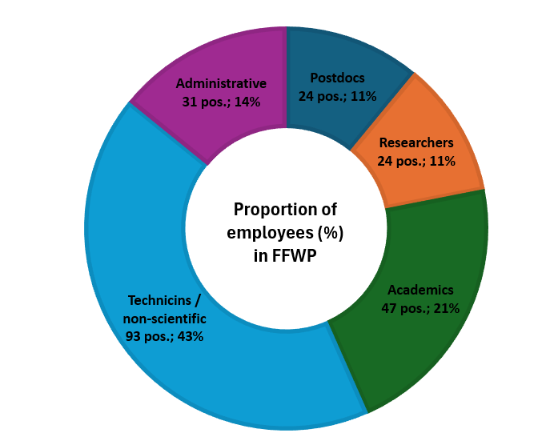
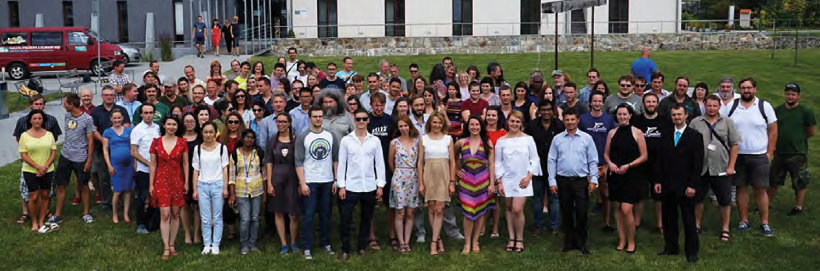
HR – structure of employees
57%
43%
Total of 219 staff

Slide 13
Economy – financial resources

Slide 14
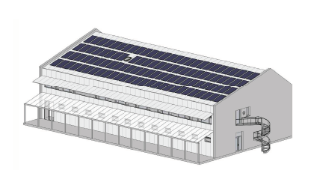
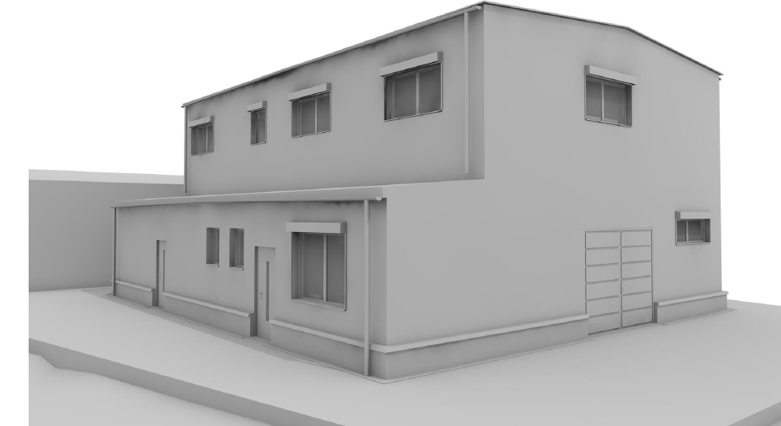
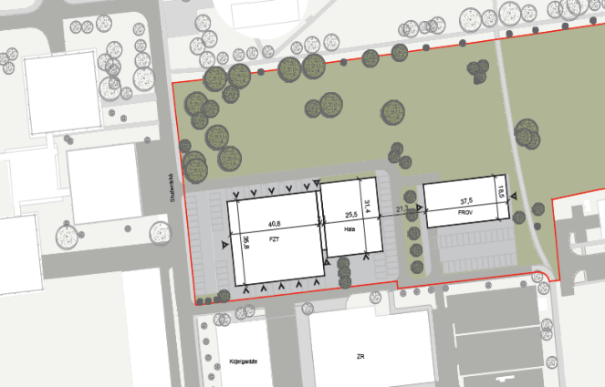
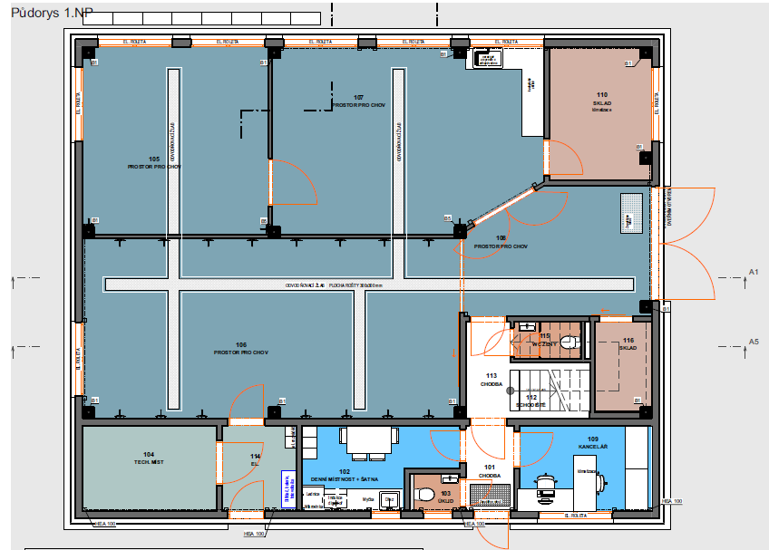
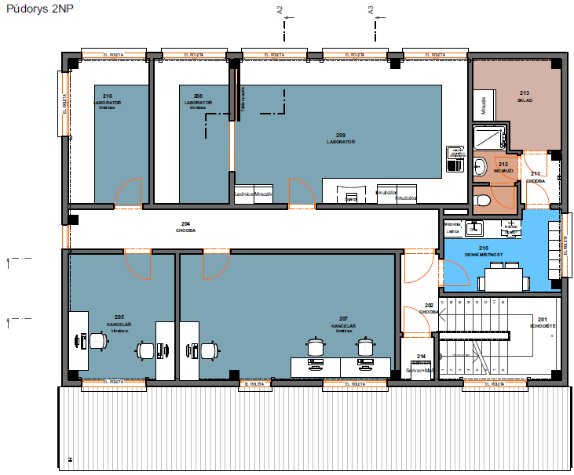
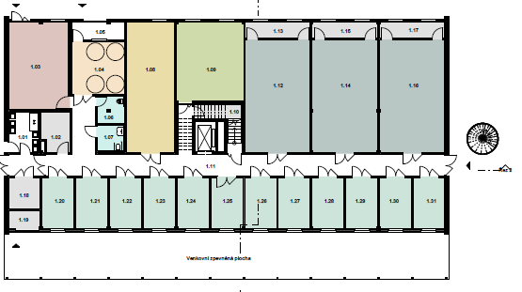
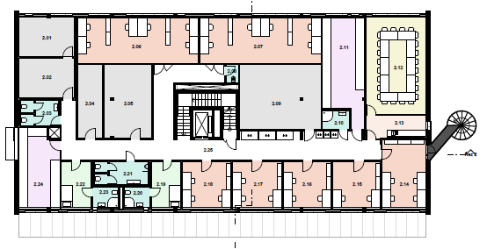
Planned investments for new fish facilities for laboratories of RIFCH and IAPW
New experimental hall for Genetic Fisheries Center (30 mil. CZK)
JU Smart Agritech RAS hall for laboratories in České Budějovice (70 mil. CZK)

Slide 15
SCIENCE AND RESEARCH IN FFPW USB
Number of outputs in total (number of articles per FTE)
1.95
2.10
2.15
1.95
1.75
1.47
2.27*
* by June 30, 2024

Slide 16




SCIENCE AND RESEARCH IN FFPW USB
Quality of articles (Impact Factor ranking)
Q1 journals
dominate
doubled
in ~ 8 yrs
66%

Slide 17



STUDY PROGRAMS
PROTECTION OF WATERS
FISHERY AND PROTECTION OF WATERS
FISHERY
FISHERY
Protection of Aquatic Ecosystems

Slide 18

NUMBER OF STUDENTS
123 students
48 students
48 students
PROTECTION OF WATERS
39 full-time
15 combined
FISHERY AND PROTECTION OF WATERS (CZ)
20 full-time
15 combined
FISHERY
24 full-time
4 combined
PROTECTION OF AQUATIC ECOSYSTEMS
17 full-time
1 combined
FISHERY
50 full-time 19 combined
FISHERY AND PROTECTION OF WATERS (ENG)
13 full-time
NUMBER OF STUDENTS AT THE FACULTY TO DATE SEPTEMBER 10, 2024

Slide 19
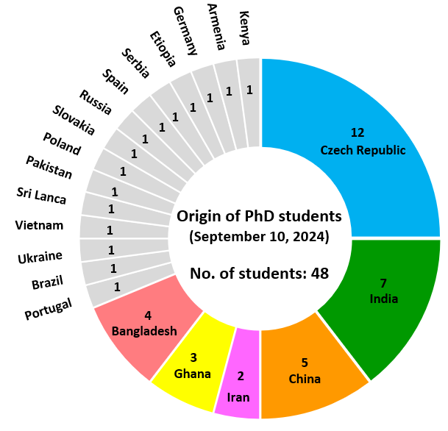
NATIONALITY STRUCTURE OF PhD STUDENTS
2024

Slide 20
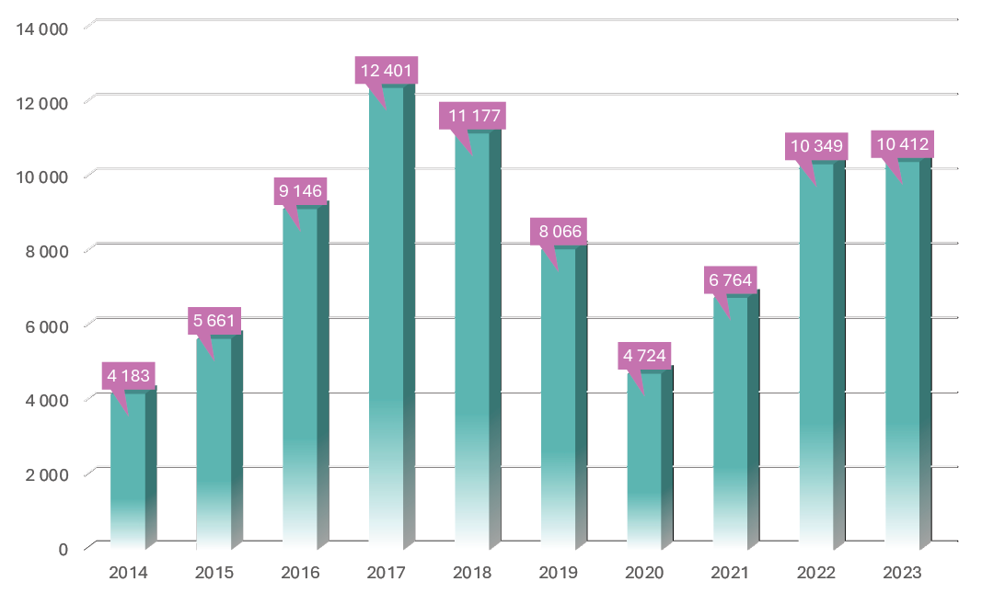
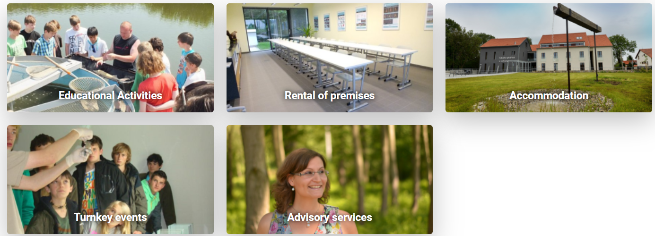

LIFELONG LEARNING
Approximately 200 events per year
Summer Schools
Children's University
Specific environmental programmes for kindergartens, basic and secondary schools
Professional seminars and workshops for public
Environmental education of teachers in basic and secondary schools (accredited educational programs)
Number of atendees

Slide 21





















NATIONAL COOPERATION

Slide 22













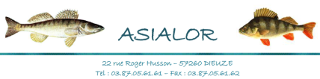

INTERNATIONAL COOPERATION
Membership in international associations and cooperation with foreign companies
Global standards for
bussiness communication

Slide 23

















INTERNATIONAL COOPERATION
More than 30 bilateral agreements

Slide 24




INTERNATIONAL COOPERATION
Improvement and protection of free rivers and freshwater life of the Danube basin
(2021 – 2031)
Application and testing of antimicrobial and antioxidant properties of grape extracts in fish farming (2022 – 2026)
CryoStore - Innovationin Germplasm Cryopreservation for Improved Animal Breeding and the Conservation of Europe’s Livestock Biodiversity (2023 – 2026)
Aquaculture Infrastructures for Excellence in European Fish Research
(2022 – 2025)

Slide 25



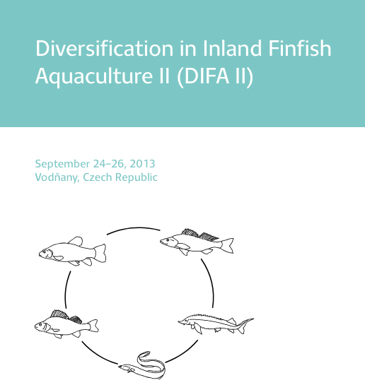
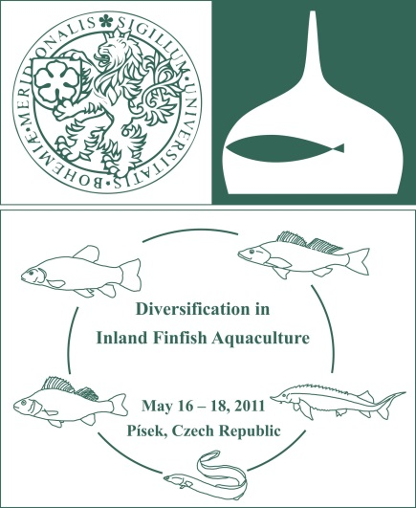

INTERNATIONAL COOPERATION
Organisation of International conferences and symposia

Slide 26





COMMERCIAL ACTIVITIES
Consultation and services for fish farms in the Czech Republic and Europe (RAS technology, controlled reproduction, larval rearing, etc.)

Slide 27




COMMERCIAL ACTIVITIES
Fish breeding, selection and testing of growth performance, feeding tests

Slide 28





COMMERCIAL ACTIVITIES
Sale of fish and fish products
(Christmas sales, fillets, fish banquets, omega3carp – utility model for feed)

Slide 29




COMMERCIAL ACTIVITIES
Sale of fish and fish products (sturgeon caviar, cosmetics, canned fish pâtés)

Slide 30





COMMERCIAL ACTIVITIES
Hydrobiological and hydrochemical monitoring of waters, sediment and biota analyses (incl. pharmaceuticals, pesticides, and drugs)

Slide 31

THANK YOU FOR YOUR ATtENTION

