Slide 1



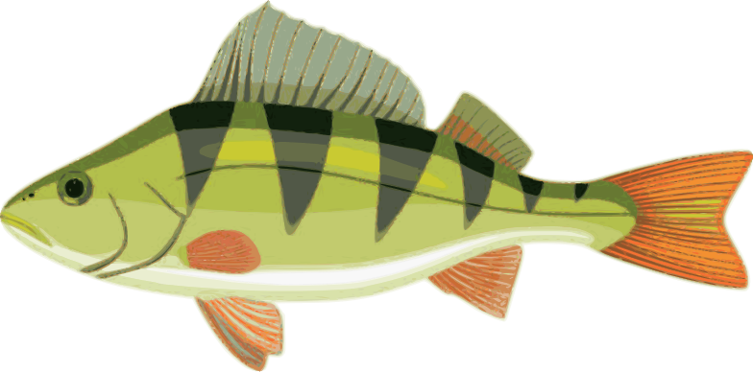
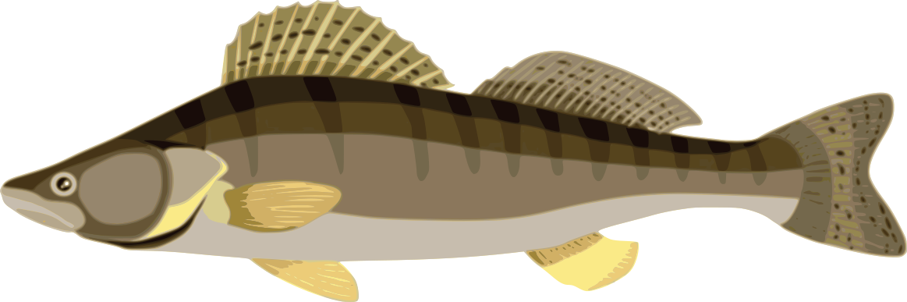

Nutritional requirements and its effects on growth performance of percid fish in
European freshwater intensive aquaculture
Tomáš Pěnka, October 22nd 2024
penkat00@frov.jcu.cz
Notes:
Good morning, everybody.

Slide 2
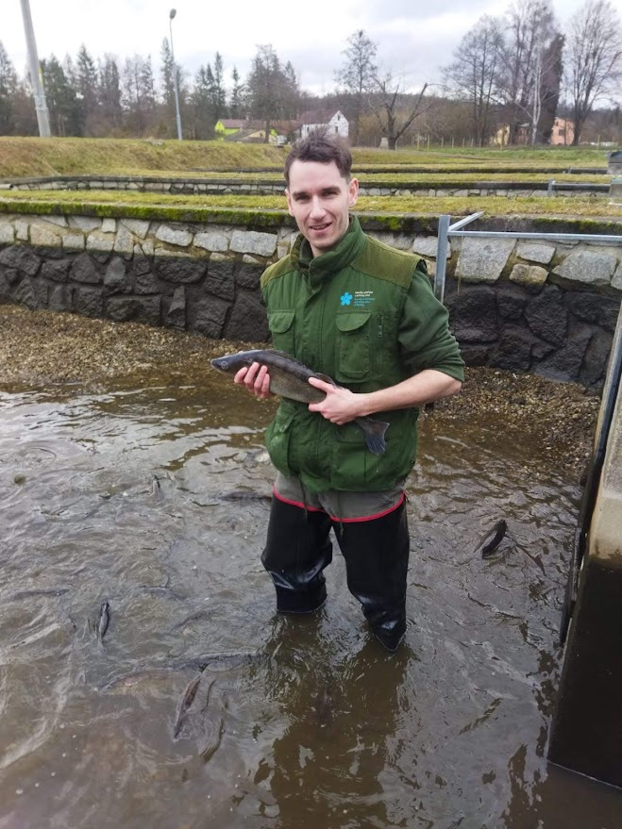
🙋🏻‍♂️ About me …
• PhD. Study – specilization: Fisheries (2021-present)
• member of EAS (since 2022)
• Focus:
  optimizing the feeding management in intensive pikeperch culture
  determination of pikeperch feeding requirements and its influence on survival and growth
  investigation of the effects of bicultural stock on feed utilization in RAS
Notes:
I’m a PhD candidate (4th year) in laboratory of intensive fish culture of University of South Bohemia. And presentation you are going to see presentation focus on Nutritional requirements
and its effects on growth performance of percid fish in European freshwater intensive aquaculture

Slide 3
📝Content:
• Introduction
  The importance of percid fish in European aquaculture
  Biological and economic benefits
  Intensive aquaculture systems
  Economic challenges and opportunities
  Nutrition of pikeperch in aquaculture
  Rearing parameters for effective feeding
• Meta-analysis for European percid aquaculture
• Challenges for the future
  Economic and environmental sustainability of feed in intensive aquaculture
  Legislative constraints and their impact on the use of new feed types
  Perspectives and future research on the nutritional needs of percid fish
Notes:
Percids, in particular pikeperch and perch, are key species in European aquaculture. These species have a high economic value, not only because of the excellent quality and palatability of their meat, but also because of their ability to adapt to the intensive conditions of aquaculture systems. Due to the increasing market demand for quality fish meat, they are becoming an indispensable part of aquaculture production in many European countries. Due to this combination of commercial and environmental advantages, perch and pikeperch are becoming increasingly important. They are species that can grow in recirculating aquaculture systems (RAS), a technology that allows more efficient and sustainable fish production.

Slide 4
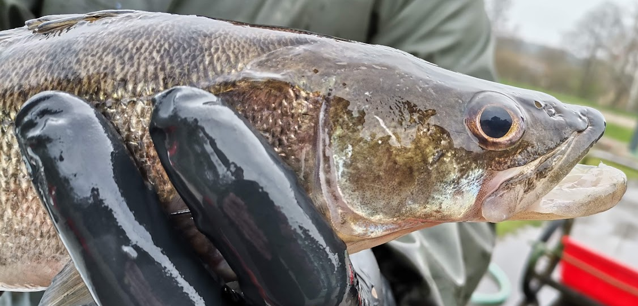

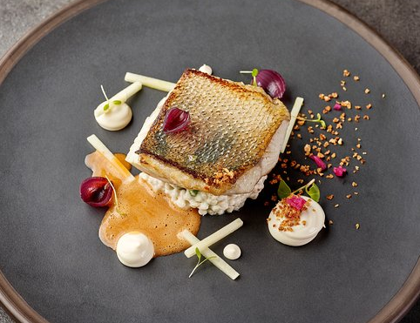

The importance of percid fish in European aquaculture
• Economic value 📈:
  ↑ demand for freshwater species in Europe
  ↑ price on markets due to quality of meat and ease of cooking
• Ecological importance ♻️💚:
  Species native to European freshwater ecosystems Adaptability to intensive aquaculture (RAS)
• Diverse market 🤹🏼📊:
  ↑ demand for perch and pikeperch not only in Europe but also on international market
  ↑ popularity in gastronomy, especially in haute cuisine and restaurants
Notes:
Pikeperch and river perch are gaining increasing economic value due to the growing demand for freshwater species in Europe. These fish are highly valued for their meat quality, which is reflected in rising market prices. In addition, they are popular for their ease of preparation and cooking. Next, their economic attractiveness, these species are also of significant ecological importance: They are native species of European freshwater ecosystems, which contributes to maintaining the ecological balance. Their adaptability to intensive aquaculture such as RAS makes them a sustainable choice for fish intensive farming. These fish have different market outputs, not only in Europe but also in international markets. They are becoming popular in the culinary world and have their place in haute cuisine and gourmet restaurants.

Slide 5
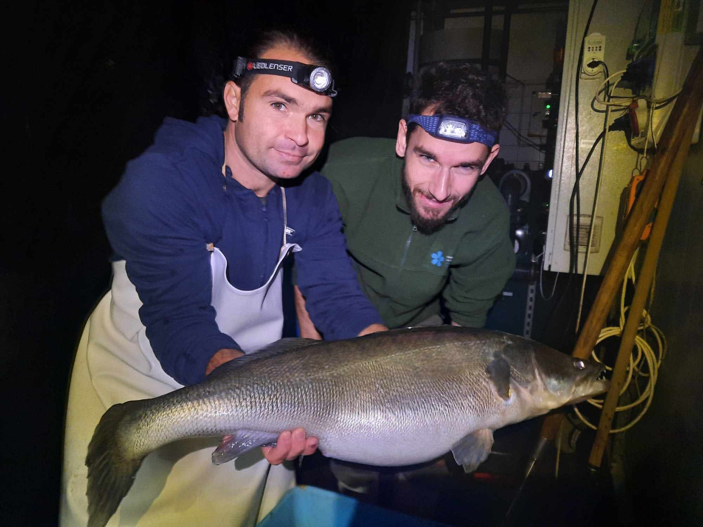

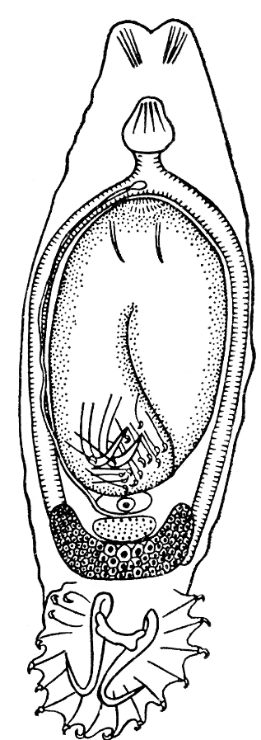
Biological and economic benefits
• Growth capabilities🌱:
  ↑ growth efficiency, proper nutritions
  Pikeperch: rapid growth, ↑↑ feed conversion
  Perch: slower growth, ↑ quality meat
• Disease resistance🦠👾🛡️ :
  Both species relative resistance to common diseases in aquaculture environment
  Properly fed and maintained in a clean
  and stable environment
Gyrodactylus longiradix
Notes:
The growth capabilities of percids in aquaculture are remarkable. With the right nutrition and environmental conditions, these species can thrive. Pikeperch is particularly attractive due to its rapid growth and efficient feed conversion, making it a popular choice for farmers. While river perch grows more slowly, it is still highly valued for its premium quality meat. In terms of disease resistance, both species show relative resistance to common diseases in aquaculture when maintained in optimal conditions. Proper feeding and maintaining a clean environment are key to ensuring their health and longevity.

Slide 6
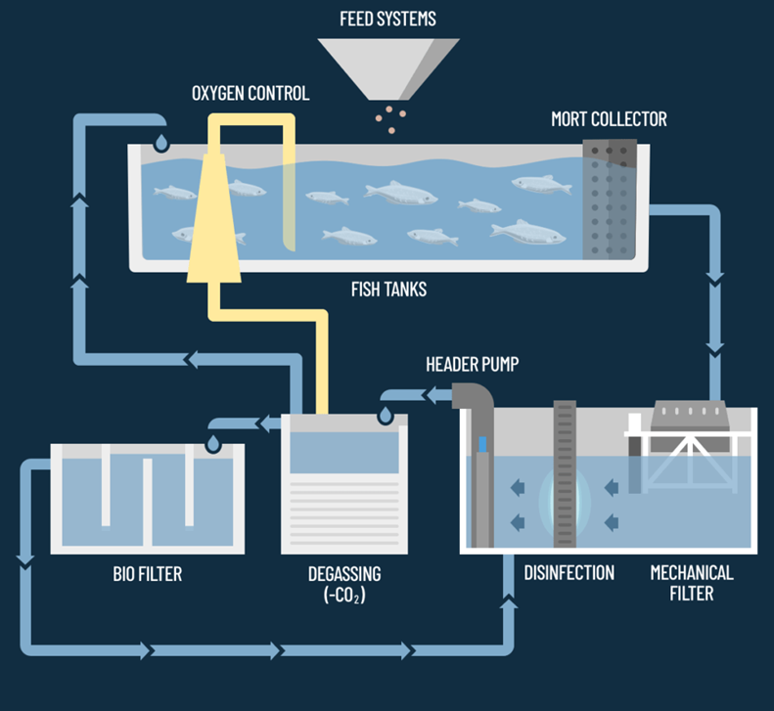
Intensive aquaculture systems
• Recirculation systems (RAS) 💡:
  Ideal for growing percid fish
  Control temperature, water quality and stocking density
  Improvement of growth and overall production, reducing the ecological footprint
• Sustainable production ♻️🔋 :
  Percid fish can be produced
  with ↓↓ environmental impact
Notes:
Recirculation Aquaculture Systems are ideal for growing percids, such as pikeperch and perch, due to their ability to precisely control temperature, water quality, and stocking density. These systems not only enhance growth and overall production but also reduce the ecological footprint of fish farming. In terms of sustainability, percid fish can be produced with minimal environmental impact. This makes them a key component of sustainable aquaculture, contributing to the industry's efforts to lower resource use while maintaining high-quality production.

Slide 7

Economic challenges and opportunities
• Feed costs 📋💲:
  The nutritional needs high quality and specially formulated feed
• Investment in technology 🛠️💲:
  ↑↑ initial investment in technology solutions
  (RAS), higher productivity and lower long-term costs
• Market potential 📈🤑:
  The market for percid fish ↑↑
  Restaurants and specialty food sector
Notes:
There are several factors to consider when producing percids, especially the cost of feed. These species require high quality feed specially formulated to meet their nutritional needs, which can increase operating costs. In addition, significant investment in technology is required, particularly in systems such RAS. Although initial costs are higher, the investment is often offset by increased productivity and reduced long-term operating costs. Despite these costs, the market potential for percids is expanding, particularly in the restaurant and specialty food sectors where demand is growing.

Slide 8
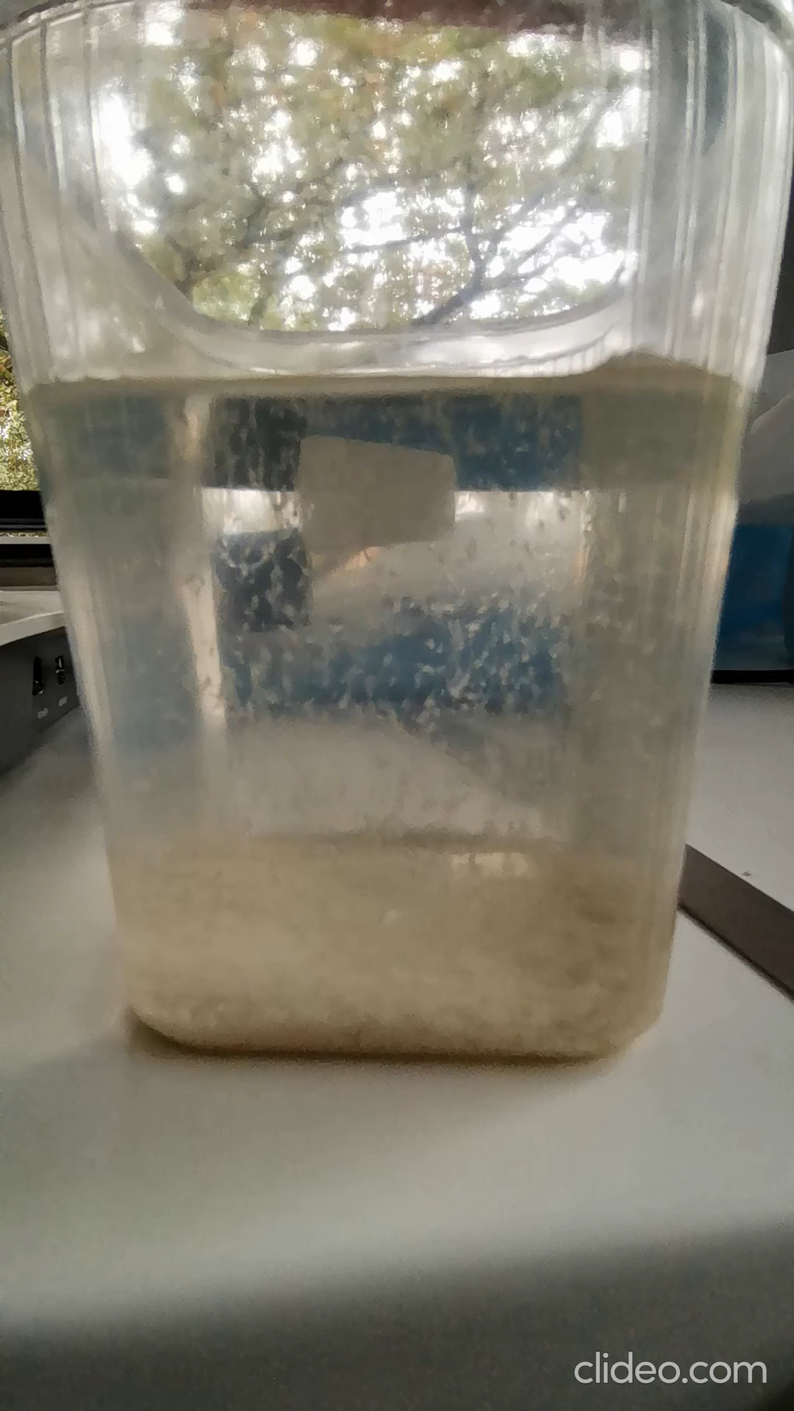
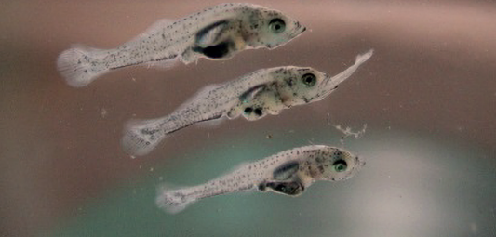
Nutrition of pikeperch in aquaculture
• Challenges associated with the nutrition of pikeperch
• Specific requirements of the nocturnal predator
• Demanding larval diet
  Small body size at the start of feeding
  Susceptibility to cannibalism at an early stage
Notes:
The nutrition of the pikeperch in aquaculture has presented many challenges to scientists in recent years. As a nocturnal predator, pikeperch has special requirements that need to be taken into account in order to be fed effectively in aquaculture. In addition, there is the demanding diet of larvae, which not only start feeding with a small body size compared to other species but are also prone to cannibalism at an early stage. Despite these high demands, scientific research has improved the efficiency of candace nutrition in aquaculture. These advances will be discussed in this chapter. Recommendations on several important parameters are also given, insofar as they can be derived from the results of the literature at the present state of knowledge. The first chapter deals with larval nutrition, followed by the nutrition of fattening pikeperch, and finally information on the nutrition of broodstock.

Slide 9
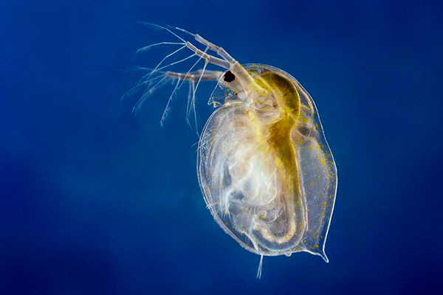
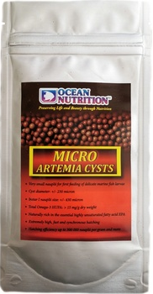
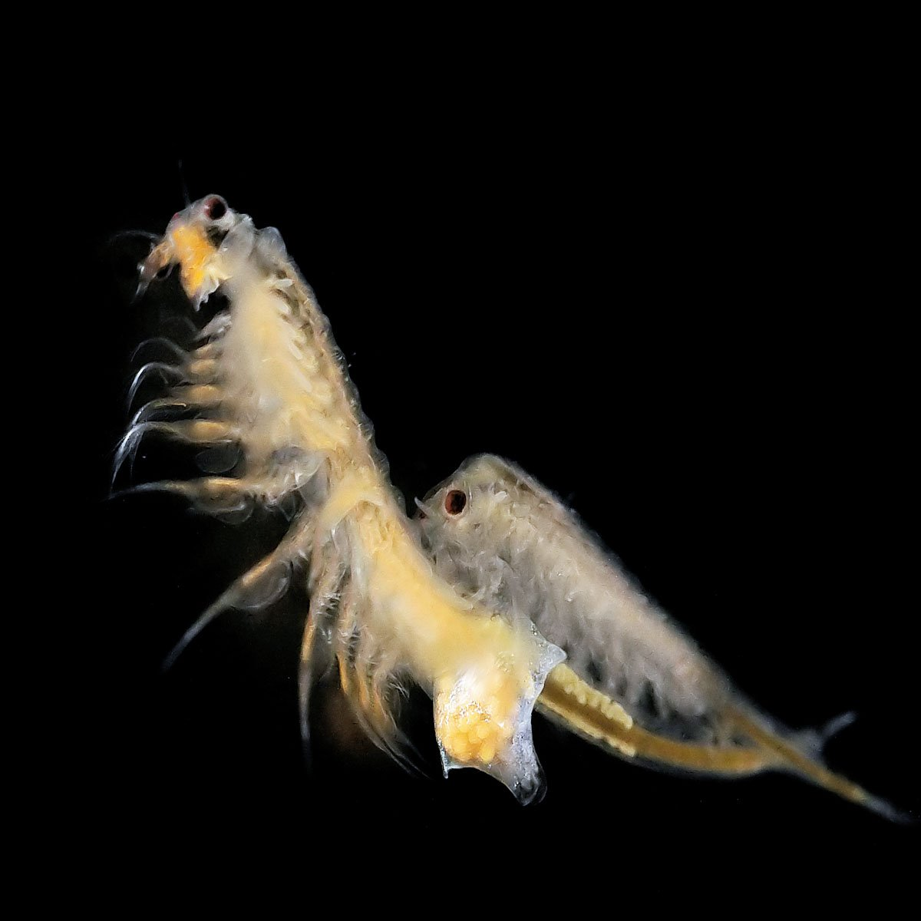
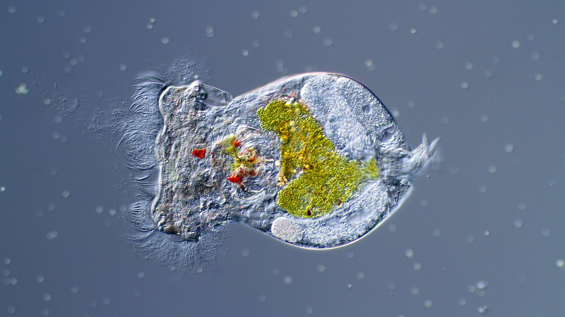
Nutrition of pikeperch in aquaculture (larvae)
Daphnia pulex
• Small size of larvae after hatching
• Short feeding time from yolk sac
• Feeding required within 10 days at 15-17 °C
• Key factors for successful feeding:
  Type of feed
Artemia salina
̈Brachinous plicatilis
Notes:
Despite their carnivorous diet, pikeperch larvae are relatively small after hatching and their yolk sac nourishes them for only a few days. After only 10 days at 15-17 °C, larvae starve to death without food. Not only the type of food and feeding regime, but also the size and nutrient composition of the feed is crucial for successful larval feeding. For optimum larval growth, the size of the food should increase according to the size of the larval mouthparts. Young larvae of pikeperch have a small body size and therefore a relatively small mouth opening once opened). Species of zooplankton such as artemia, rotifers or water fleas can serve as food in the early life stages, as the digestion of young larvae is still very limited. A constant feed supply is extremely important for the survival rate of larvae, as it can mitigate the rapid cannibalism that occurs. Different diets have already been tested for pikeperch larvae, resulting in very different survival rates¨. In addition to live food, dry foods in the form of microparticles have also been developed for larvae, which have various advantages over fed organisms. These advantages include, in particular, the time saving required to work when feeding live organisms, the reduced risk of introducing diseases or parasites into the system and the higher energy content of dry food compared to fed organisms. However, there are also several disadvantages to using dry feed, such as reduced. In addition to live feed, dry feeds in the form of microparticles have been developed for larvae, which have various advantages over fed organisms. These advantages include, in particular, the saving of time required to work with live feeding organisms, the reduction of the risk of introducing diseases or parasites into the system and the higher energy content of dry feed compared to fed organisms. However, the use of dry feed also brings several disadvantages, such as reduced acceptability of the feed, which can lead to starvation, increased cannibalism and increased pollution of water bodies.

Slide 10
Diets of larvea | Days of the experiment | Initial body weight (mg) | Final body weight (mg) | Survival rate (%) | Literature source
Zooplankton from the lake | 19-28 | 0.3-0.5 | 70-80 | 27-44 | Schlump-berger and Schmidt, 1979
Artemia (non-enriched) | 14 | 3.4 | 105.8 | 64.5 | Mamcarz et al., 1997
 | 35 | 0.8 | 212 | 54.4 | Ostas-zewska et al., 2005
 | 24 | 3.1 | 363 | 24.8 | Kestemont et al., 2007
 | 18 | 8.1 | 301 | 71.4
Artemia (enriched with highly unsaturated fatty acids and vitamin C) | 18 | 8.1 | 373 | 70.9
Artemia and Zooplankton | 35 | 0.5 | 120-150 | 26.7 | Klein Breteler, 1989
Artemia and rotifers | 12 | 0.66 | - | 53-68 | Imentai et al., 2020
Rotifers | 12 | 0.55 | 28 | 74 | Yanes-Roca et al., 2018
Artemia and rotifers | 12 | 0.55 | 5.66 | 64
Artemia and rotifers (enrinched) | 18 | - | - | 76 | Yanes-Roca et al., 2020
Marine larval feed | 35 | 0.8 | 190 | 52.4 | Ostas-zewska et al., 2005
Casein-based diet | 35 | 0.8 | 53.8 | 28.4
Freshwater larval diet | 18 | 8.1 | 231 | 77.4 | Kestemont et al., 2007
Marine larval feed | 18 | 8.1 | 144 | 63.9
Diet with soy phospholipids | 25 | 2.5 | 160-238 | 33-36.2
Notes:
This table summarizes the results of various feeding experiments with larval pikeperch. It contains information on the types of food such as zooplankton, Artemia (unenriched and enriched), marine and freshwater larval food and casein based-diet. Experiments lasted 12 to 35 days, with initial larval weights ranging from 0.3 to 8.1 mg and final weights ranging from 2.8 to 238 mg. Larval survival rates varied from 24.8% to 77.4%. The table also shows the sources of these studies, which date from 1979 to 2020. The results show how different types of feed affect the growth and survival of pikeperch larvae, which is crucial for optimising their nutrition in aquaculture.

Slide 11
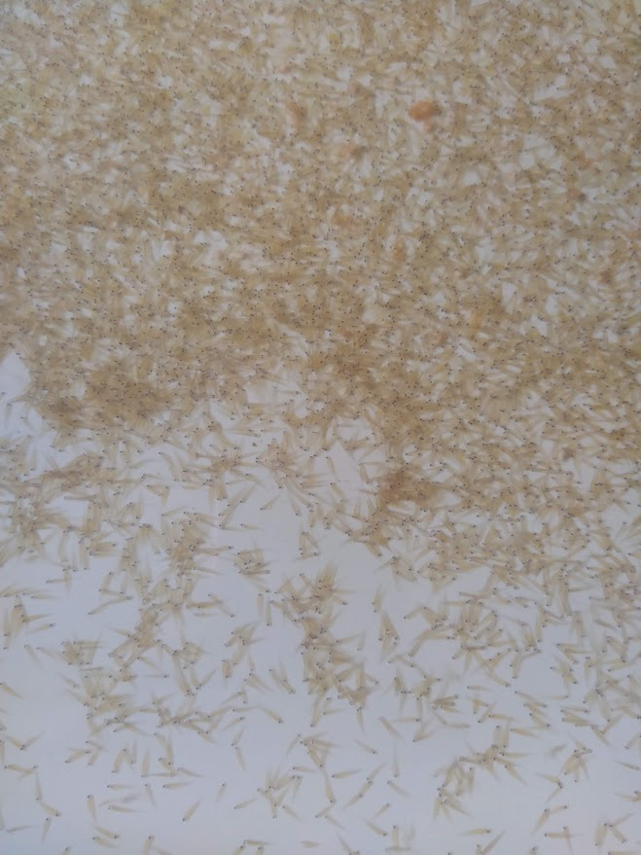
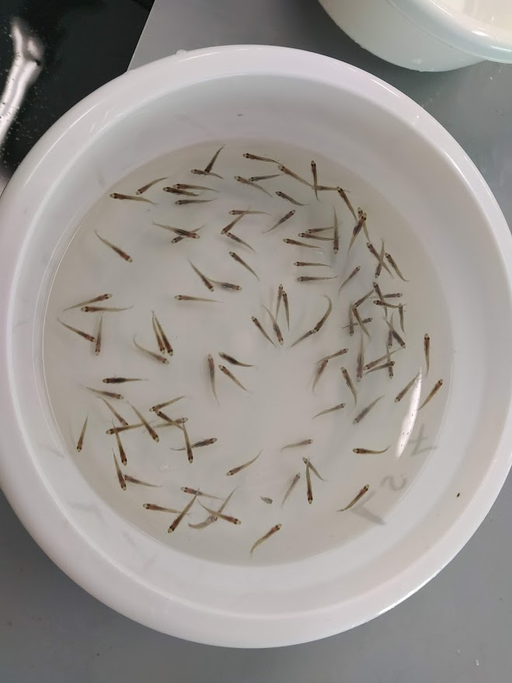
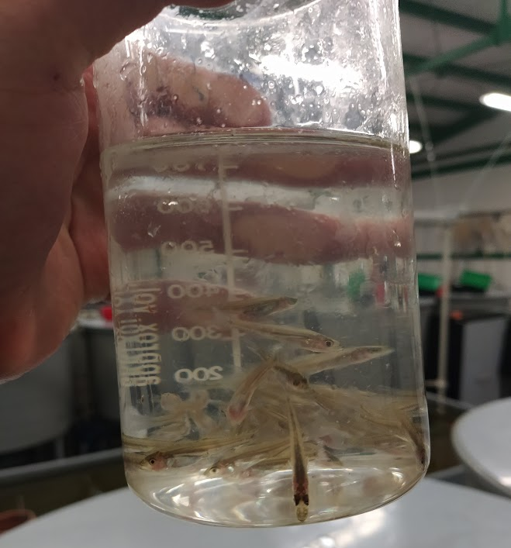
Nutrition of pikeperch in aquaculture (larvae)
• Key factors for successful feeding:
  Size and nutrient composition
2-3 DPH
15-20 DPH
40-60 DPH
Notes:
In order to maximize larval survival rates, different feeding strategies have been proposed that can combine several feed types with each other. These food types are offered to the larvae either sequentially or simultaneously. Live feed is often used to bridge the very early life stages, and at some point they switch to dry feed in the form of micropellets. The timing of this transition (called "weaning") is extremely important for larval survival. Kestemont et al. (2007) found that the best time for weaning is 19 days after hatching, when the pikeperch larvae are first fed Artemia. Recommend a similar transition time to dry micropellets (15 or 16 days after hatching). When switching to this particular dry feed, a so-called co-feeding phase can be used, where both microparticulate dry feed and live feed are used to facilitate the transition for the larvae. However, this co-feeding is not recommended by Colchen et al. (2020) for pikeperch.

Slide 12
Nutrition of pikeperch in aquaculture (larvae)
• Key factors for successful feeding:
  Size and nutrient composition
Days post hatching (DPH) | 5 DPH | 8-15 DPH | DPH 15-19
Feed | Feed enriched with rotifers (Chlorella vulgaris) | Artemia | Micro-particulate dry food (slow change over 9 days)
Notes:
In addition to the timing of the transition, the duration of the process is also important. Colchen et al. (2020) recommend a duration of nine days, during which time pikeperch larvae are gradually converted from live feed to a special dry feed. In contrast, Ostaszewska et al. (2005) found that feeding commercial microparticle feeds immediately after mouth opening is also possible without significantly affecting survival rates. Recent studies, however, still recommend the use of live feed in the early stages of larval development of pikeperch. Experiments by Imentai et al. 2020 and Yanes-Roca et al. 2018 have shown that the combination of Rotifers and Artemia leads to high survival rates of pikeperch larvae. In this case, rotifers are fed first (until 8-10 days after hatching) and then Artemia or a combination of Artemia and rotifers (here until day 17 after hatching). Enrichment of rotifers with some phytoplankton species (Chlorella vulgaris) also further increases survival rates and larval growth.

Slide 13
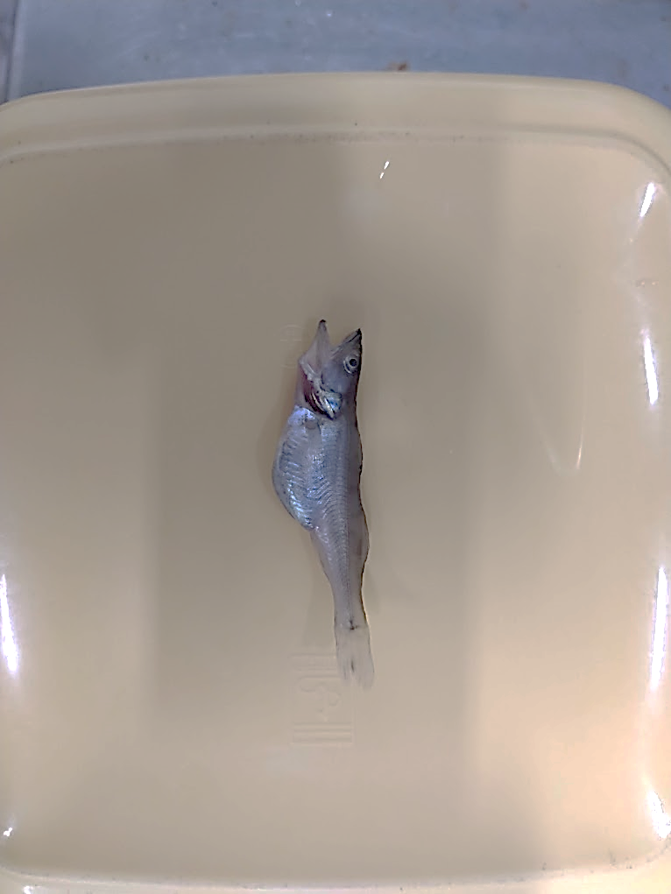
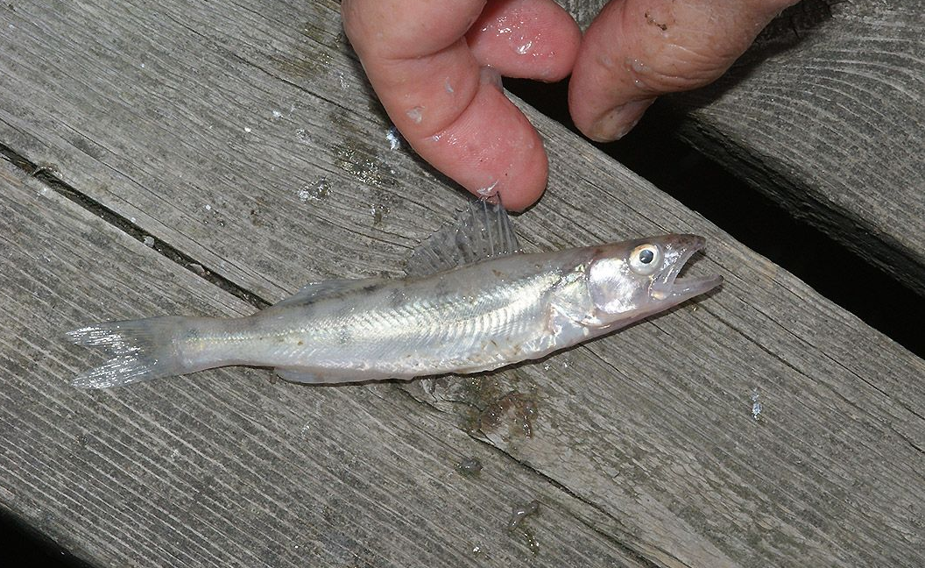
Nutrition of pikeperch in aquaculture (larvae)
• Size and nutrient composition
    The importance of proteins and fats
    Importance of AA and FA composition
Role of fatty acids
  SFA and USFA as a source of energy
  Polyenoic fatty acids for building body components (muscle, brain, retina)
  Importance for development and stress resistance
Notes:
The supply of protein and fat to the larvae's diet is particularly important to meet their energy needs. In addition, the composition of amino acids and especially fatty acids is extremely important for larval growth. Pikeperch uses both saturated and unsaturated fatty acids as a source of energy, while polyunsaturated fatty acids have a structural function and are mainly used to build various body components (muscles, brain, retina, etc.). These polyunsaturated fatty acids are extremely important for development and also for the resistance of larvae to stress. This was demonstrated, for example, by Yanes-Roca et al. in 2020 when enriching green algae (Chlorella vulgaris). The authors related the improvement in survival and growth rates to the additional supply of polyunsaturated fatty acids compared to other food sources used for rorquals. In addition to these fatty acids, the use of phospholipids in diets for common shrimp larvae may also improve their growth. Lund et al. 2018 recommend the addition of phospholipids, eicosapentaenoic acid (EPA) and docosahexaenoic acid (DHA) when using dry microparticulate diets to improve larval development and growth. El Kertaoui et al. (2019) also showed that different components, such as polyunsaturated fatty acids, vitamins and minerals, are not only important for larval growth and development, but that interactions can also occur between these substances. Here, attention should be paid to the dosage and the relative proportions of the substances.

Slide 14
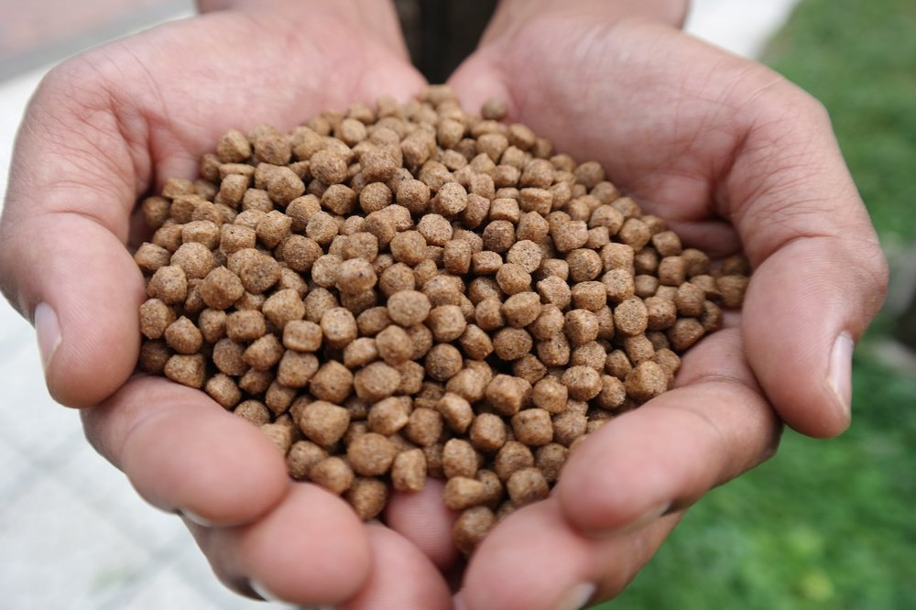
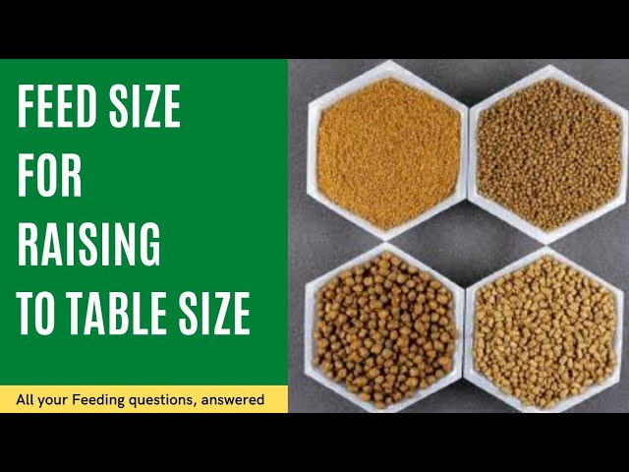
Nutrition of pikeperch in aquaculture
Composition and quantity of feed🍱:
  Depends on the size of the fish
  Protein requirement decreases as fish age
Proteins 🍳🥩🍖:
  Breaks down into AA and peptides
  Fry: 47-54% crude protein
  Juvenile (≥51.1g): 43-50 % crude protein
  Commercial feeds: 54-62 % crude protein
Notes:
The composition of the feed, as well as the amount of feed, is strongly dependent on the size of the fish. In general here, the protein requirement of the feed decreases as the age of the fish increases (Geay and Kestemont, 2015). Pikeperch is no exception. Protein is largely broken down in the digestive tract of fish into individual amino acids, di- and tripeptides, before passing through the intestinal wall and being utilized by the fish. These absorbed amino acids and peptides are then used as building blocks for various body tissues, such as muscles, or to meet energy needs. According to Schulze et al. 2007, 2008, the preferred crude protein content of pikeperch is between 47-54% depending on the crude fat content of the feed. Juveniles (51.1 g) have a lower crude protein requirement of 43-50%. This decrease in crude protein requirement is also reflected in commercial feeds where the crude protein content is higher (EFICO Sigma 970, BioMar Group, 3-6 mm: 54% crude protein; ALLER THALASSA EX, Aller Aqua A/S, 0.5-2 mm: 60-62% crude protein). It can be assumed that adult pikeperch have a similar crude protein requirement to juvenile pikeperch, but this has not yet been sufficiently scientifically investigated.

Slide 15
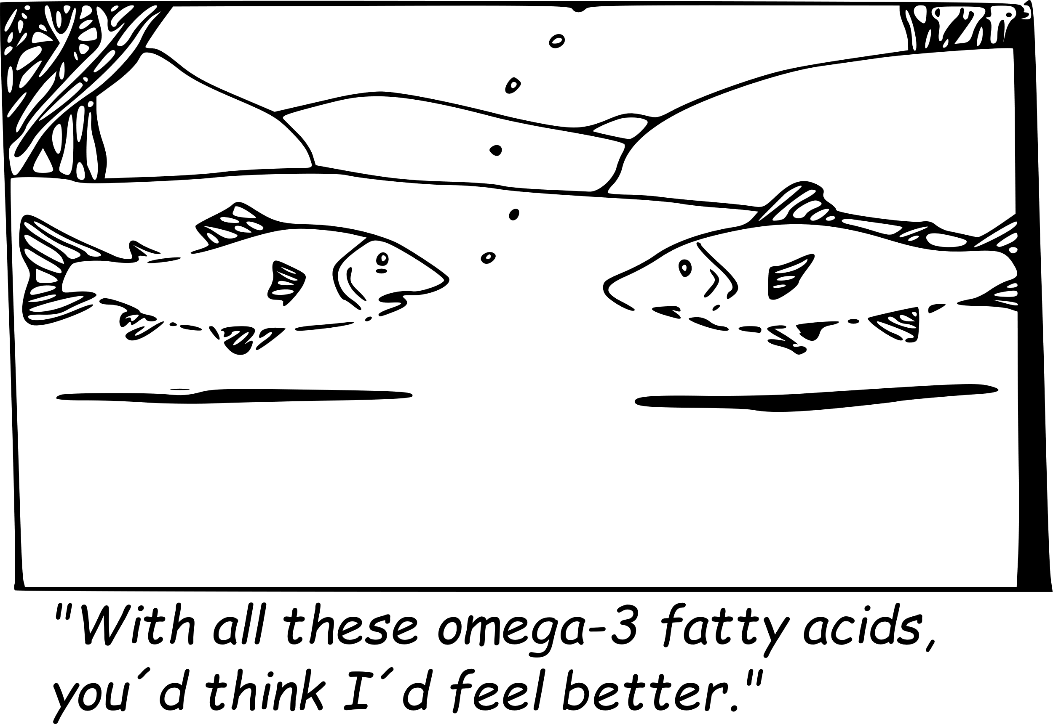
Nutrition of pikeperch in aquaculture
Fats 🧈🥑 :
  Energy source, protein-sparing effect
  Optimal ratio of crude protein to fat
  Fry: 17 % fat
  Juveniles (≥ 51.1 g): 10-16 % fat
  Adults (≥ 210 g): 10 % fat
Notes:
Fats are mainly used as an energy source for fish and their use in feed can lead to the so-called protein saving effect. This ensures that fats are used instead of amino acids for energy production, thereby increasing protein utilization. However, this effect may not occur in pikeperch if the feed has a high protein content. Since the optimal feed composition also depends on the ratio between crude protein, crude fat and carbohydrates, the crude fat content of the feed should always be considered in relation to the crude protein content. It depends on the relative energy content of the different substances. At 47 or 54% crude protein content, a 17% crude fat content and at 44% crude protein content, an 18% crude fat content in fingerling feed was assumed to be optimal for feed conversion. For juvenile fish (51.1 g), the recommended crude fat content of the feed is 10 to 16% if the crude protein content is at least 43%. As the fish weight increases, the fat requirement tends to decrease further. Zakęś et al., 2004 found that pikeperch with a starting weight of 210 g should have a crude fat content of approximately 10% in the feed to achieve the best feed conversion. The fat requirements of adult pikeperch have not yet been adequately investigated.

Slide 16
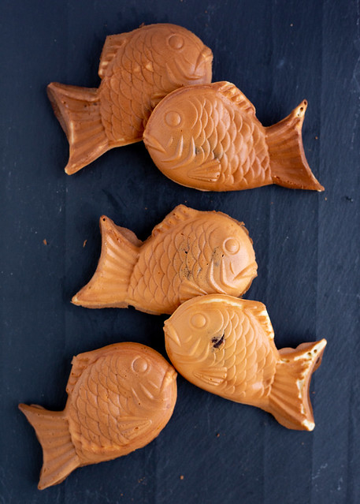
Nutrition of pikeperch in aquaculture
Carbohydrates 🍞🥐🥨:
  Carbohydrate to fat ratio affects growth
  Optimal growth:
    43% protein
    22% fat
    20% carbohydrate
Notes:
The above protein-saving effect could also depend on the ratio between carbohydrate and crude fat content. The best growth was achieved when the ratio of the two substances was equal based on their energy content. At the same crude protein content Nyina-wamwiza et al, 2005 found that carbohydrate ratios of 15 and 20% resulted in better feed conversion than 10%. In this study, the best growth was achieved at 43% crude protein, 22% crude fat and 20% carbohydrate and at 50% crude protein, 16% crude fat and 20% carbohydrate. Overall, carbohydrates in the diet of pikeperch are very understudied and require further research.

Slide 17
Nutrition of pikeperch in aquaculture
Life stages | Crude protein content (%) | Crude fat content (%) | Carbohydrate content (%)
Larvae, fry | 47 ‒ 54 | 17 ‒ 18 | N/A
Juvenile | 43 ‒ 50 | 10 ‒ 16 | 15 ‒ 20
Adult | N/A | N/A | N/A

Slide 18
Nutrition of perch in aquaculture
Life stages | Crude protein content (%) | Crude fat content (%) | Carbohydrate content (%)
Larvae, fry | 43.6 ‒ 56.5 | N/A | N/A
Juvenile | 46.6 | 12 ‒ 19.3 | N/A
Adult | N/A | N/A | N/A

Slide 19
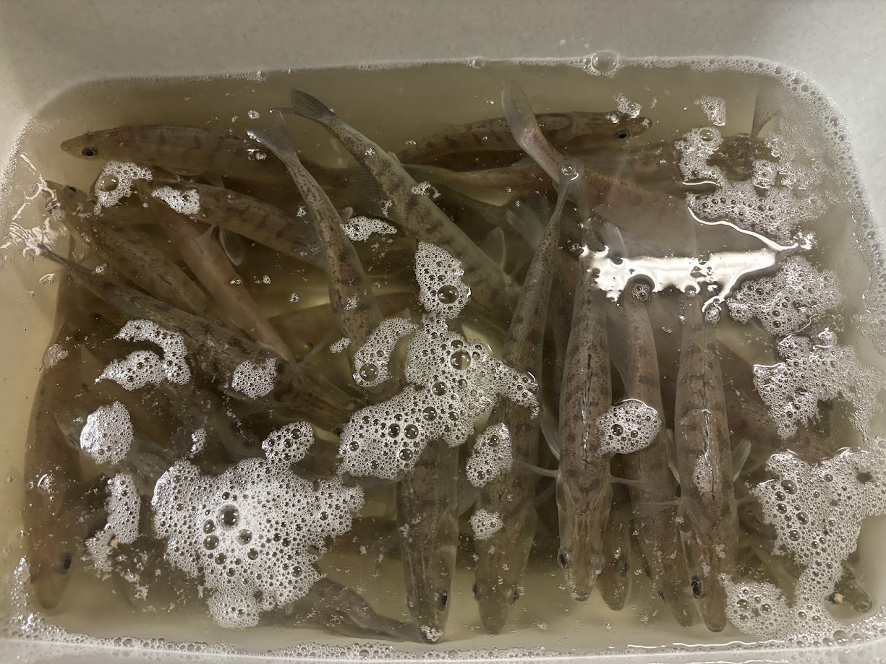
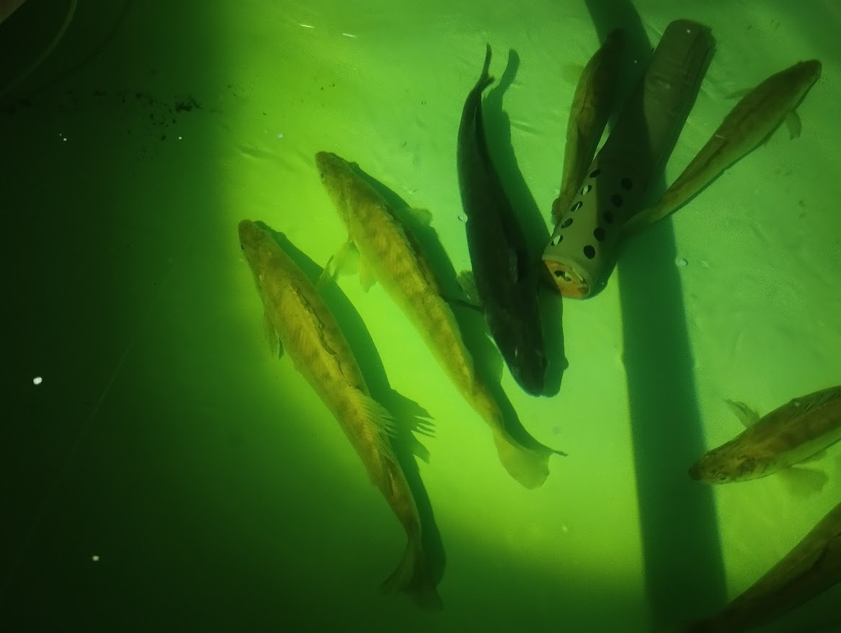
Rearing parameters for effective feeding
Factors influencing feed conversion and growth:
  Abiotic factors: temperature, light intensity, wavelength of light, amount of feed
  Biotic factors: interactions between abiotic factors
Temperature and growth 🌡️:
  Optimal temperature depends on the size of the fish
  Larger fish more sensitive to higher temperatures
  Recommended temperatures:
    Larvae: 26-30 °C
    Juvenile (≥84 g): 25 °C
    Adult: 18.8 °C
Notes:
Many factors influence the feed conversion and growth of pikeperch after the larval period. These include abiotic factors such as temperature, light intensity, wavelength of light and amount of food. The influence of factors such as light intensity and wavelength is indirect, as they can lead to fish stress if not optimised. Biotic factors can also fundamentally alter the turnover of feed in fish. It is particularly important to realize that abiotic factors interact with each other. For example, the optimum amount of feed depends strongly on water temperature and also on the size of the fish. In addition to the above factors, the composition of the feed used is of course also decisive for the success of the growth. The optimum temperature for fattening pikeperch appears to be largely dependent on the size of the fish. In general, larger pikeperch are more sensitive to higher temperatures than fry or juveniles. Hilge and Steffens, 1996; Kestemont et al., 2003; Wang, Xu and Kestemont, 2009 and Willemsen, 1978, recommend an optimum temperature of 26-30 °C for fry. In comparison, Rónyai and Csengeri (2008) found that growth of juvenile pikeperch (84 g) is maximal at 25 °C. The optimum temperature for adults is 18.8 °C.

Slide 20
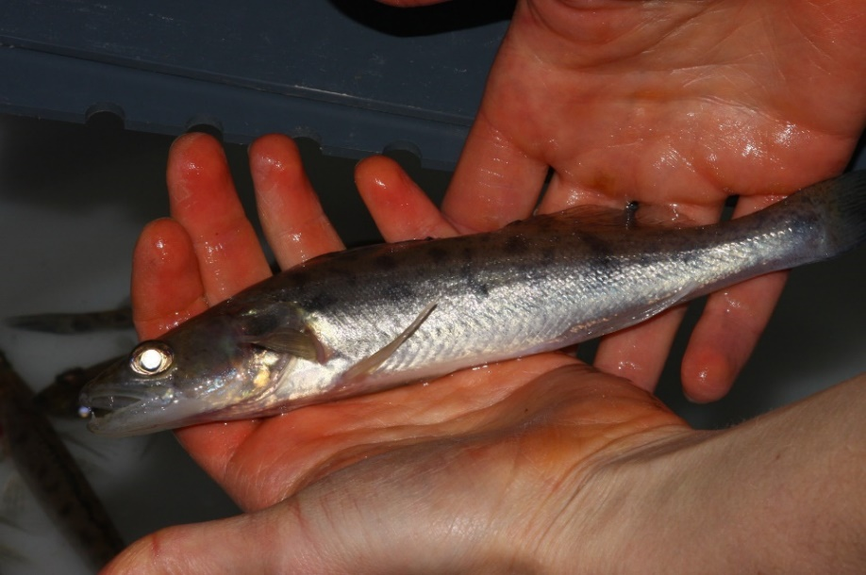
Rearing parameters for effective feeding
Lighting conditions🔦⚡:
  prefers turbid waters, crepuscular
  Tapetum lucidum for better vision in low light conditions
  High light intensity =⟩ stress and reduces feed turnover
  Sensitivity to light increases with fish size
  Adult pikeperch prefer low light intensity
Notes:
Pikeperch naturally prefers turbid waters and is crepuscular. The formation of tapetum lucidum, a reflective layer in their eyes, allows them to see better in low light conditions. However, this adaptation leads to increased stress at high light intensity, resulting in reduced feed turnover. The tapetum lucidum is fully developed in pikeperch at approximately 15 cm in length. Thus, as size increases, pikeperch becomes more sensitive to high light intensity. In contrast to larvae, hatchling and juvenile pikeperch in the studies of Baekelandt, Mandiki and Kestemont, 2019; Luchiari et al., 2006; and Kozlowski et al., 2010, preferred the already lowest light intensity tested (1-45.1 lx). This suggests that adult pikeperch most likely also prefer extremely low light intensity. In addition to light intensity, wavelength also appears to play an important, albeit indirect, role in the foraging behaviour of pikeperch. For example, Baekelandt, Mandiki, Schmitz et al. 2019 and Luchiari et al. 2009 showed that red light with a wavelength of approximately 610 nm leads to better feed conversion and thus better growth than light with a shorter wavelength. Both authors worked with juvenile pikeperch (<10 g and 33 g), so we can only assume that adult pikeperch also prefer the same wavelength. In contrast to wavelength and In contrast to wavelength and light intensity, light regime showed no effect on the growth of pikeperch. This seems to be more important for larval rearing and generational population management. However, simulating different seasons in the light regime may affect the immune system of pikeperch.

Slide 21
Rearing parameters for effective feeding
Life stages | Water temperature (°C) | Light intesity (lux) | Wavelength of light (nm) | Amount of feed (% of body weight)
Larvae, fry | 26 ‒ 30 | 10 ‒ 45 | 610 | 1.5 ‒ 6
Juvenile (≥84 g) | 25 | 1 ‒ 1.2 | 610 | 2
Adult | 18.8 | <1 | 610 | 1.1 ‒ 1.25
Notes:
Here you can see the usual parameters for rearing percids especially pikeprch in different life stages. It includes control of water temperature, light intensity, wavelength of light and amount of food, which are key factors for effective aquaculture or fishing practices.

Slide 22

Meta-analysis for European percid aquaculture
• Meta-analysis of 23 peer-reviewed articles (1996-2023)
  Significant effect of crude protein (CP), crude lipid (CL) and crude energy (CE) content on the growth of percids
• Optimal conditions for growth
  Highest thermal growth coefficient (TGC) at:
  CP ~54.5%
  CE ~4080 kcal kg⁻¹
  CL level of 15.0-15.5% maximizes TGC and specific growth rate (SGR)
• Further findings
  Unclear maximum for CE and non-nitrogen free extracts (NFE) content for SGR
  Minimum SGR around 19% for NFE
  Two local maxima for SGR at a coarse ash (CA) content of 9-12%
Notes:
This review analyzed 23 studies (1996-2023) and found that percid growth depends heavily on the levels of crude protein (CP), crude lipid (CL), and crude energy (CE) in their feed. The best growth was predicted with 54.5% CP, 15.0-15.5% CL, and 4080 kcal/kg of CE.
A meta-analysis of 23 peer-reviewed articles from 1996 to 2023 shows that the growth of percids is significantly influenced by the content of crude protein (CP), crude lipid (CL), and crude energy (CE) in their feed. The highest thermal growth coefficient (TGC) was observed at approximately 54.5% CP, 4080 kcal/kg CE, and a CL level of 15.0-15.5%, which also maximized both TGC and specific growth rate (SGR). Additional findings indicate that there is no clear maximum for CE and nitrogen-free extract (NFE) content in relation to SGR, although a minimum SGR was predicted at around 19% NFE. SGR also exhibited two local peaks when the crude ash (CA) content in the feed was between 9-12%.

Slide 23
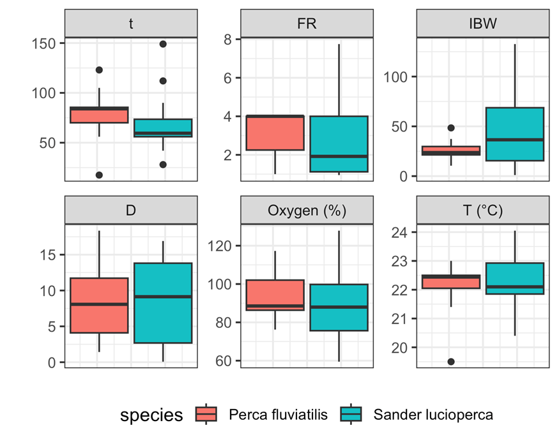
Meta-analysis for European percid aquaculture
Essential amino acid (EAA) | Requirement (mg g⁻¹ protein)
Arginine | 67.86
Histidine | 41.51
Lysine | 93.55
Isoleucine | 55.14
Leucine | 79.22
Methionine | 39.40
Phenylalanine | 51.22
Threonine | 51.80
Tryptophane | 9.22
Valine | 62.72
Notes:
). t = duration of experiment in days, FR = feeding rate in percent biomass per day, IBW = initial bodyweight in grams, D = stocking density in kg m⁻³

Slide 24
Meta-analysis for European percid aquaculture
• Ideal protein concept for optimal feeding conditions 💭🍱 :
  Quality protein sources: fish, crustaceans, poultry, insects, potatoes, rice [digestible indispensable amino acids score (DIAAS): >60%]
  Suboptimal protein sources: blood, keratin/feathers, gelatine, insects, nuts, corn, guar, canola, bacteria (DIAAS: <15%)
• Energy sources ⚡:
  Lack of information on carbohydrate processing by percids
  High lipid content is favourable
Notes:
The ideal protein concept for optimal feeding conditions in percids focuses on quality protein sources such as fish, crustaceans, poultry, insects, potatoes, and rice, which have a digestible indispensable amino acids score (DIAAS) of over 60%. On the other hand, suboptimal protein sources include blood, keratin/feathers, gelatin, insects, nuts, corn, guar, canola, and bacteria, which have a DIAAS of less than 15%. There is limited information on carbohydrate processing in percids, but a high lipid content is considered favorable for energy.

Slide 25
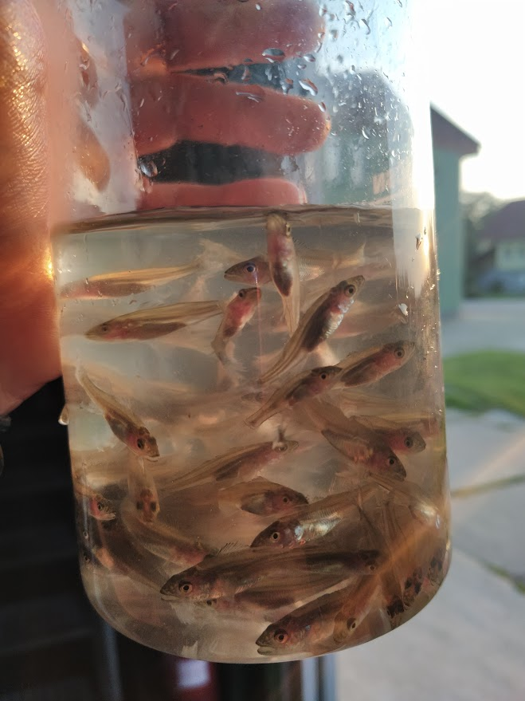
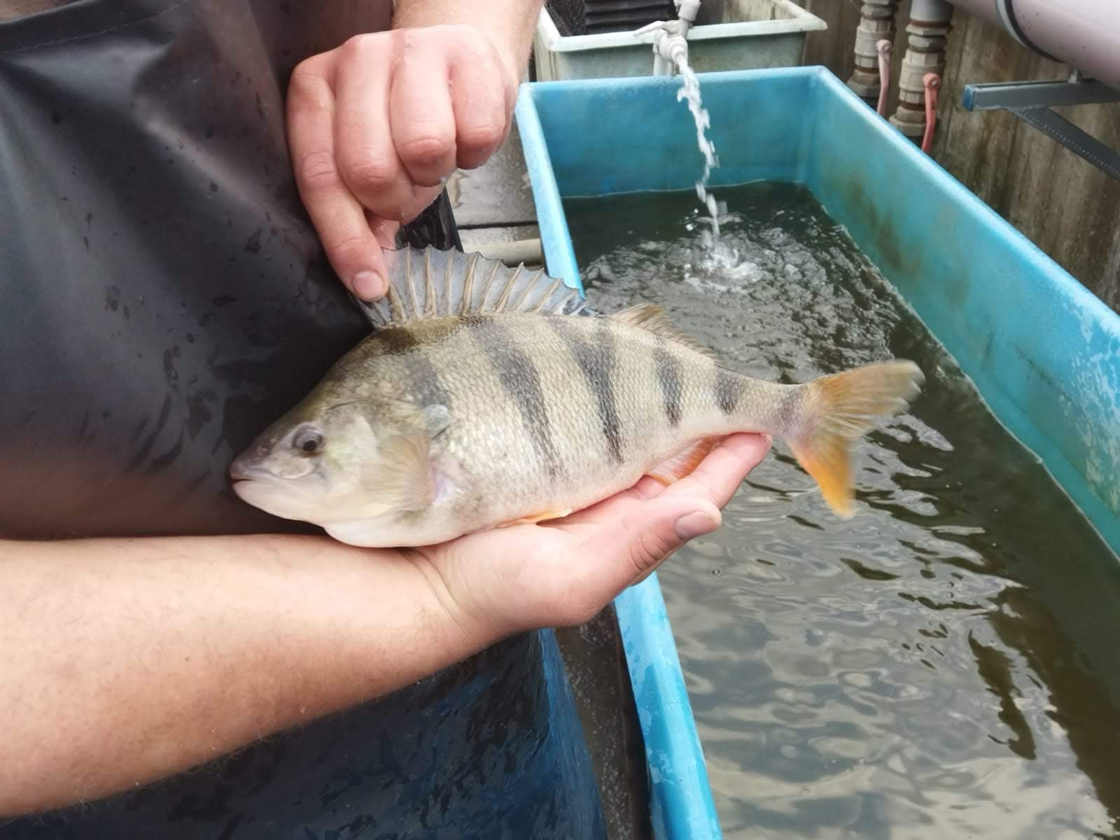
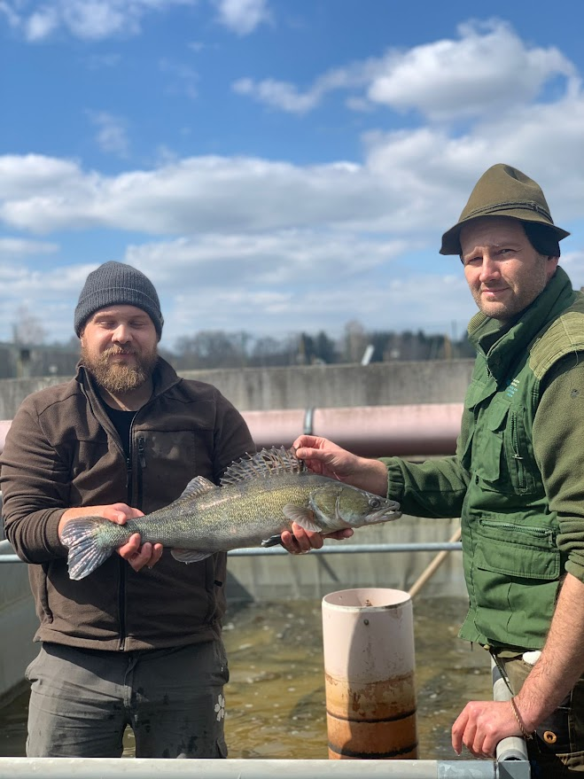
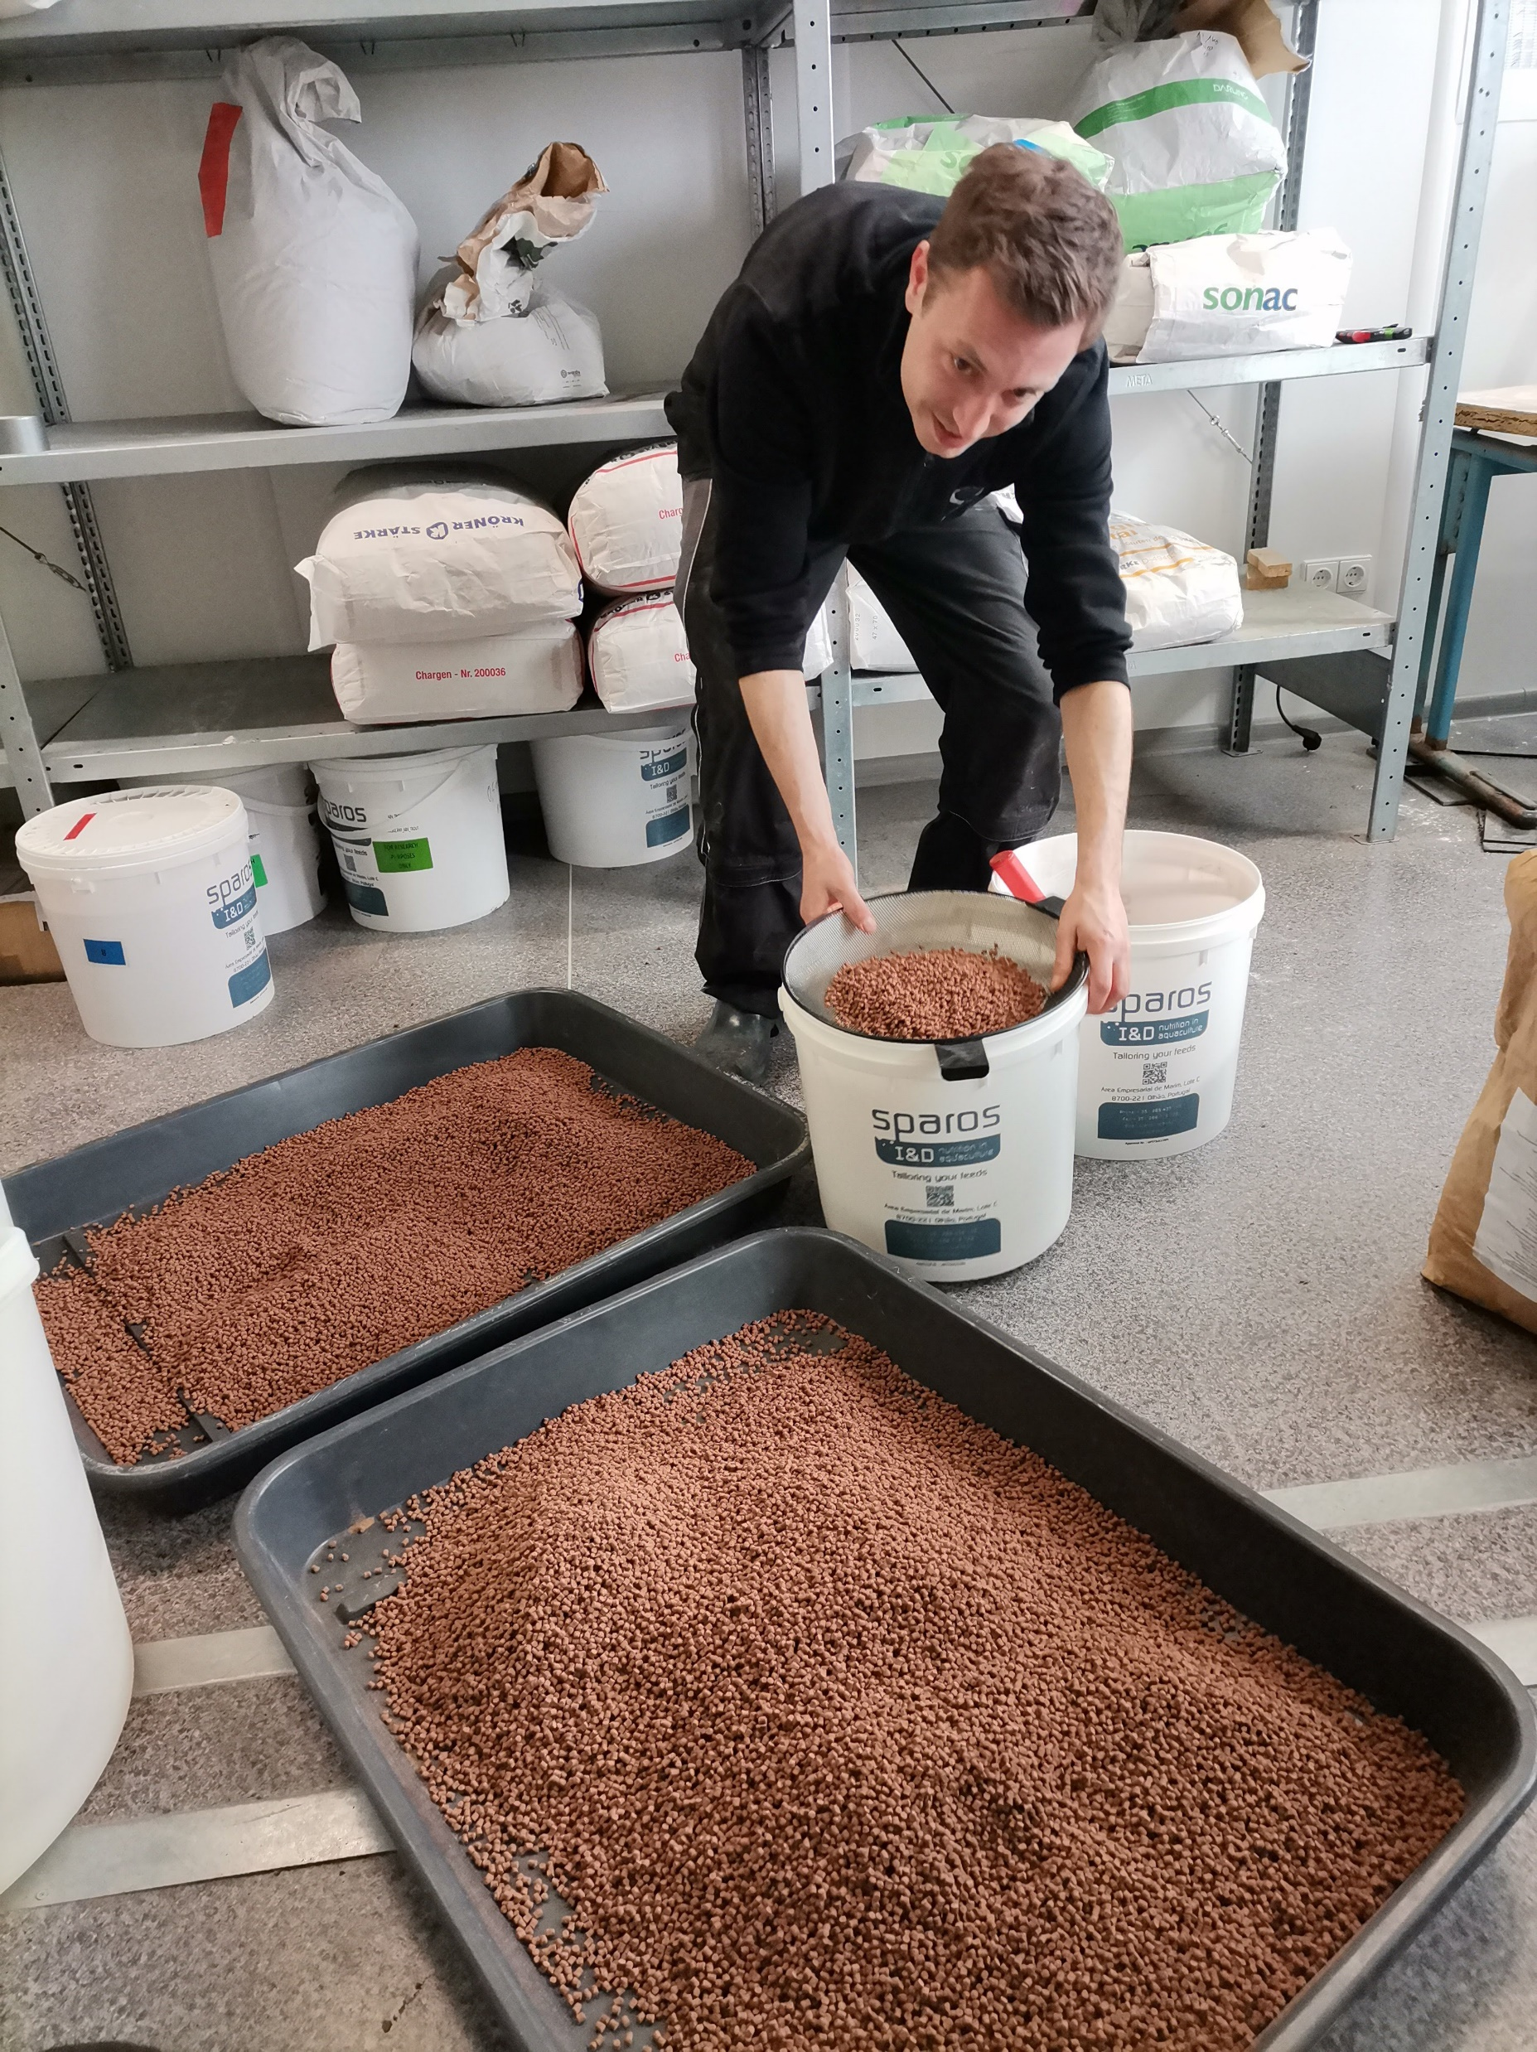
Challenges for the future
1. Economic and environmental sustainability of feed in intensive aquaculture ♻️🌾🏞️
2. Legislative constraints and their impact on the use of new feed types ⚖️🥪 🐟
3. Perspectives and future research on the nutritional needs of percid fish 🔮🔬🎣
Notes:
Next, I would like to present the three main challenges we face in European freshwater percid intensive aquaculture.

Slide 26
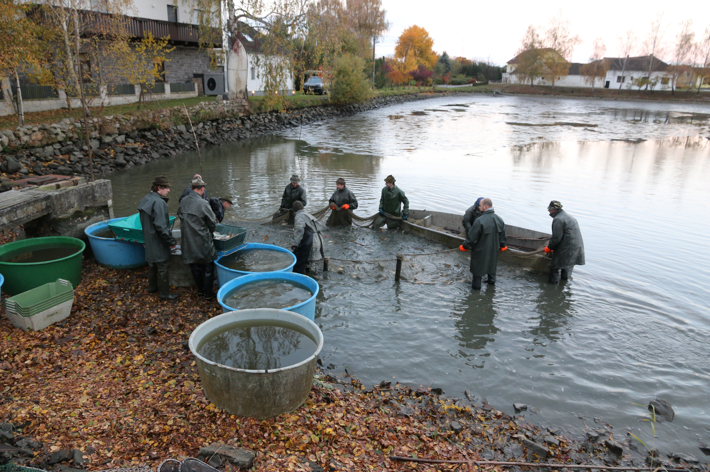
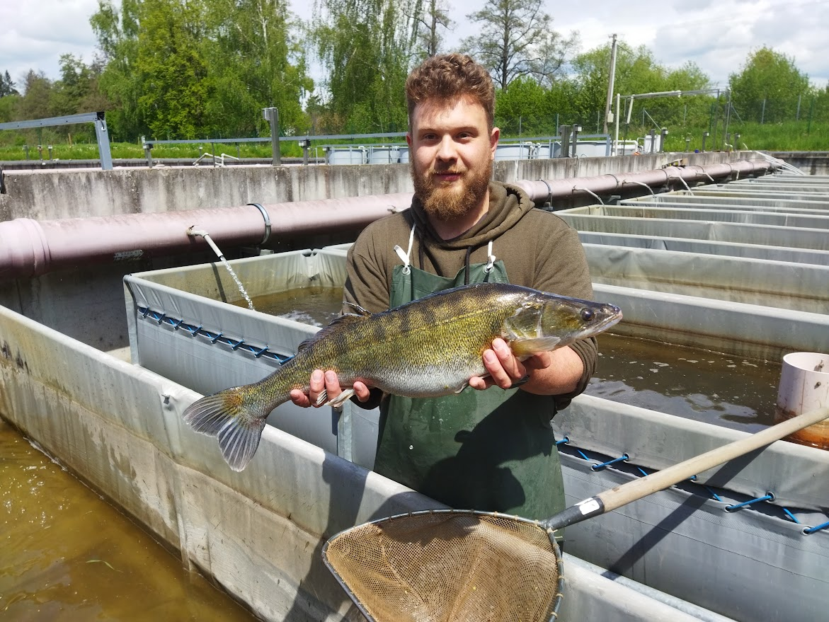
Challenges for the future ♻️🌾🏞️
Key question 🔑 :
  Interest from fishermen, legislative bodies and scientific institutions
  Balance between efficient fish growth and ↓↓ environmental impacts
Main objective 🎯:
  Feed innovation, new technologies and supporting legislative framework
Alternative raw materials for feed 💭🥩:
  Traditional feeds: fishmeal and fish oil
  Alternative protein sources: insect, algae, soy
  Reduction of ecological burden
  Economic benefits (lower costs $$, sustainability)
Challenges 🧗🏻:
  Meeting the nutritional requirements of percids
  Specific requirements for AA and FA
Notes:
The economic and environmental sustainability of feeds in intensive aquaculture is one of the key issues being addressed today, not only among fish producers, but also legislative bodies and scientific institutions. The main objective is to strike a balance between the need for efficient fish growth and minimizing environmental impacts, a challenge that requires innovations in feed, new technologies and a supportive legislative framework.
One of the main aspects of sustainability in the feed sector is the choice of alternative raw materials for feed. Traditionally, intensive aquaculture has relied on fishmeal and oil, which are rich in protein and essential fatty acids, but their production has a high environmental impact, particularly in terms of overfishing pressure on wild fish stocks. Alternative sources of protein, such as insect proteins, algae or plant proteins, can contribute significantly to reducing this ecological burden. At the same time, these new feed sources are often cheaper and more sustainable in terms of raw materials, which also brings economic benefits. However, there is also a balancing act, as the feed must meet the strict nutritional requirements of percid fish, which have specific requirements for amino acids and fatty acids that are important for their growth and health.

Slide 27

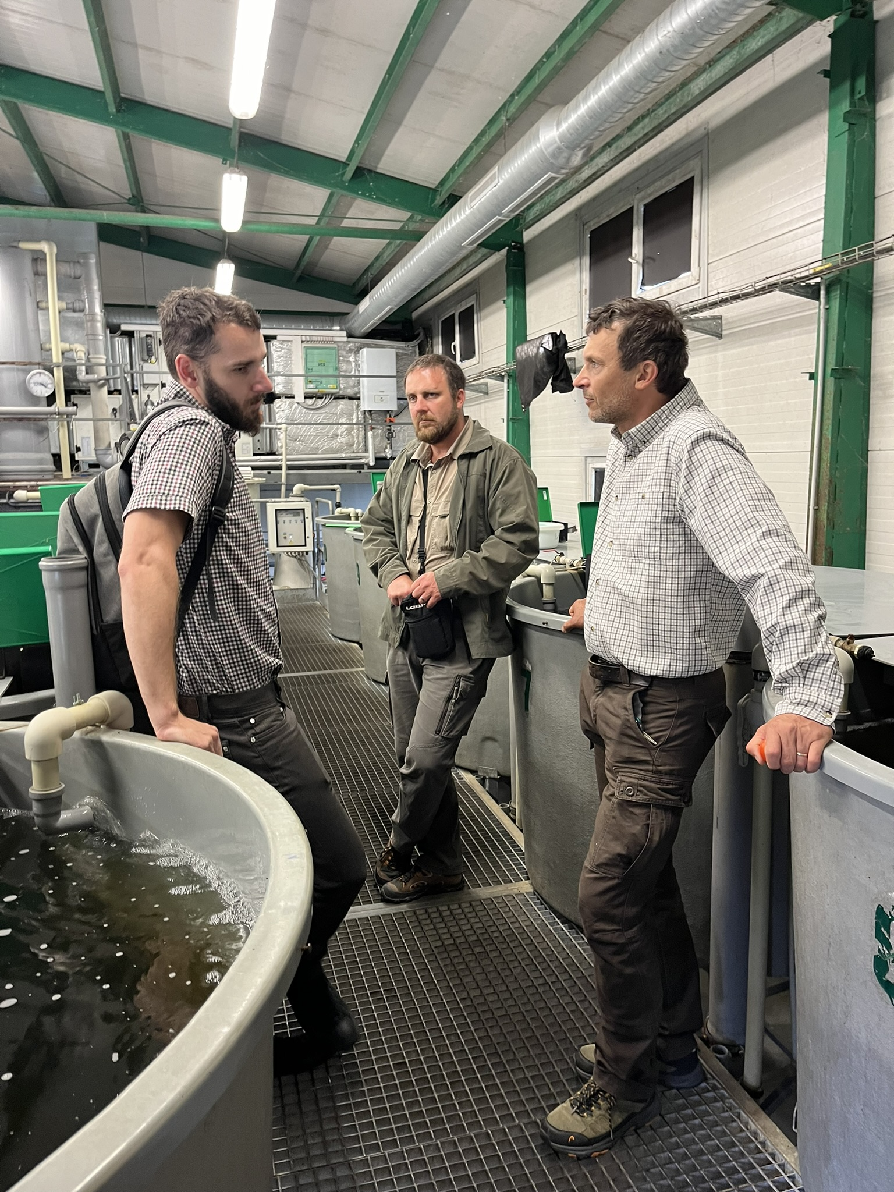
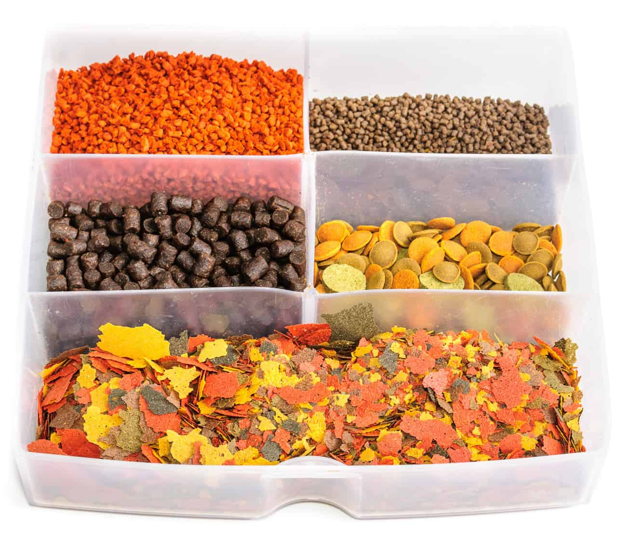
Challenges for the future ⚖️🥪 🐟
• Legislative restrictions and regulation ⛔ 🚧 🤓:
  Significant impact on the use of new types of feed
  Strict rules in the EU and other regions
• Reasons for legislation 📝🏛️:
  Food safety
  Quality of fish products
  Impact on the environment
• Approval process ✍🏻✅:
  Slowing down the introduction of new technologies and products
  Ensuring safety and sustainability of feed
• Other legislative factors 🧗:
  ↑↑ transparency throughout the production chain
  Possible changes in feed production and distribution practices
Notes:
Legislative constraints and regulation are another factor that has a major impact on the use of new types of feed. Within the European Union and other regions, there are strict rules on the permitted raw materials in aquaculture feed, which affects the speed of innovation in this area. Legislation often reflects concerns about food safety, quality of fish products and environmental impact, which is why each new ingredient must undergo thorough testing and approval. This process can slow down the introduction of new technologies and products, but it also ensures that feed used in aquaculture is safe and sustainable. Another legislative factor is the pressure to increase transparency and sustainability throughout the production chain, which can lead to changes in feed production and distribution practices.

Slide 28
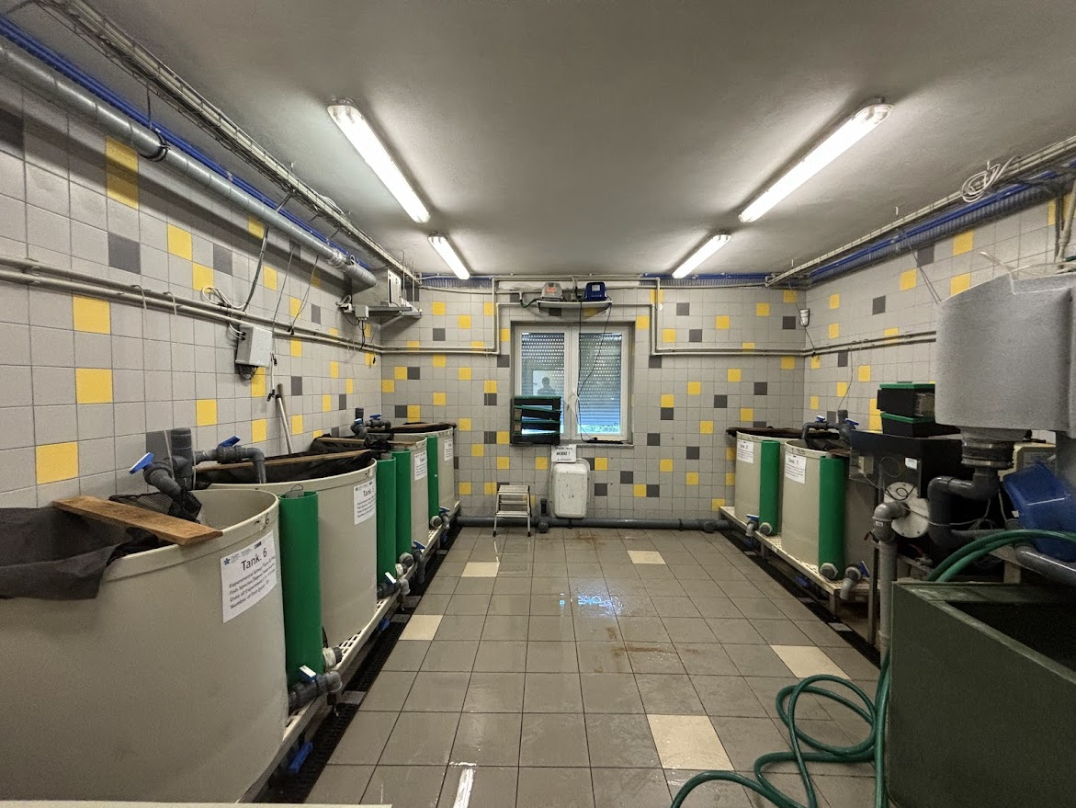
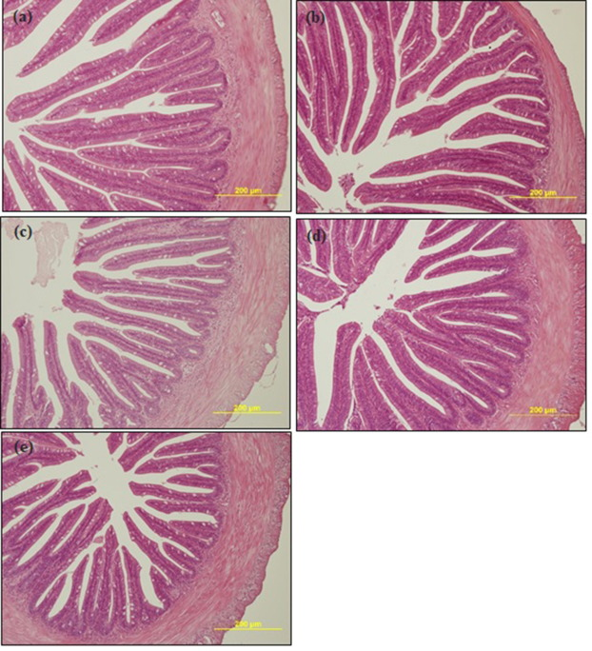
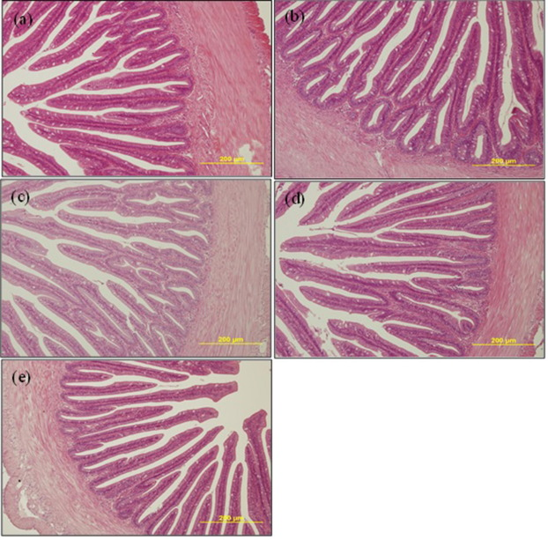
Challenges for the future 🔮🔬🎣
• The future of research on the nutritional needs of percids 🔜 👩🏼‍🔬 🥗:
  Better understanding of nutritional requirements
  Optimal growth
  Minimal environmental impact
• New technologies 👨🏼‍💻🦾:
  More accurate feeding in intensive systems (RAS)
  Optimisation of nutrient supply
  Minimisation of feed wastage
• Research on the fish microbiome 🔬🐟:
  Relationship between gut microbiota and nutrient uptake efficiency
Notes:
Regarding the future of research on the nutritional needs of percid fish, one of the main directions is a better understanding of their nutritional requirements, especially in terms of essential amino acids, lipids and micronutrients. While the basic nutrient requirements are already well understood, there is still room for the development of more efficient feed mixtures that ensure optimal growth with minimal environmental impact. At the same time, new technologies are being explored to enable more precise feeding in intensive systems such as recirculating aquaculture systems (RAS) that can optimize nutrient supply while minimizing feed wastage. Another research perspective lies in the area of the fish microbiome, where researchers are focusing on the relationship between gut microbiota and nutrient uptake efficiency.

Slide 29
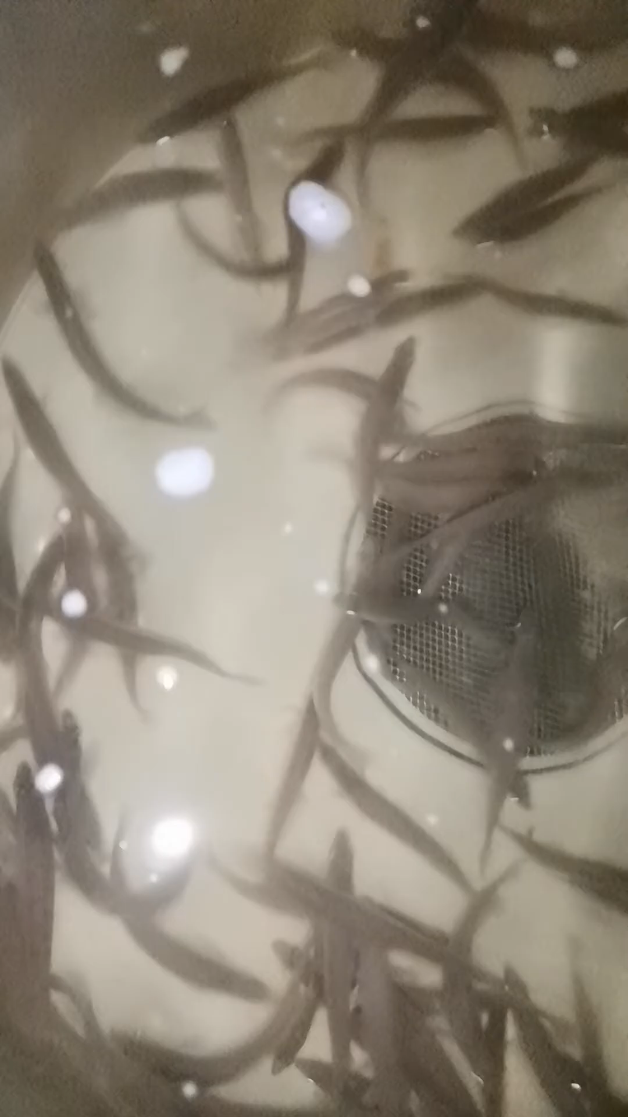
Challenges for the future 🔮🔬🐟
• $ The economic side of sustainability $
  Investment in new technologies and feeds can be ↑
  Long-term innovation leads to ↓ $$
  ↓↓ ecological impact
• 🛠Research and development🛠
  Continued research and development is key
  New insights for process optimization
  Ensuring sustainability of percid production
• The future of feed in percid aquaculture
  Towards greater sustainability
  Economic and environmental sustainability
  Ensuring long-term sustainability and efficiency
Notes:
The economic side of sustainability is also very important. While investments in new technologies and feeds can be high, in the long run these innovations can lead to lower costs through improved fish growth efficiency and lower ecological impact. It is therefore important that research and development in this area continues to provide new insights to enable fish producers to optimise their processes while ensuring the sustainability of their production.
In conclusion, the future of feeding in intensive aquaculture is moving towards greater sustainability, both economically and environmentally. This shift requires synergies between legislative bodies, scientific research and fish producers to ensure the long-term sustainability and efficiency of this important component of percid production.

Slide 30


Thank you for your attention
Far more:
Any questions?
Website:
LinkedIn:

