Slide 1
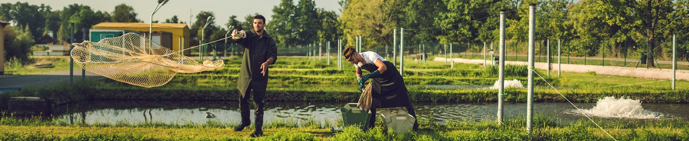
Diversification of inland aquaculture: Sustainable way to upscale fish production using In-Pond Raceway technology in existing pond infrastructure
Ing. Václav Kučera
Laboratory of intensive aquaculture, FFPW USB, FAO workshop 2024

Slide 2
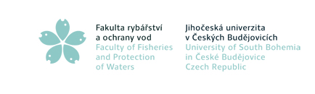
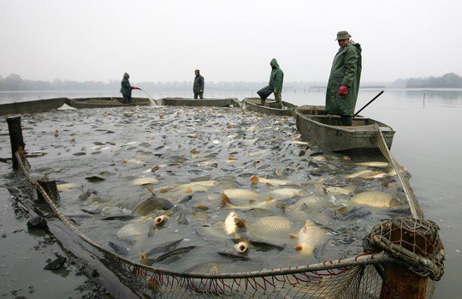
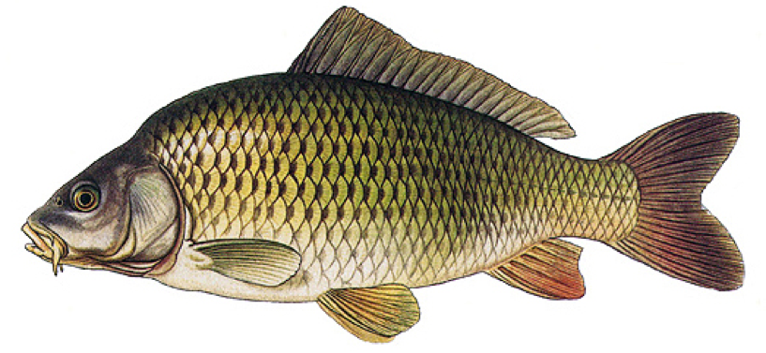
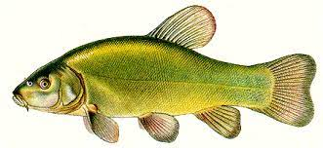
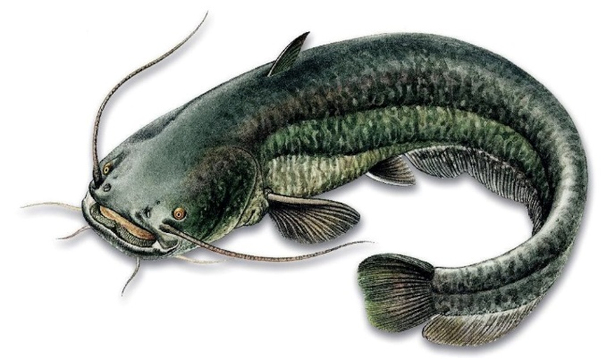
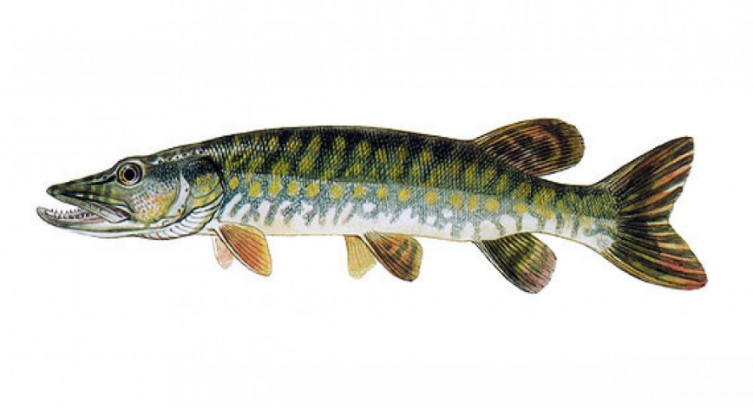
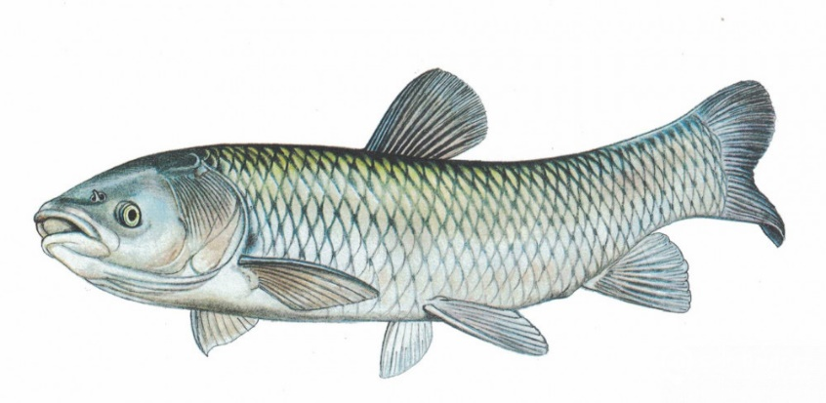
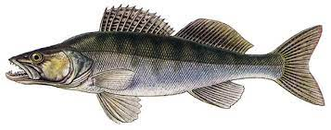
Need of diversification of the aquaculture
19 000t annually – 85% of pruduction

Slide 3
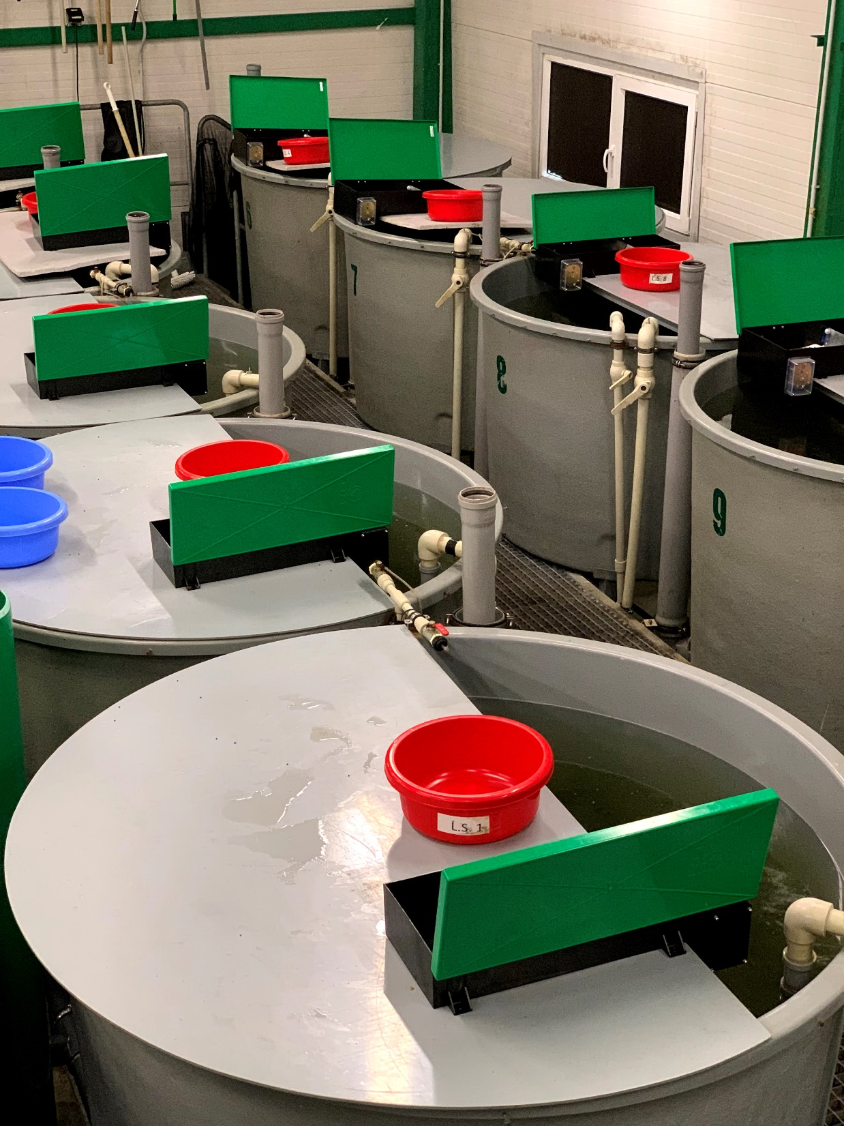
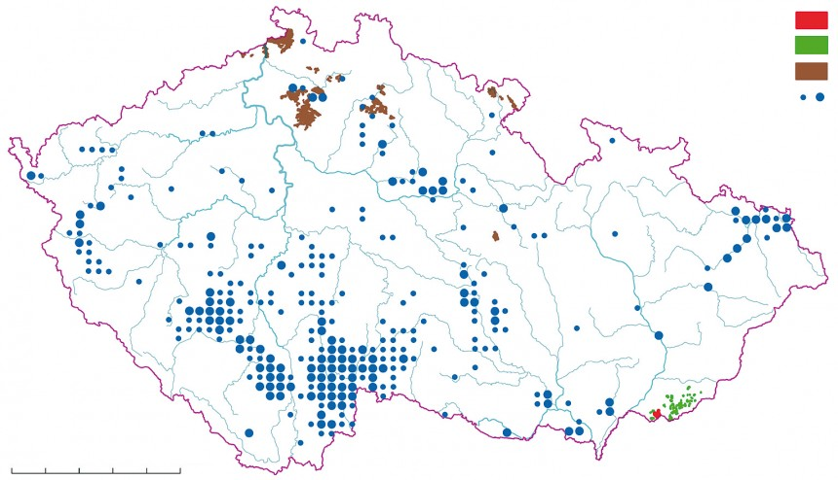
Large pond infrastructure in Czech republic
RAS production – effective but low amount
Rising temperatures and oxygen deficiencies – low predictability of the of production outcome in ponds
With correct equipment – feasibility of diversification of the pond production
High initial investment, high running costs and highly trained staff

Slide 4
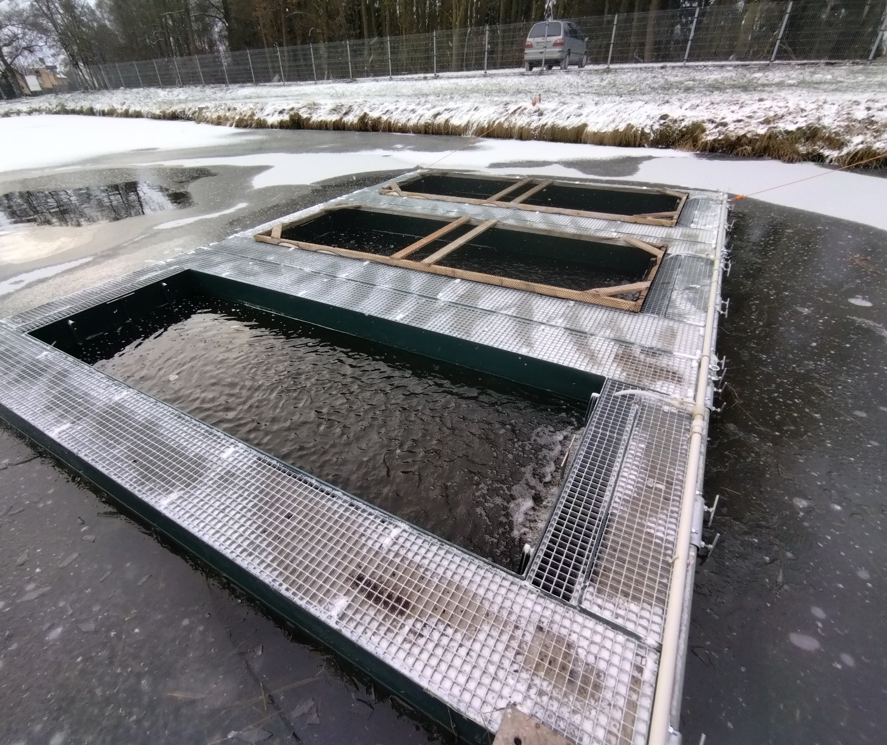
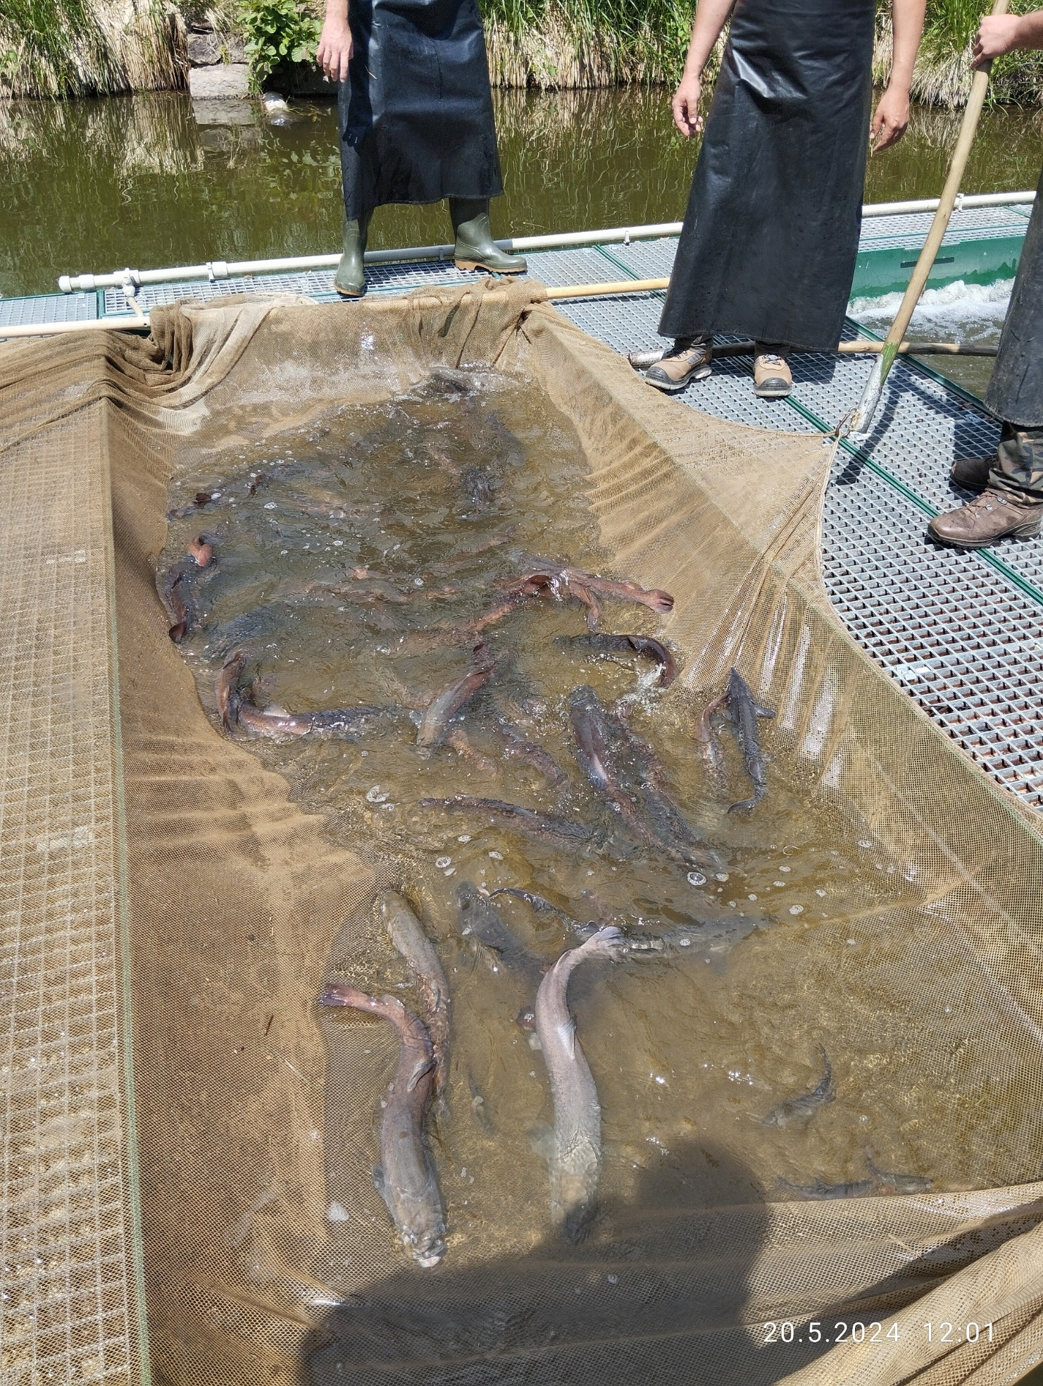
Implementation of the IPRs (In-Pond Raceway systems) into the Czech aquaculture
Possibility to use an existing large pond infrastructure with lower initial investment than RAS

Slide 5
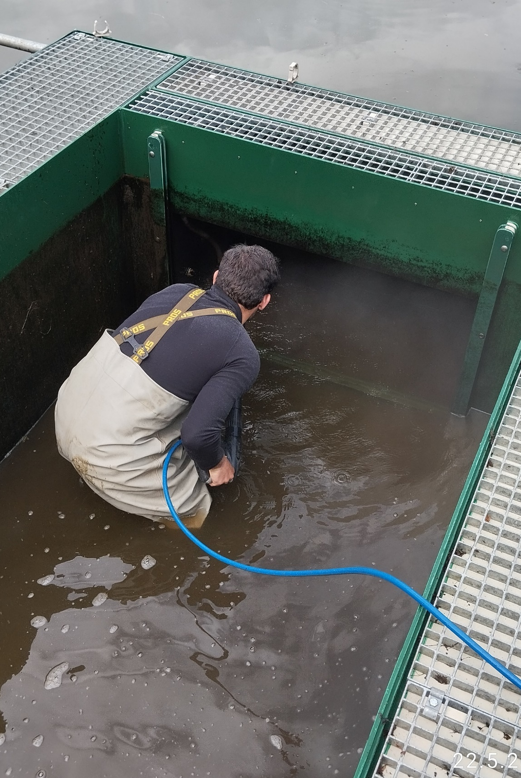
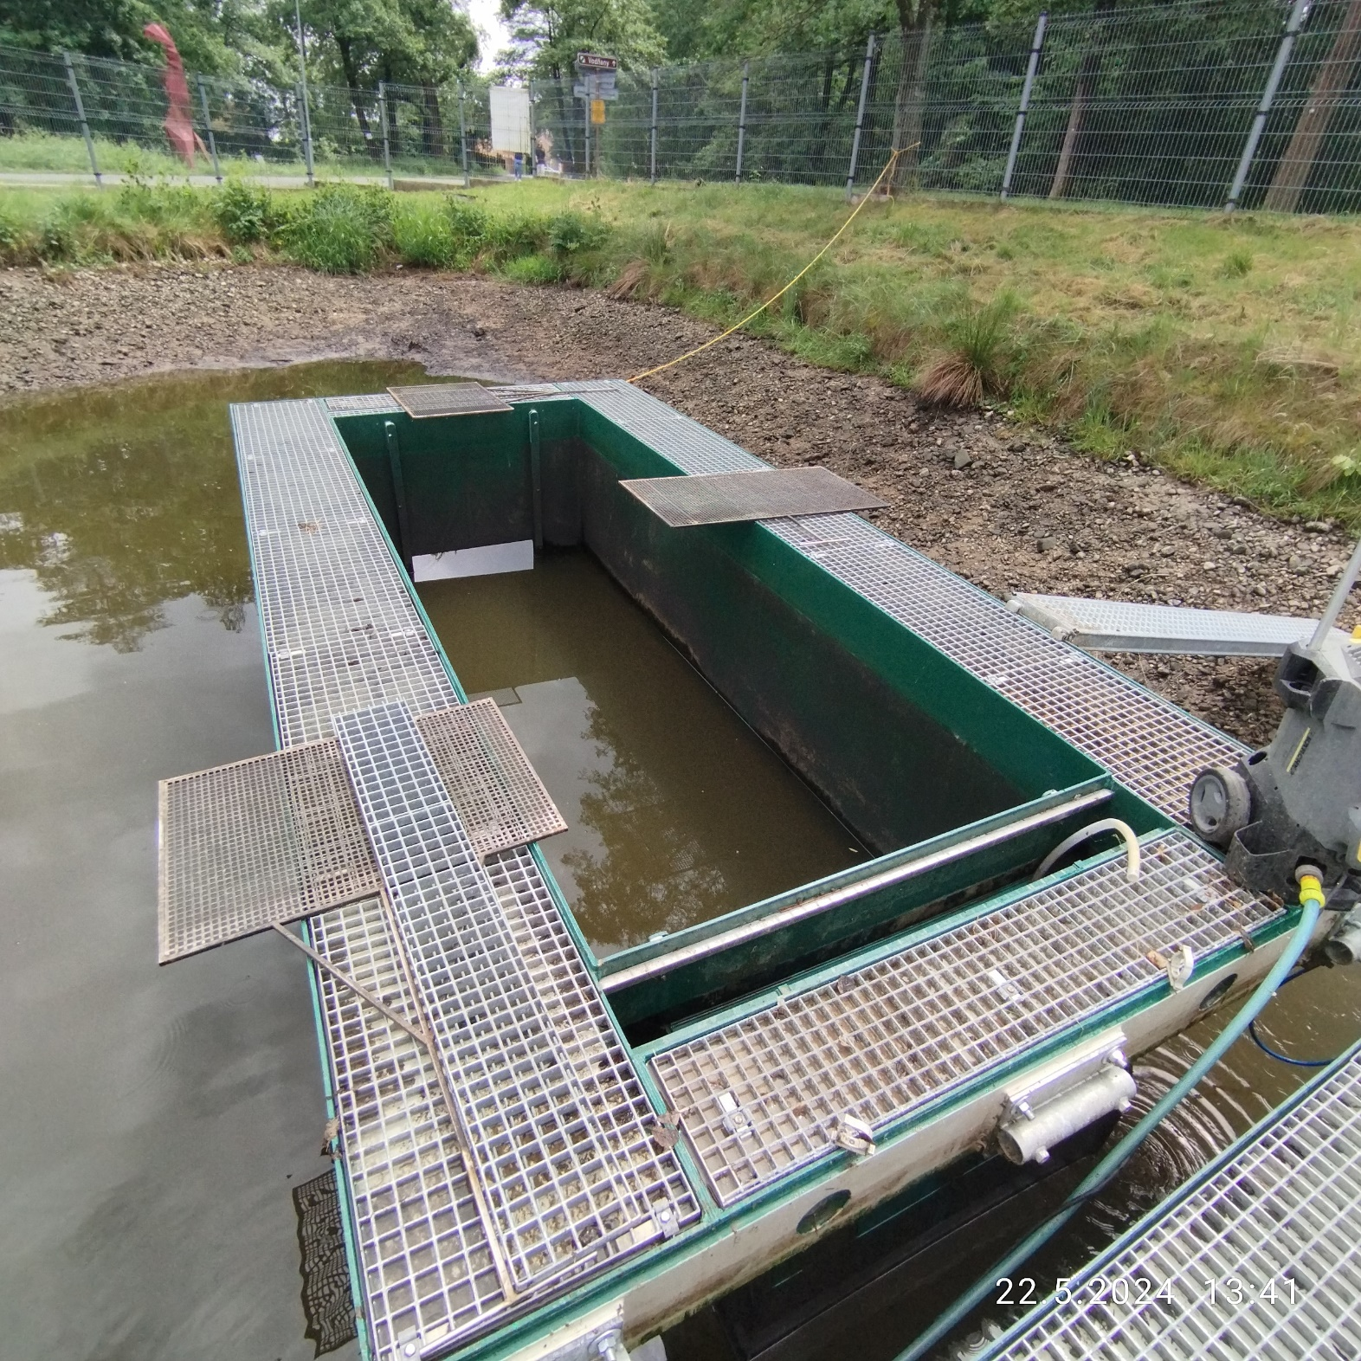
IPRs – In-Pond Raceway system
Air-lift powered
Plastic made tanks
Pond acting as a huge biofiltration unit
Stainless steel bars preventing escaping of the fish
Possibility to change bars according to fish size and cleaning
Self-carrying

Slide 6
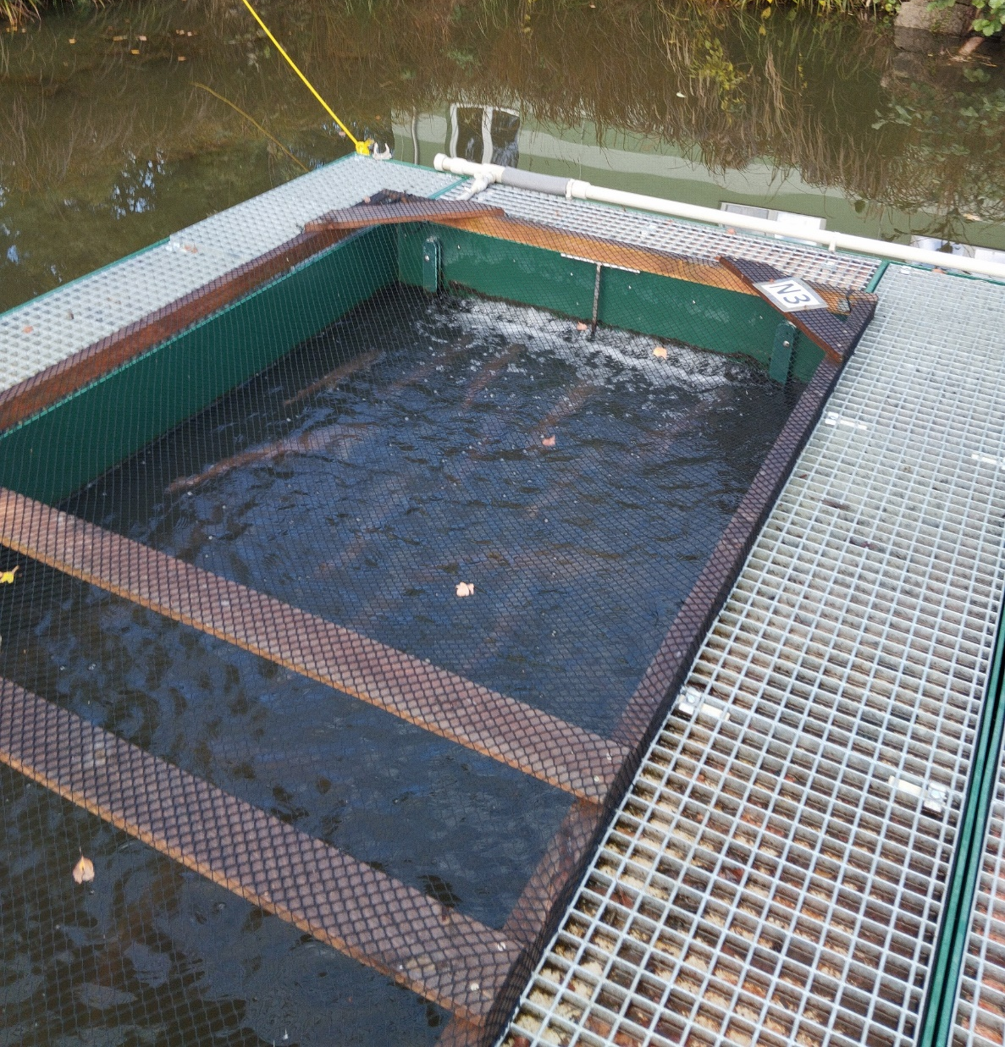
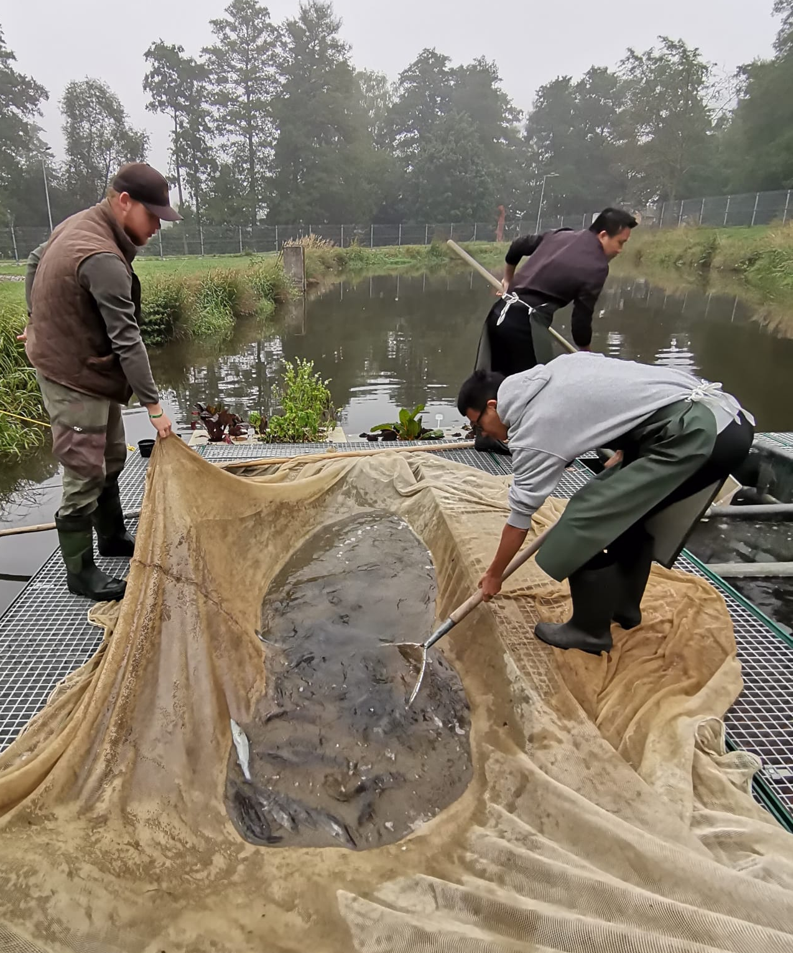
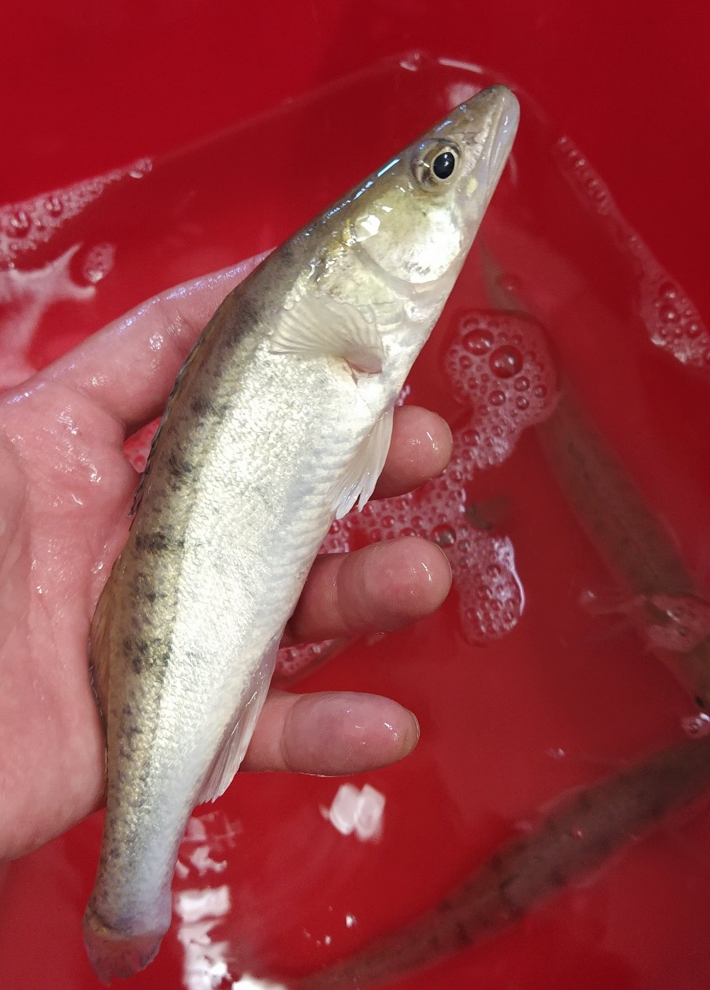
What is positive and negative about the In-Pond?
Suitable for numerous species
Lower energy consumption compared to RAS
Lower maintenance needed
Use of dry pelleted feed
Control of the fish possible
Possible to move
More complicated harvest than in RAS
Less effective treatements
Dependent on the water quality in ponds
Seasonality of production??

Slide 7
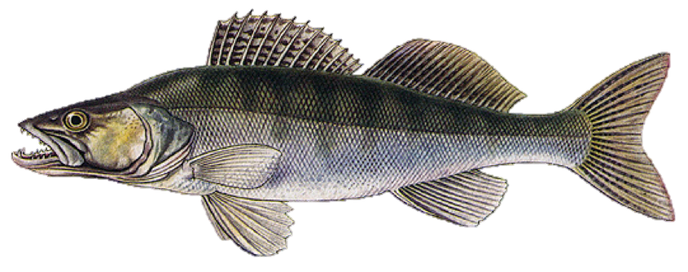

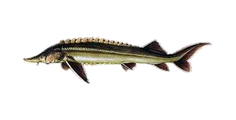
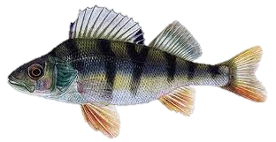
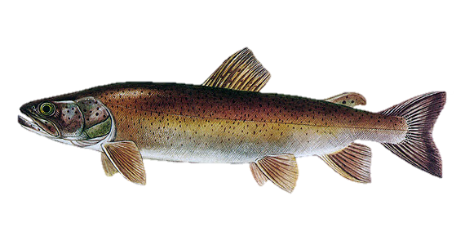
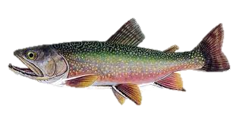
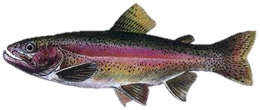
Is seasonality in Czech really a disadvantage?
Controlled broodstock wintering
Pikeperch (Kučera et al., under review, Nagy et al., 2022) and perch production together with sturgeon clean-up crew
Rainbow trout, Brook trout and sturgeon clean-up crew production

Slide 8
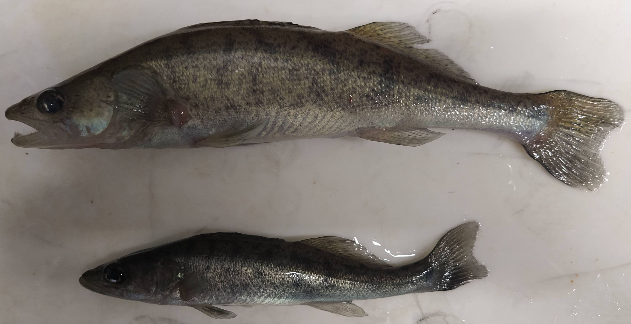
Production data after 24 weeks of rearing rearing
 | Initial | RAS | IPRs | POND | F-statistics | P-value
FTL (mm) | 197 ± 11.6^{c} | 279 ± 32.6ᵃ | 249 ± 23.2ᵇ | 208 ± 15.8ᶜ | F(3,784)=37.2 | P<0.005
FBW (g) | 51.6 ± 10.3^{c} | 190 ± 67.7ᵃ | 121 ± 36.4ᵇ | 62.5 ± 19.3ᶜ | F(3,784)=312 | P<0.005
WG (%) | - | 268 ± 21.2ᵃ | 132 ± 1.25ᵇ | 28.3 ± 18.6ᶜ | F(2,6)=109 | P<0.005
SR (%) | - | 83.9 ± 3.65ᵃ | 88.9 ± 0.81ᵃ | 5.91 ± 4.11ᵇ | F(2,6)=421 | P<0.005
CF | 1.1 ± 0.10^{c} | 1.30 ± 0.10ᵃ | 1.20 ± 0.11ᵇ | 1.10 ± 0.17ᶜ | F(3,784)=67.5 | P<0.005
SGR (%.d⁻¹) | - | 0.71 ± 0.01ᵃ | 0.41 ± 0.02ᵇ | 0.11 ± 0.08ᶜ | F(2,6)=57.0 | P<0.005
FCR (g.g¹) | - | 1.00 ± 0.03ᵃ | 1.60 ± 0.10ᵇ | - | F(1,4)=70.9 | P<0.005

Slide 9
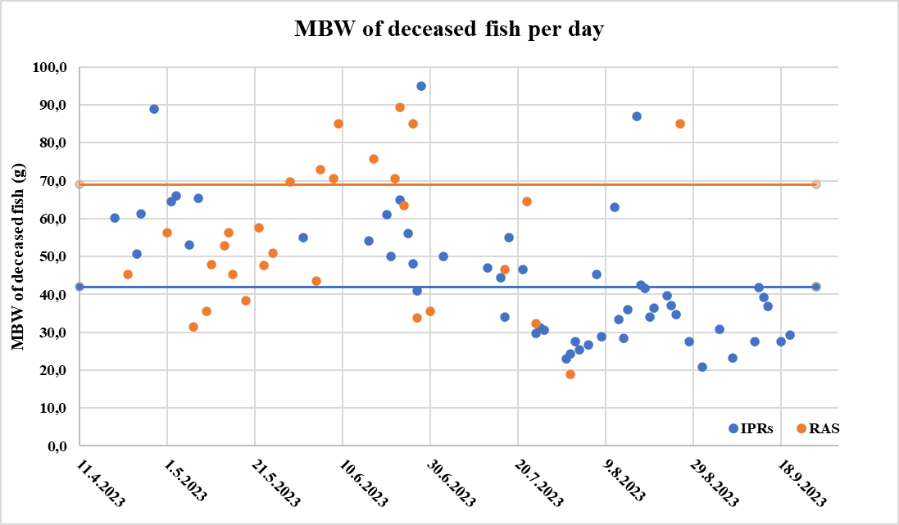
Survival of pikeperch

Slide 10
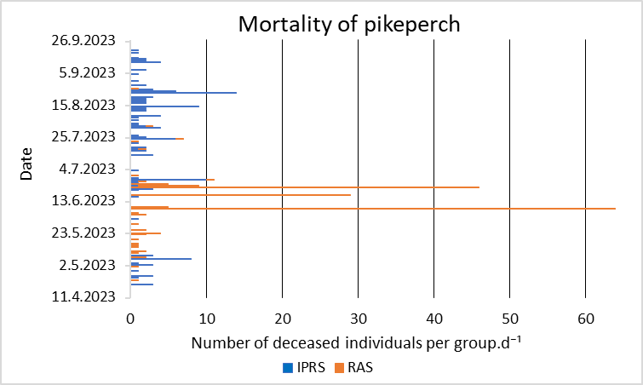
Survival of pikeperch

Slide 11
Frequency of fin erosion of pikeperch juveniles – All in stage 1

Slide 12
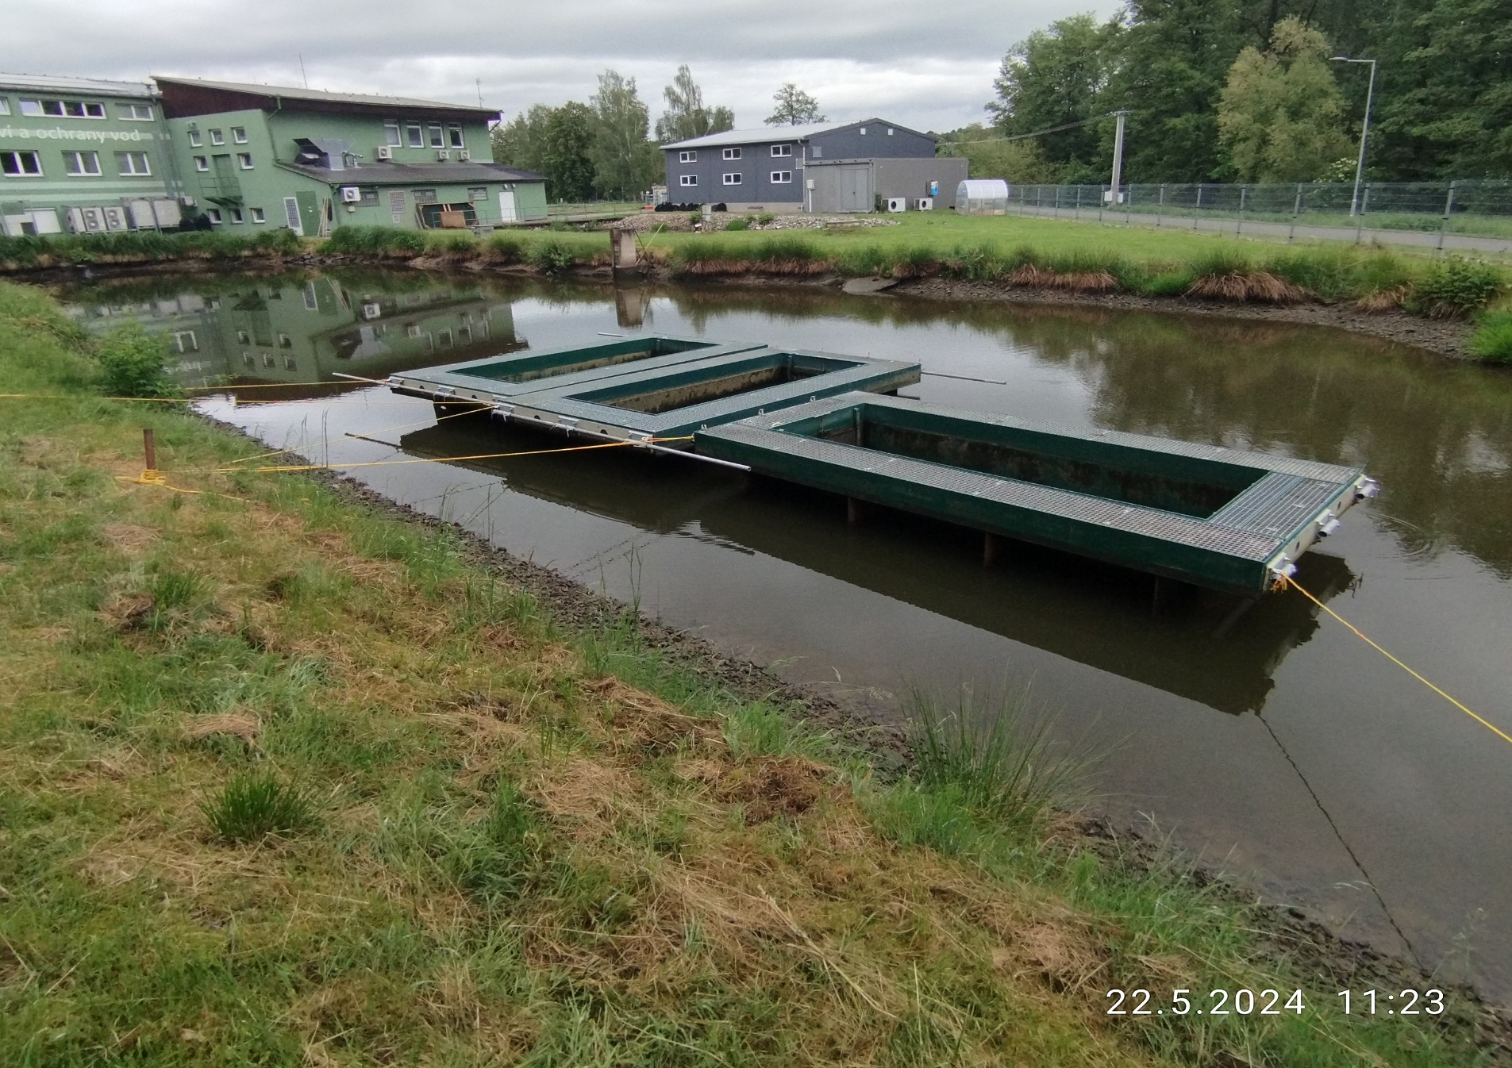
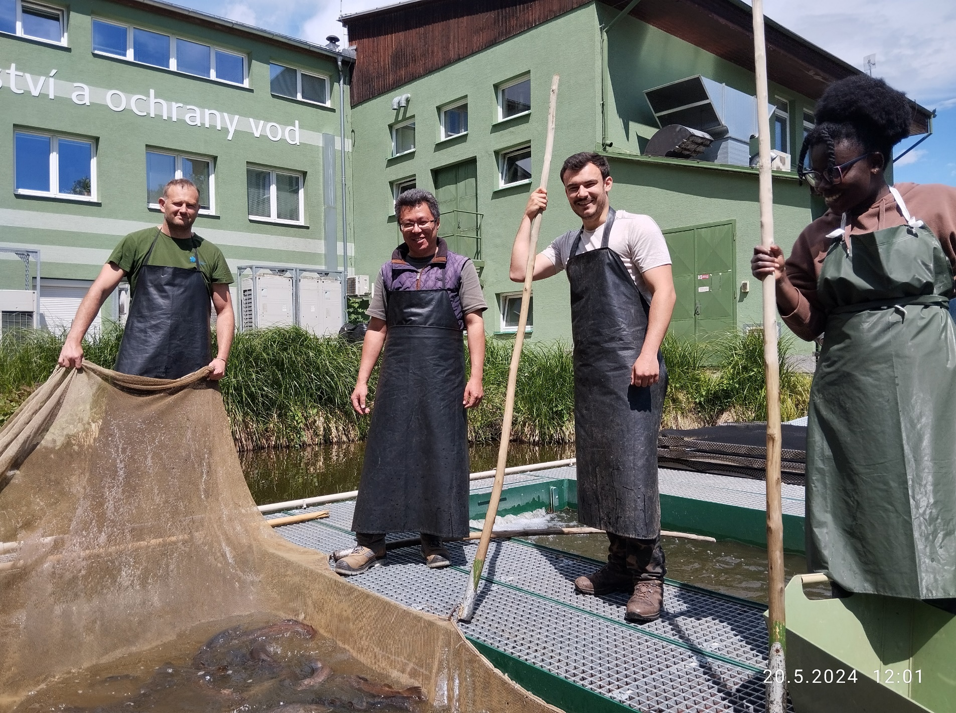
Take home message
IPRs can be sucessfully applied for fish culture in conditions of central Europe all around the year
Implementation of IPRs into pond aquaculture may bring significant benefits in terms of production increasement and species diversification

Slide 13
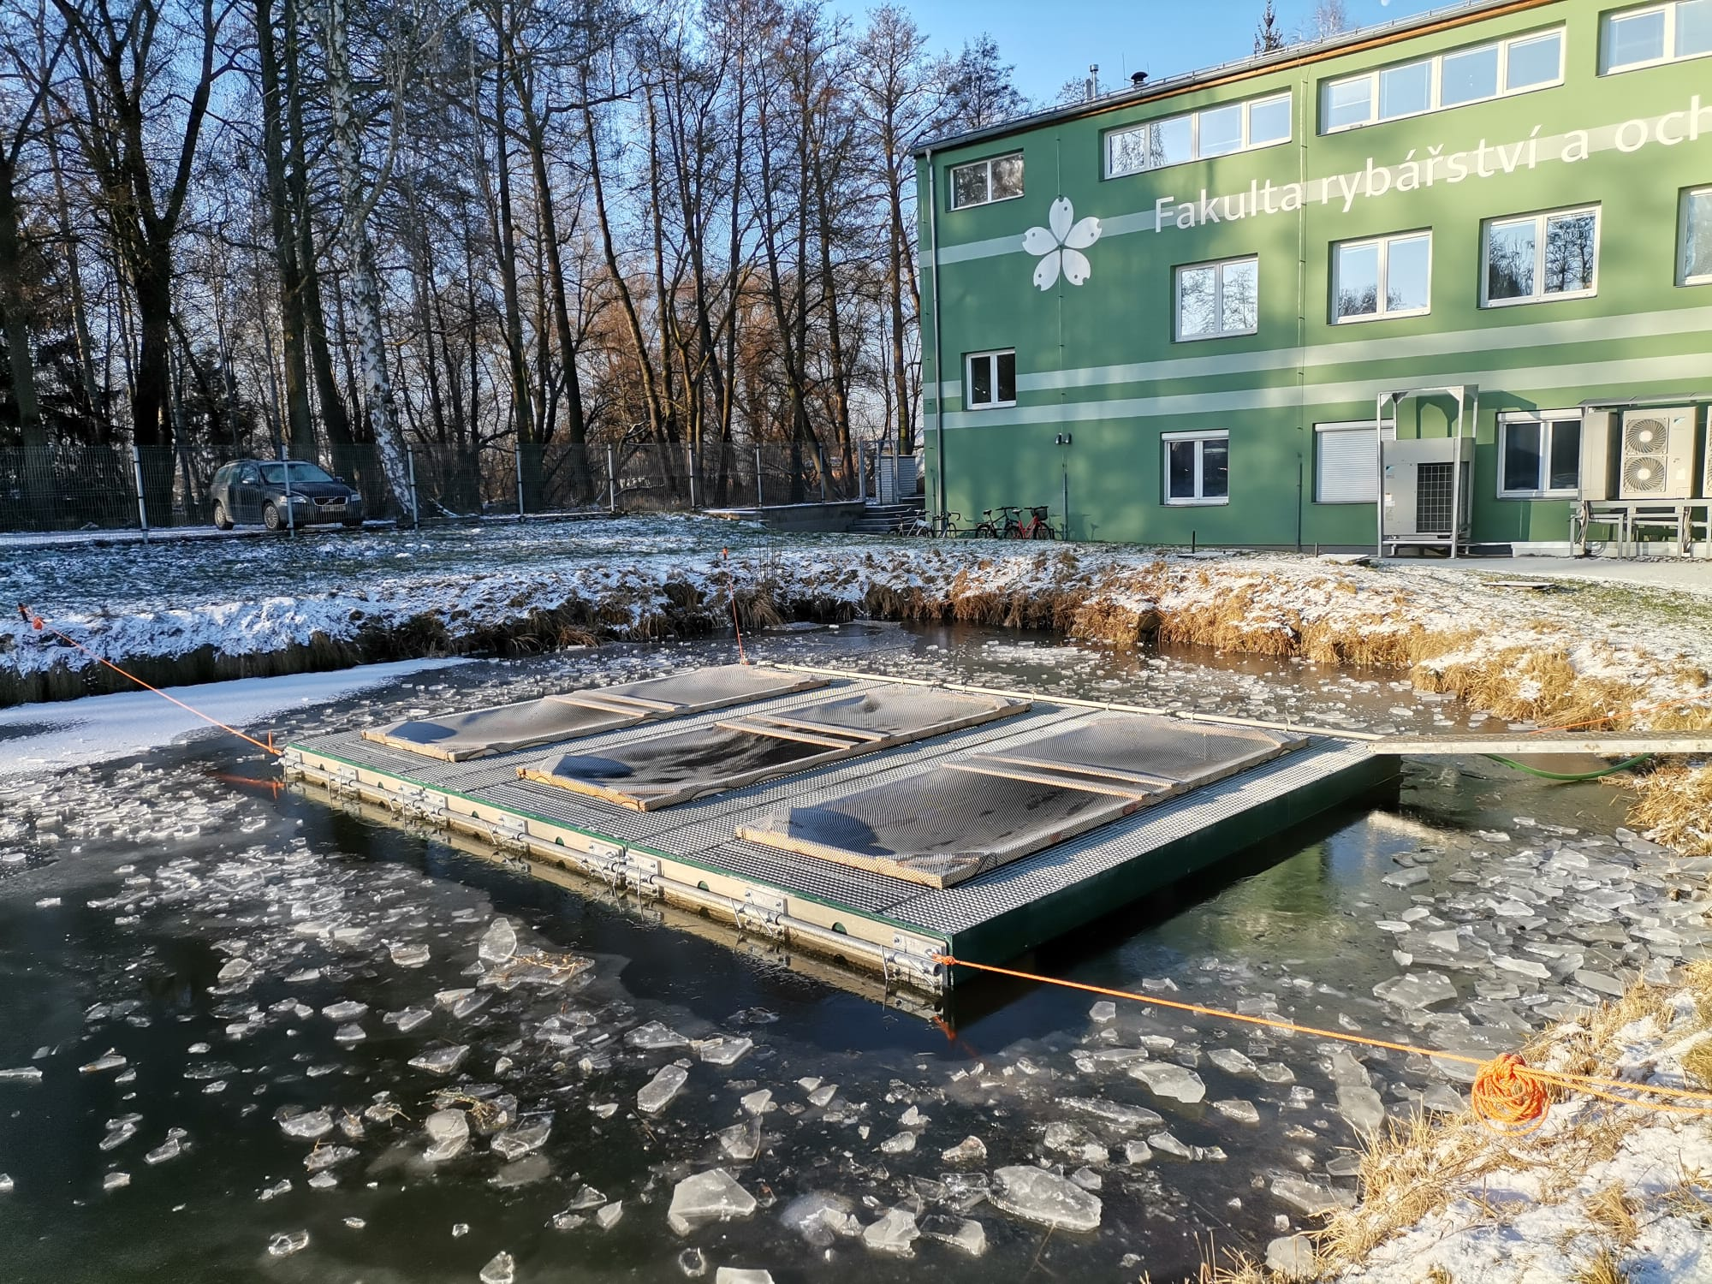
Thank you for your attention
Discussion

