Slide 1
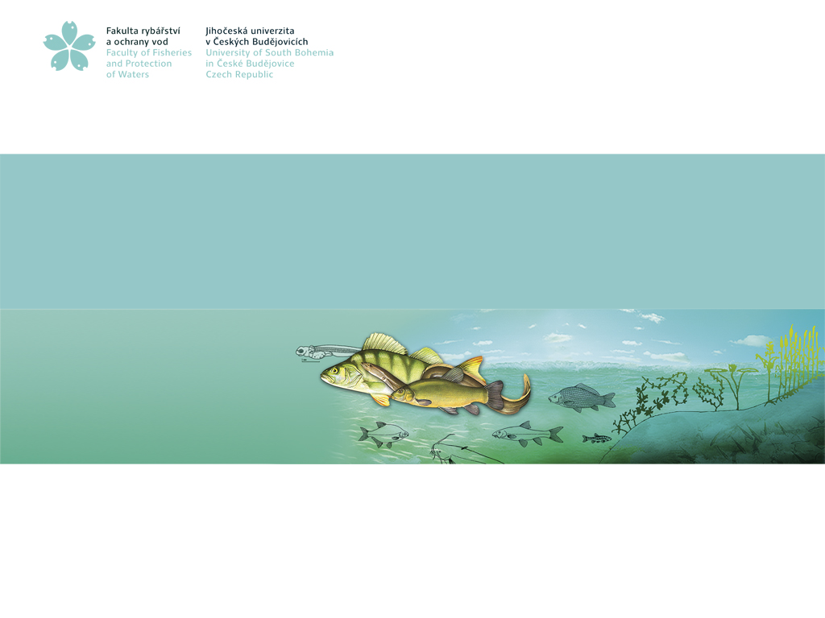
MICROORGANISMS IN AQUACULTURE
Otakar Strunecky

Slide 2
MICROORGANISMS
A microorganism is a microscopic organism that is typically too small to be seen with the naked eye and requires a microscope for observation.
Bacteria: prokaryotes found in almost every habitat on Earth. Bacteria play critical roles in nutrient cycling, fermentation, and pathogenesis.
Cyanobacteria are a group of photosynthetic prokaryotes, form the base of many food chains.
Fungi: eukaryotes with highly diverse morphology. They decompose organic matter and are important in nutrient recycling.
Algae: Photosynthetic microorganisms found in aquatic environments that produce oxygen and form the base of many food chains.
Viruses – not a cell - deserves its own topic

Slide 3
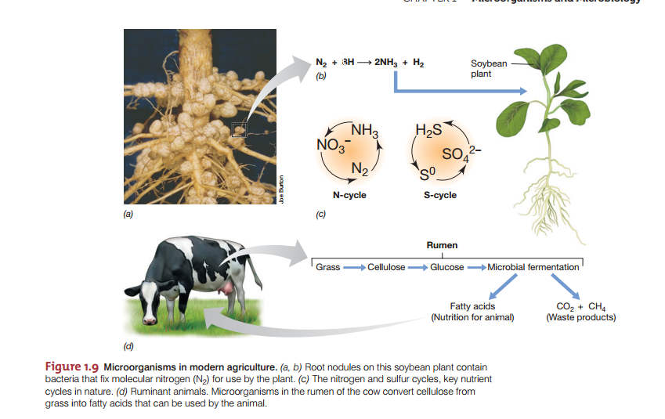

THEY MIGHT BE EITHER GOOD

Slide 4
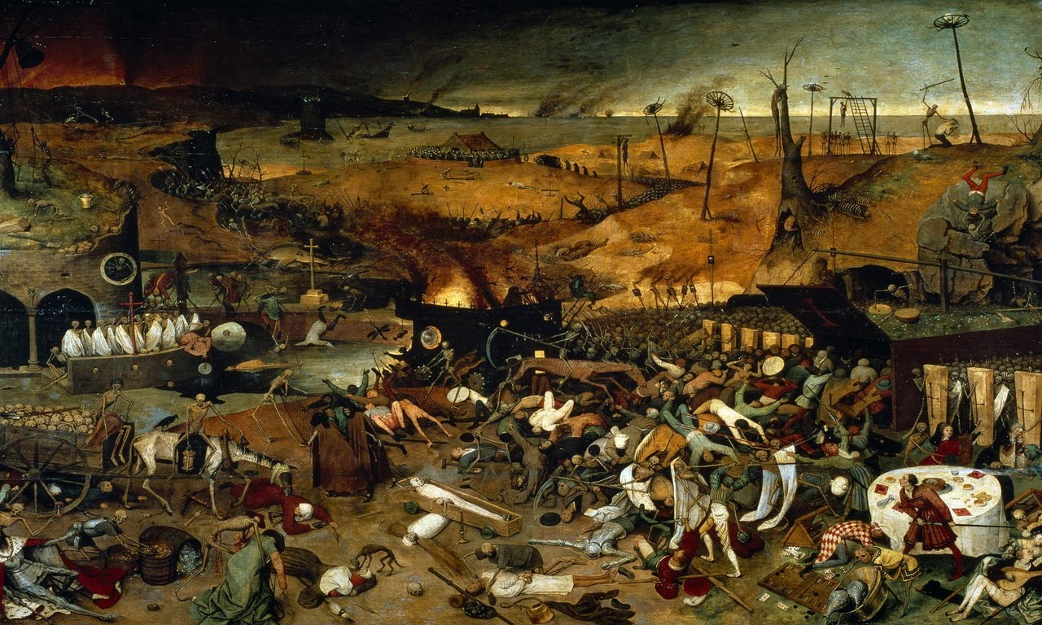
Pieter Bruegel in his mid-16th-century "The Triumph of Death"
OR BAD

Slide 5
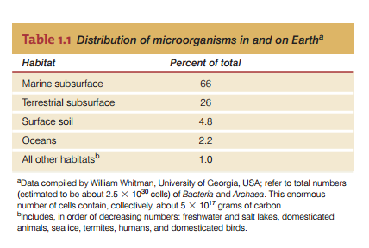
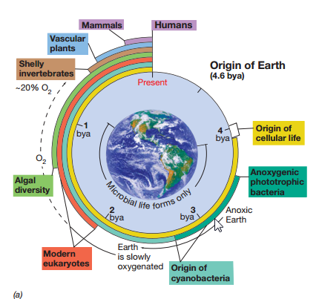
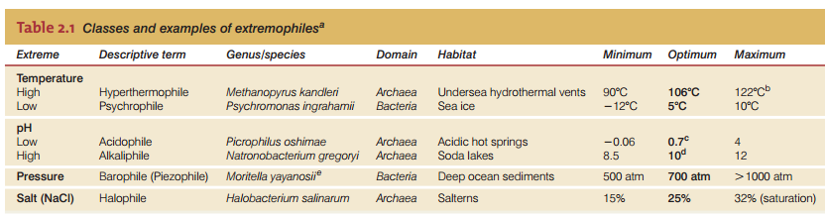
Where All the BACTERIA Are
It is believed that there could be between 10 million to 1 billion bacterial species on Earth. However, only a fraction of these, about 30,000 to 40,000 species, have been formally described and classified.
1 000 – 1 000 000 x bigger biomass of microorganisms than macroorganisms

Slide 6
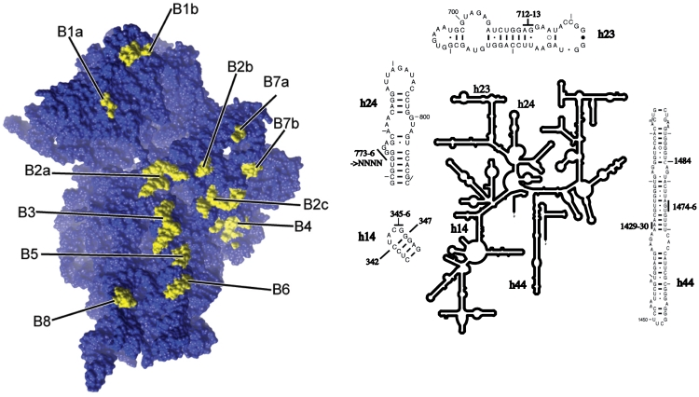
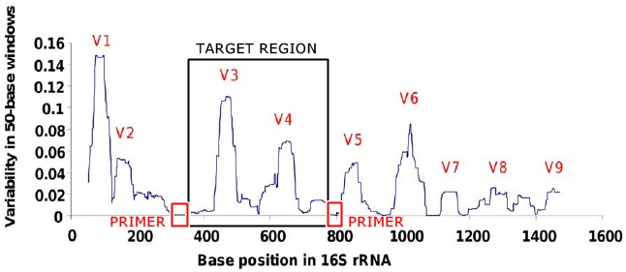
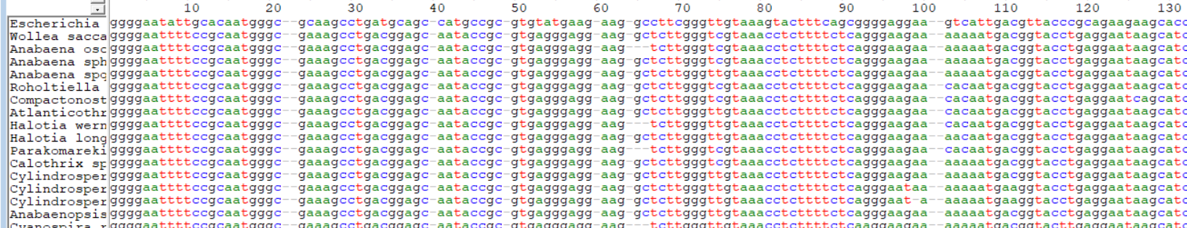
Identification of bacteria
Based on genes coding ribosomal RNA
Ribosomes are essential for protein production
V3-V4 regions are two of the hypervariable regions within the 16S rRNA gene frequently used for bacterial identification and diversity analysis (400 - 500 bp)
Amplicon Sequence Variants (ASVs) are specific sequences obtained from high-throughput sequencing of marker genes with single nucleotide differences
Operational Taxonomic Unit (OTU) classify groups of closely related organisms (species or genera)
Sun et al. 2011
biorender.com
Notes:
Pro studovani fylogenetického signalu bakterii, vcetne sinic se pouzivaji obecne dva typy markeru – gen pro 16S rRNA a tzv. multilocusovy genomicky pristup. V obou pripadech se vyuzivaji velmi konzervativni geny, s velmi omezenou mutacni rychlsoti. 16S rRNA zjednodusene mutuje na smyckach a a ještě k tomu takovym zpusobem, aby se prilis nenarusila jeji vazba na 20 proteinu, které jsou nezbytne ke spravnemu fungovani ribozomu., tedy vyrobu bilkovin v bunce. Kdby nahodou doslo ke vneseni cizorodého genu z jiného organismu, pro 16S například prostřednictvím viru, nebo elektroporaci, tj v prirode když do more nebo pudy uhodi blesk, je velmi nepravdepodobne ze ta bunka s tim novym genem prezije.
Vybrane housekkeping geny jsou taky velmi konzervativni , například jsou to geny pro ribozomalni proteiny, kde plati to co jsem před chvili řekl o 16s. Geny prelozene do AA aby se omezil vicemene nahodny vliv tretiho nekodujicicho nt a protože srovnavana sekvence je zasadne delší nez 16ska dokážeme získat podstatne delší fylogeneticky signal.
Materska bunka tedy po rozdeleni preda tento fylogeneticky dvema dcerinych bunek a je silny predpoklad ze vertikalni linie dedicnosti je tak zachovana.

Slide 7
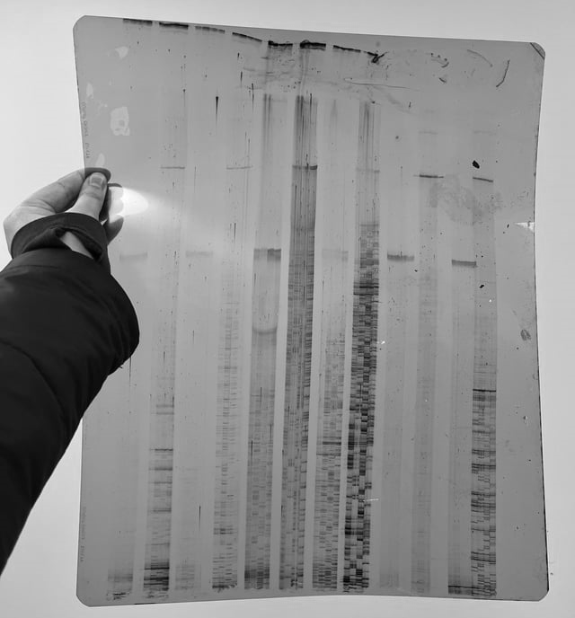
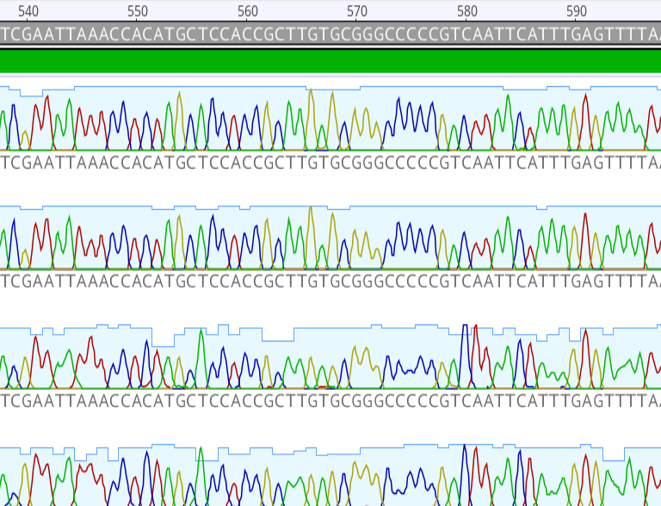
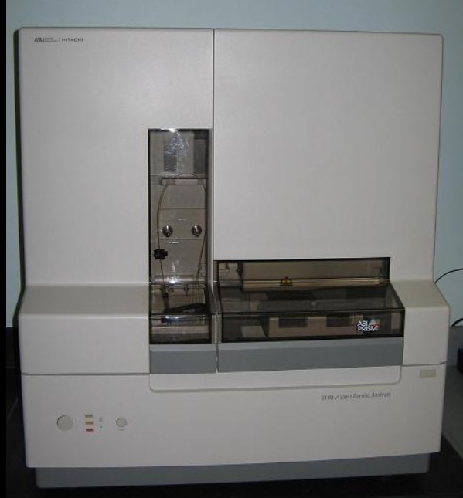
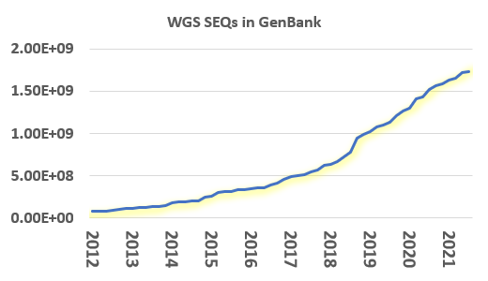
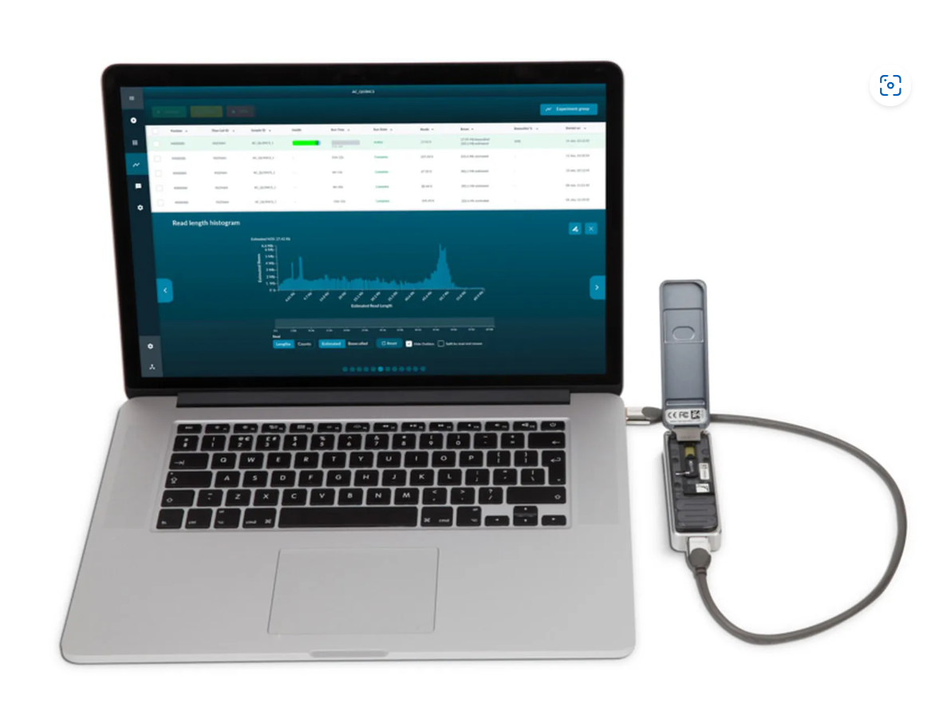
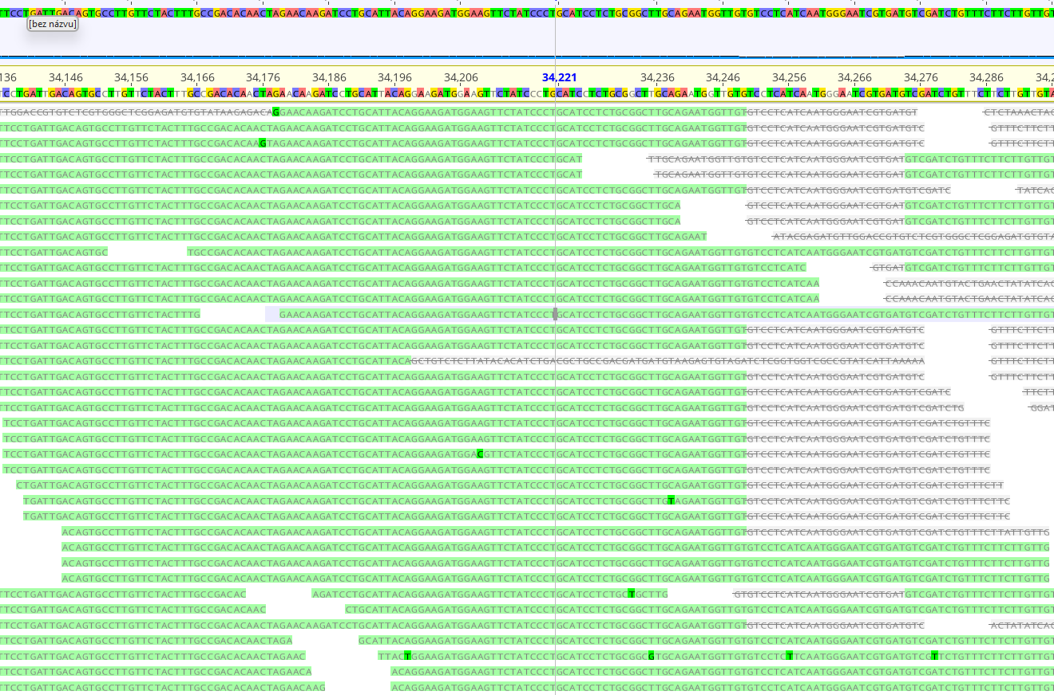
Rapid development in technology
In 1990, one of the most ambitious scientific projects in history began: the Human Genome Project (HGP). Sequencing 3 billion base pairs took 13 years and cost 2.7 billion USD.
By 2014, the cost of sequencing one human genome had dropped to 1,000 USD.
Pepperigefarm at pinterest.com
Pepperidge Farm
nanoporetech.com
Notes:
V soucanse době obvykle posleme amplifikovanou DNA do servisni laboratore a do par dnu dostaneme naší kýženou sekvenci. Vhldem k tomu, ze se kvenovani srychle a podstatne zlevnuje, predpokladam, ze v blizke době prejdeme z 16s na genomicke, tj multilokusove sekvenovani. Ta rychlsot je tak neuveritelna ze sem minuly ctvrtek cestou sem hodil vzorek do sekvenacniho kasliku a v patek odpoledne mi prisly výsledky. Nepredpokladam ze tenhle chromatogram 16s za mou někdo dokážeme identifikovat, lec je za nim skryt zajimavy hydrobiologicky pribeh. V lete jsme s kolegou Janem Regendou zacali merit prubeh koncentrace kysliku na rybniku Vysatov. Umistili jsme tam pristroj, tkery kazdou pulhpdinu ponoril sondu do vody, zmeril koncentraci kysliku a hodnotu poslal do nasich pocitacu. Prubeh byl velmi netradicni, koncentrace kysliku zacala opakovane rust kolem 11 hodiny dopoledne, maxima dosahovala kolem devate hodiny vecer, hodinu po zapadu slunce a pak klesala, nez dosahla 30 % nasyceni. Několik hodin se držela na 30 % a kolem 11 hodiny dopoledne se cyklus opakoval. Mereni pristroje jsme overili exosondou a zaroven odebrali vzorek vody. Voda obsahovala, odhadem, vic jak 90 % koloniii hnedych bakterii. Ocekavali jsme něco specialniho, proto jsme tyto kolonie osekvenovali a prislo tohle – sekvence E coli. V organicky zatizenem rybniku jede neuveritelna bakterialni smycka na které se zivi 4-5 mm Daphnie, coz je systém, který jsme dosud nezaznamenali. Denní prubeh kysliku si sice stále neumíme vysvětlit, ale minimalne je to velmi zajimave. Pokud byxte enkdo chtěl studovat bakterialni smycku, je proto Vysatov idelani rybnik.

Slide 8
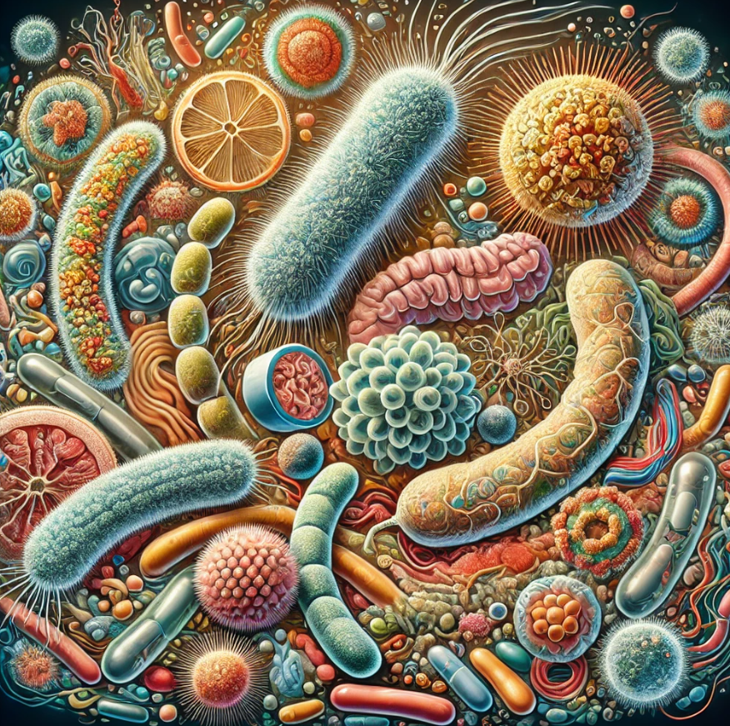
Focus on aquaculture systems:
How does microorganisms influence fish?
Pathogens
Microbiome refers to the entire collection
of microorganisms a particular environment
HAVE AN IMPACT ON
Fish nutrition and digestion
Immunity and disease resistance
Waste degradation
Fish farming productivity

Slide 9
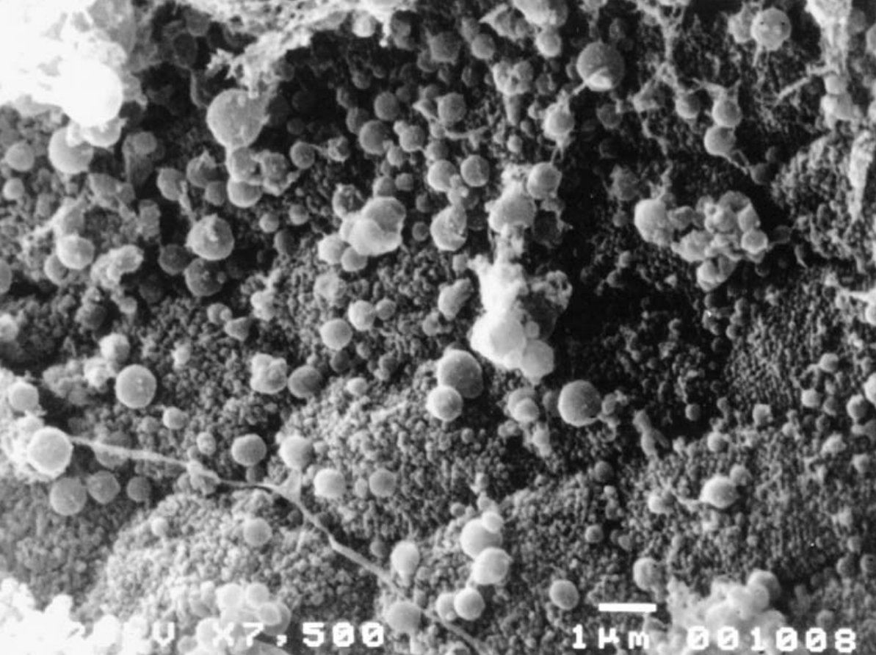
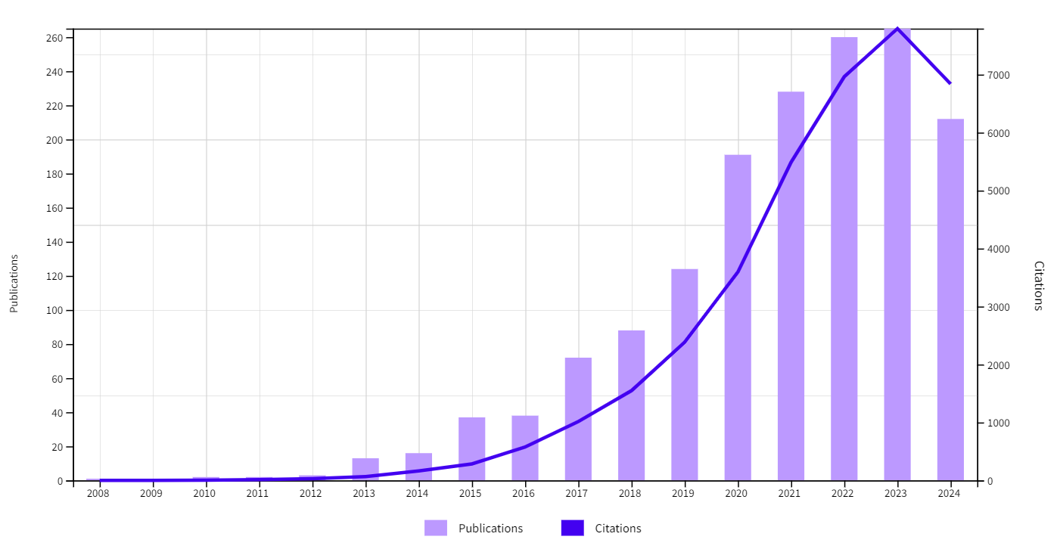

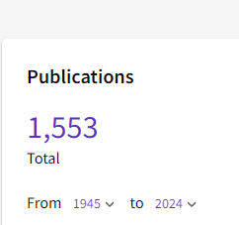
Fish microbiome – a rising topic
Scanning electron microscopy (SEM) micrograph showing coccoid-shaped bacteria associated with enterocytes in the hindgut of Arctic charr (S. alpinus L.).
Ringø and Olsen (1999)

Slide 10

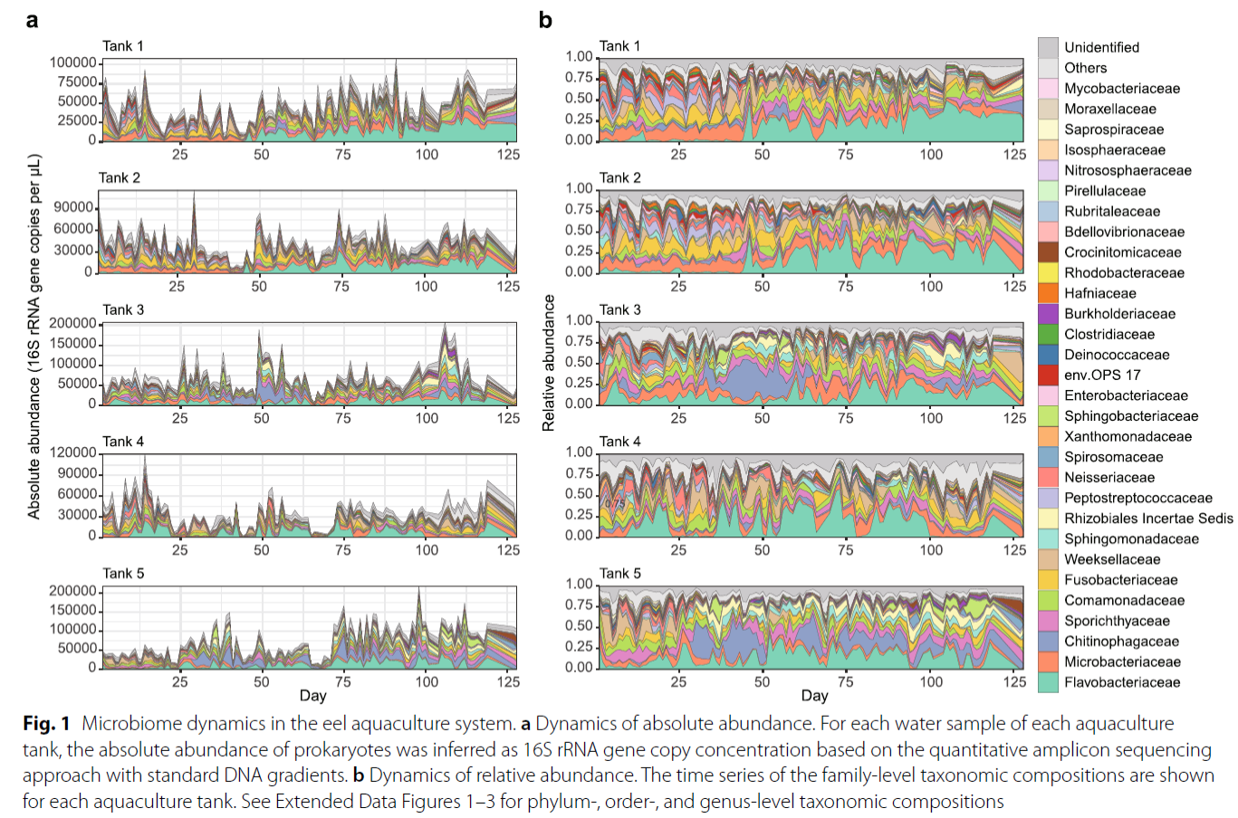
Environment – the water
Commertial recirculation indoor
eel-aquaculture,
(volume = 20 m³), 1400–4300
eel individuals (average weight = 80–130 g).
Water was sampled every day during
the 128 days.
The pH, dissolved oxygen (DO), and
eels’ activity were recorded for each tank every day.
9605 bacterial ASVs representing
618 genera and 325 families.
Notes:
Amplicon sequence variants

Slide 11
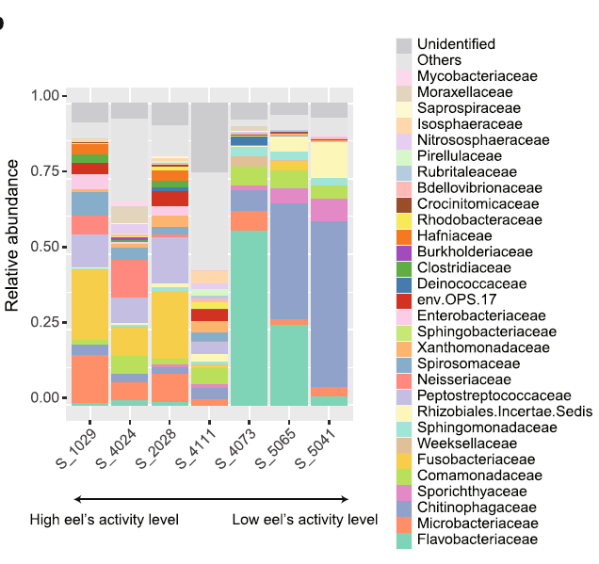
Environment – the water
Commertial recirculation indoor
eel-aquaculture,
(volume = 20 m³), 1400–4300
eel individuals (average weight = 80–130 g)
Water was sampled every day during
the 128 days
The pH, dissolved oxygen (DO), and
eels’ activity were recorded for each tank every day.
9605 bacterial ASVs representing
618 genera and 325 families
the Flavobacteriaceae and Chitinophagaceae-dominated states, which were observed in high-pH conditions, were associated with low eels’ activity

Slide 12
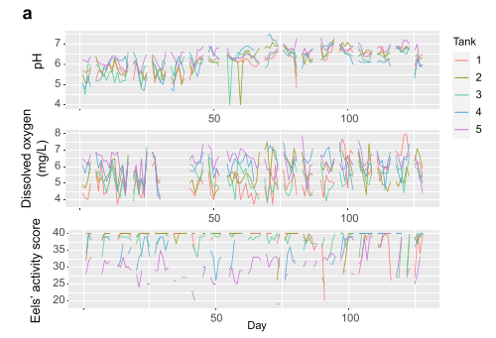
Environment – Reproducibility
Commertial recirculation indoor
eel-aquaculture,
(volume = 20 m³), 1400–4300
eel individuals (average weight = 80–130 g)
Water was sampled every day during
the 128 days
The pH, dissolved oxygen (DO), and
eels’ activity were recorded for each tank every day.
9605 bacterial ASVs representing
618 genera and 325 families
the Flavobacteriaceae and Chitinophagaceae-dominated states, which were observed in high-pH conditions, were associated with low eels’ activity
Notes:
Brings into detail how difficult these studies are, clear reproducibility is almost impossible due to sublte changes in physical environmental variables

Slide 13
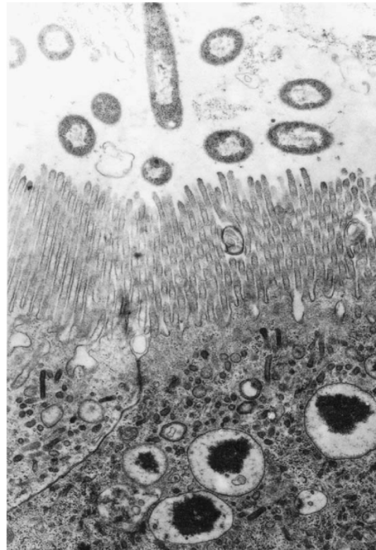
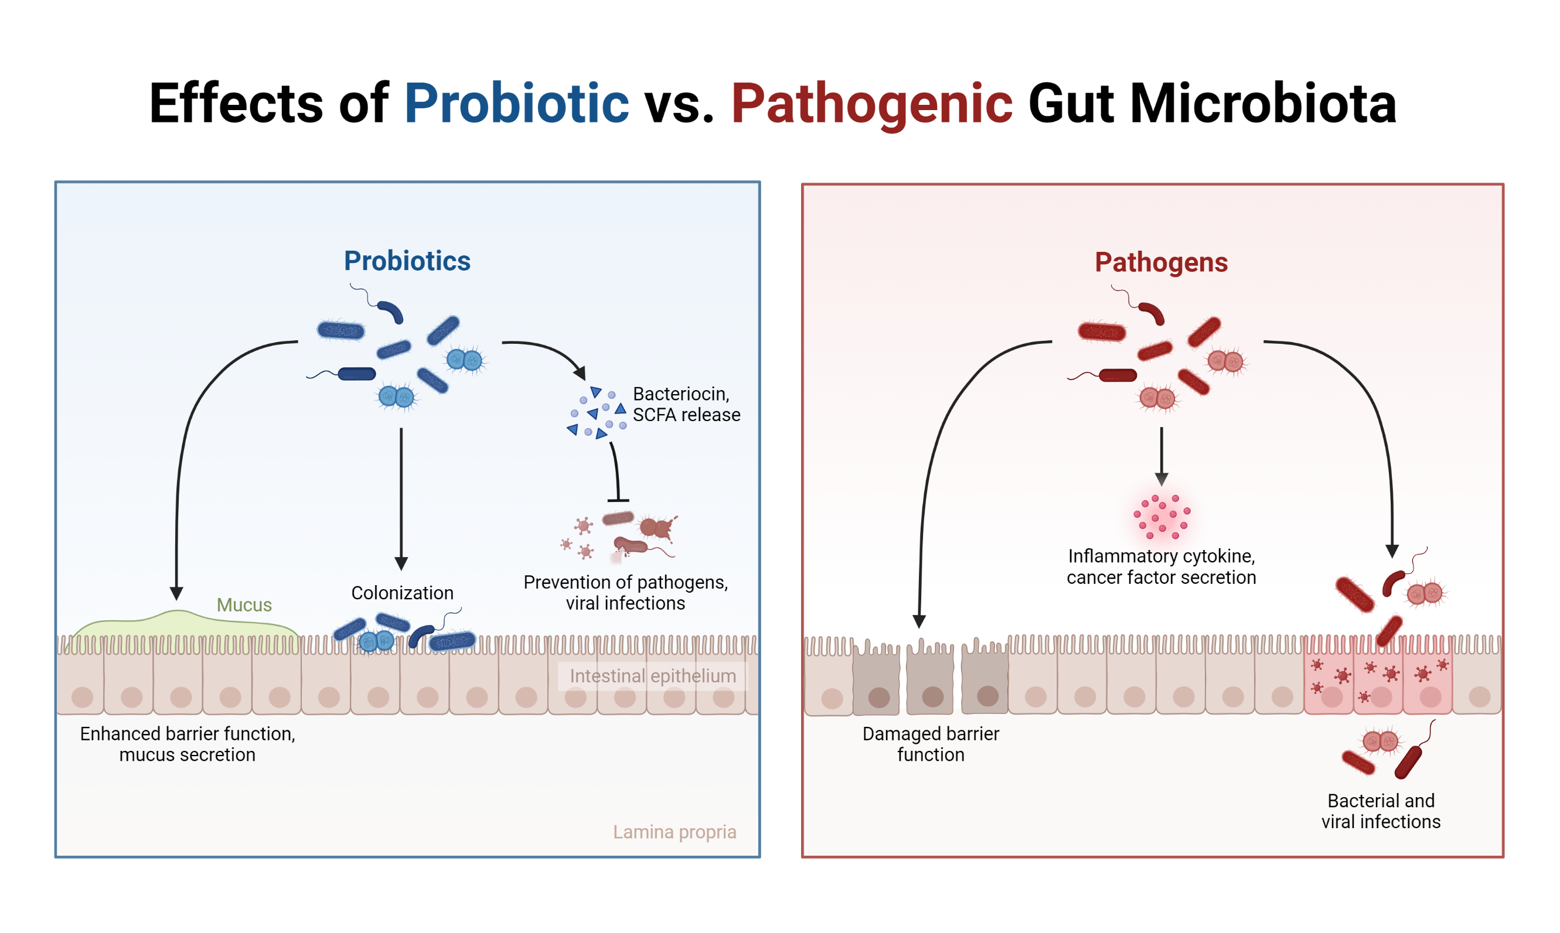
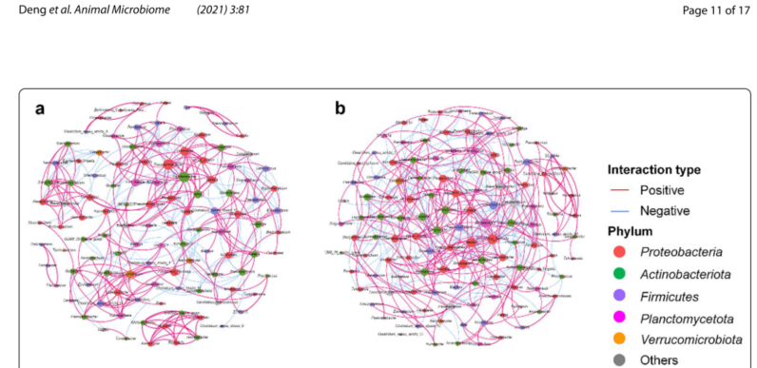
FISH Gut - GOOD vs BAD
Majority of neutral or symbiotic bacteria
Endocytosis of bacteria demonstrated in enterocytes in the hindgut in a 14-day-old herring larva. Bar = 1.0 Am. Hansen and Olafsen (1999)
Deng et al. (2021)
Notes:
intestinal villus
FORMATION OF COMPLEX BACTERIAL NETWORKS, EVERY BACTERIUM PRODUCE A VASTE PRODUCT THAT THE OTHER USES AS A FOOD.

Slide 14
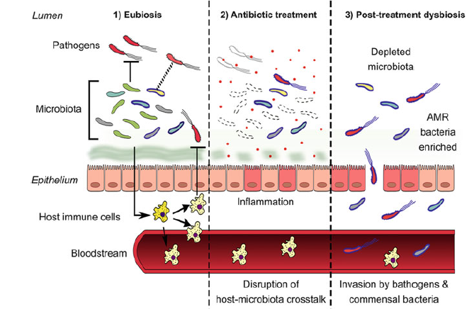
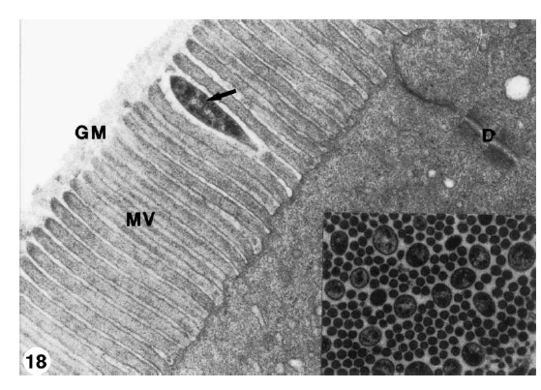
Antibiotic treatment / or harmful stimulI disrupting the equilibrium of the natural microbiome
Transverse section of brush border showing microvilli and bacteria (arrows). Hellberg and Bjerka (2000).
Notes:
In this respect, I must have a note on antibiotics. They are a good servant but a bad master.

Slide 15
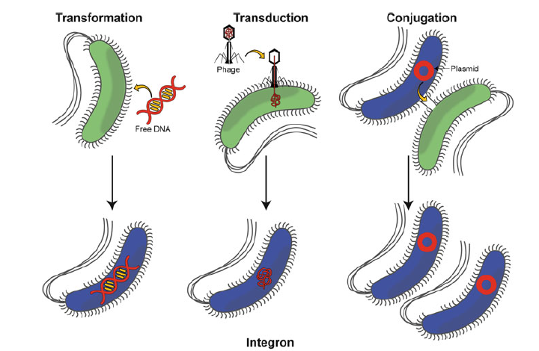
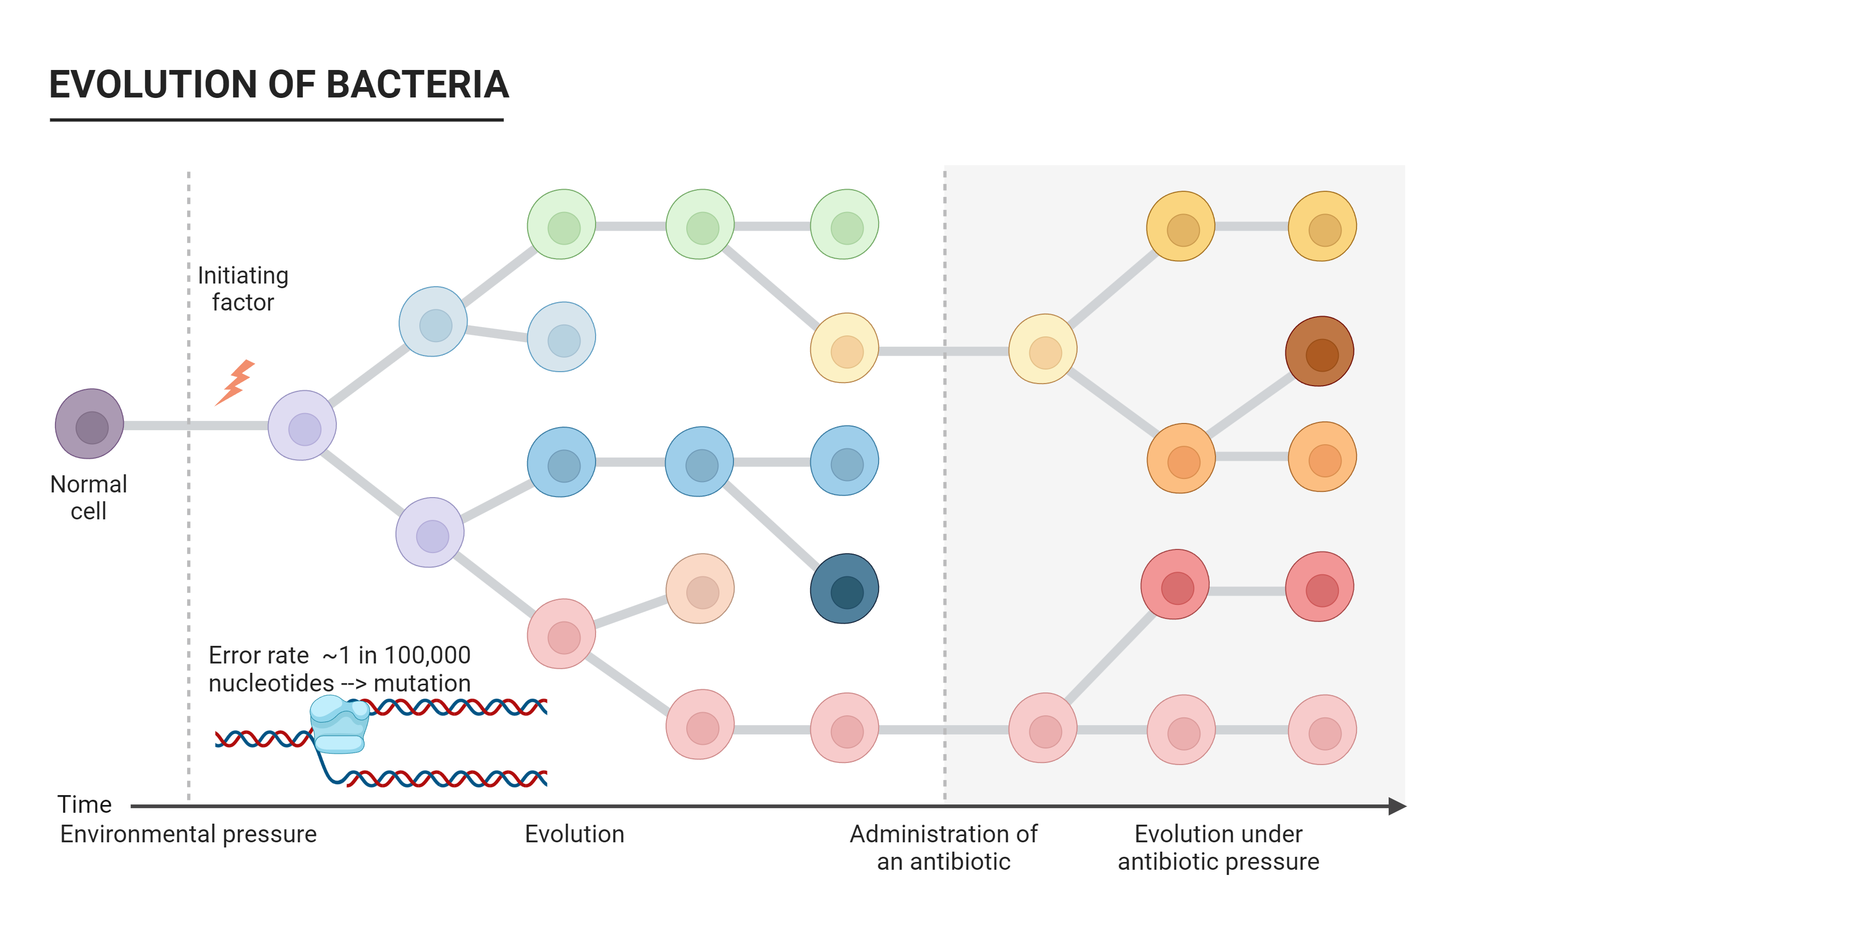
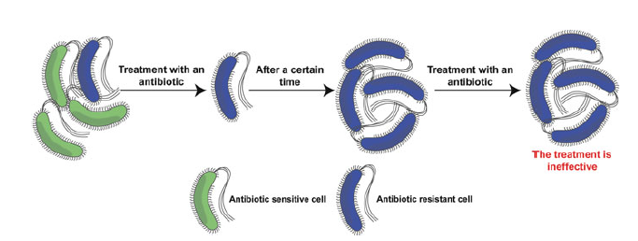
Mechanisms of antibiotic resistance
(Evolutionary race to survive)
https://www.youtube.com/watch?v=plVk4NVIUh8

Slide 16

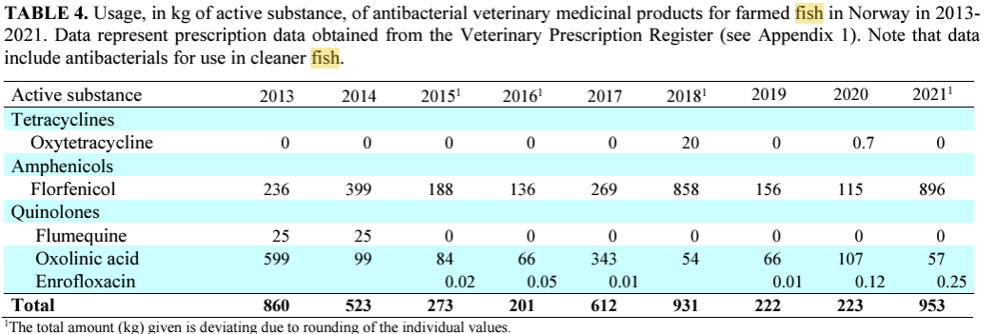
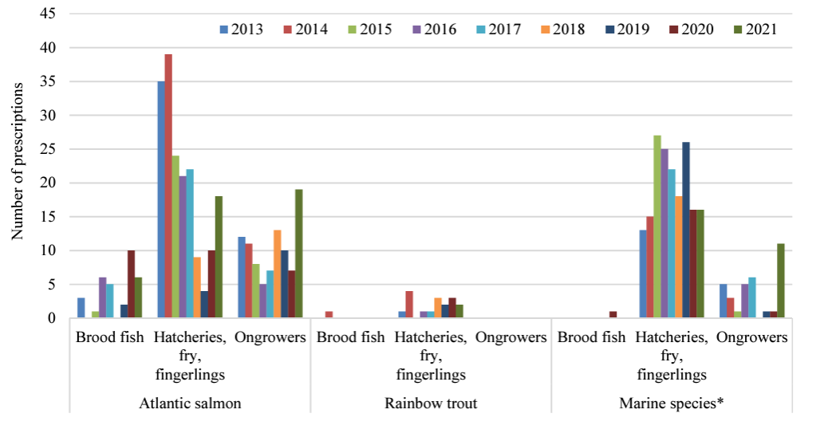
ANTIBIOTIC USE IN NORWAY

Slide 17
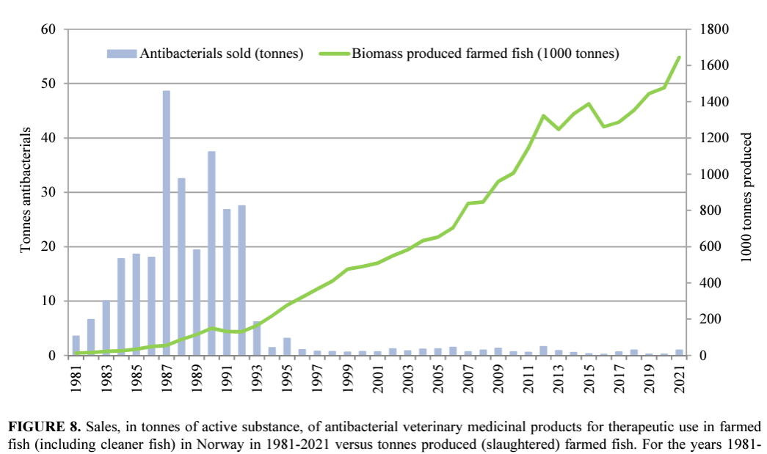
ANTIBIOTIC USE IN NORWAY

Slide 18
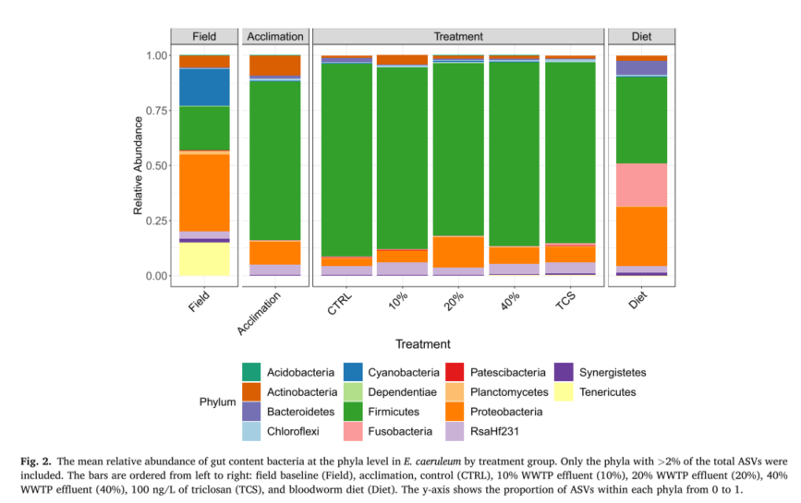
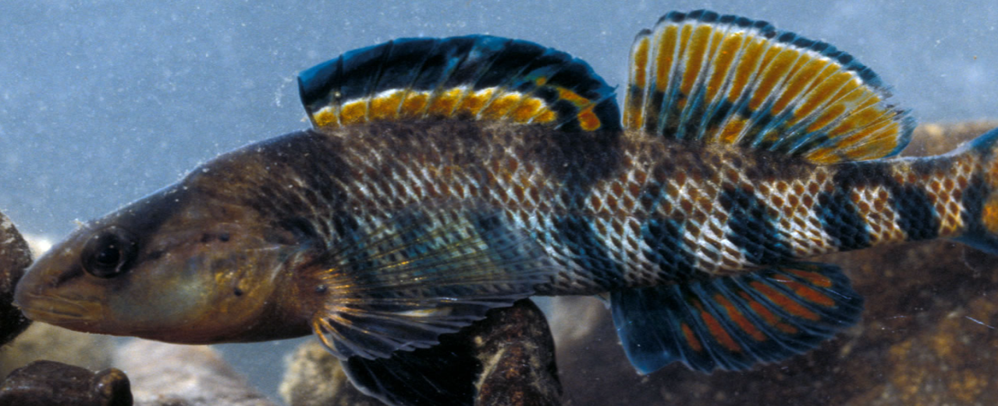

FISH GUT - high number of species
High tens to small hundreds of species in fish gut.
It varies based on the methods used, the study, the natural or aquaculture environment, and the species.
Wild rainbow darter had greater ASVs per sample (423-1304) compared to lab fish (19-685).
Notes:
And now, we are turning into the fish itself. I will focus namely on fish gut and fish skin
natural sample blood

Slide 19
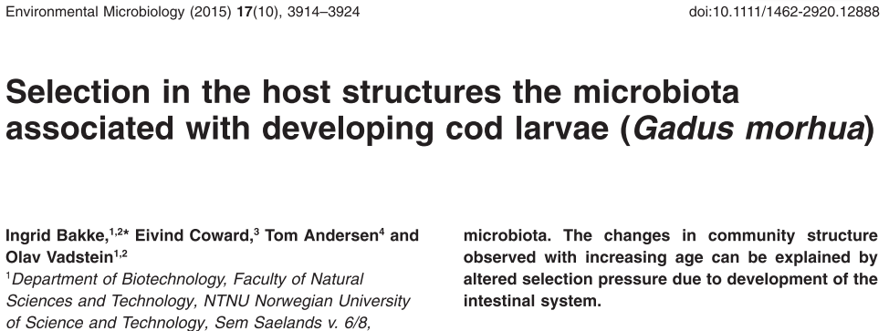
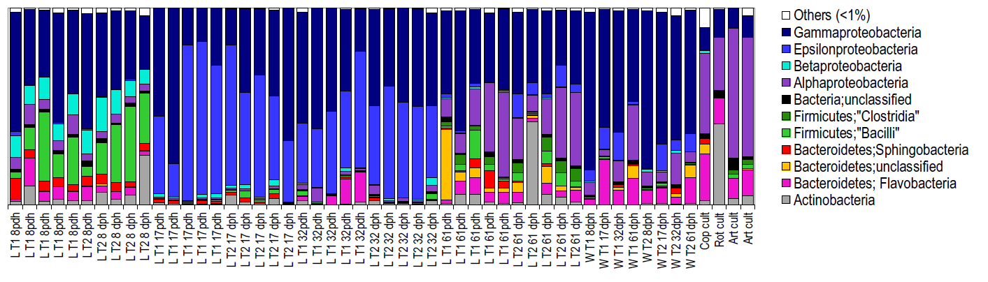
FISH GUT Microbiome
Relative abundance of bacterial phyla and families represented in the 16S rDNA amplicons obtained from individual cod larvae, water and live feed samples. At the phylum level, the microbiota is presented as bar graphs (bottom), and at the family level as a heat map (top) with the abundance of each family represented by a coloured block as specified in the figure. Bars labelled D8, D17, D32 and D61 represent cod larva individuals at the ages 8, 17, 32 and 61 dph respectively. Bars labelled W and F represent water and live feed samples.
Notes:
Five larveae from one tank have quite different microbiome composition, then it changes and stabilizes, but after 62 days of experiment goes wild againd

Slide 20

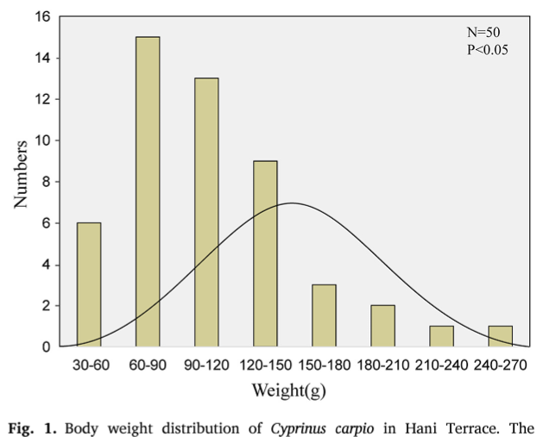
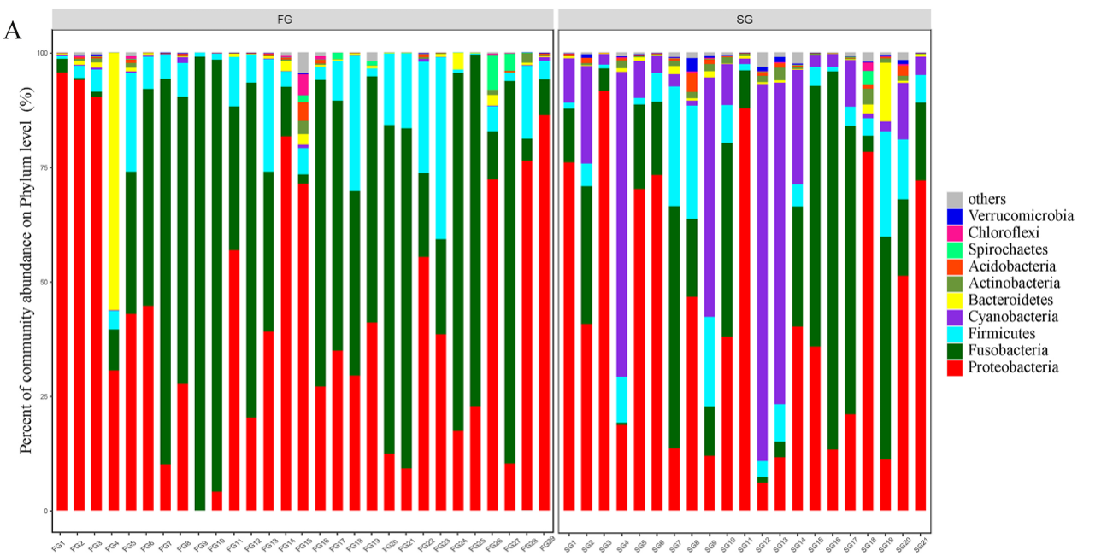
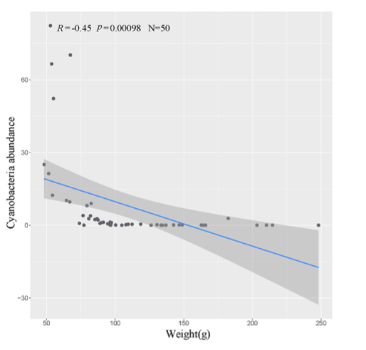
DO CYANOBACTERIA INHIBIT FISH GROWTH?
The paddy fields were planted with Red Rice. After a month, the rice turned green, common carp at an average weight of 38.46 g were put in paddy fields at a uniform density of 0.4 individuals per square meter. No feed and fertilizer were added during the experiment. Two months later, 50 fish were randomly collected from the same rice terrace. The weight of the 50 fish varies greatly, from 48.01 g to 248.15 g, which were far from normal distribution

Slide 21
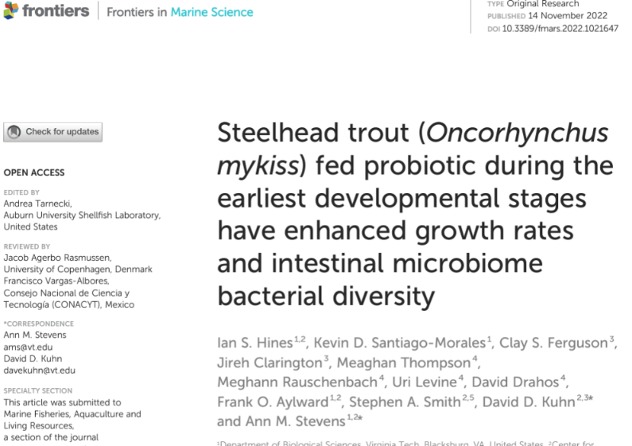
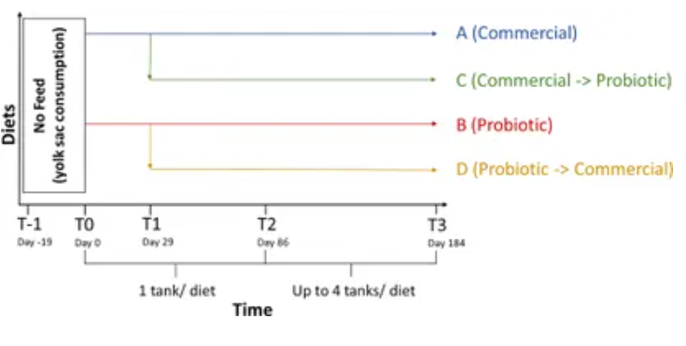
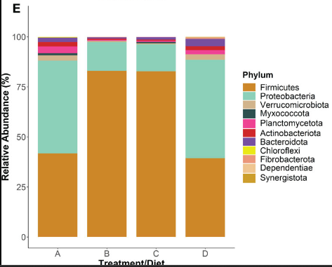
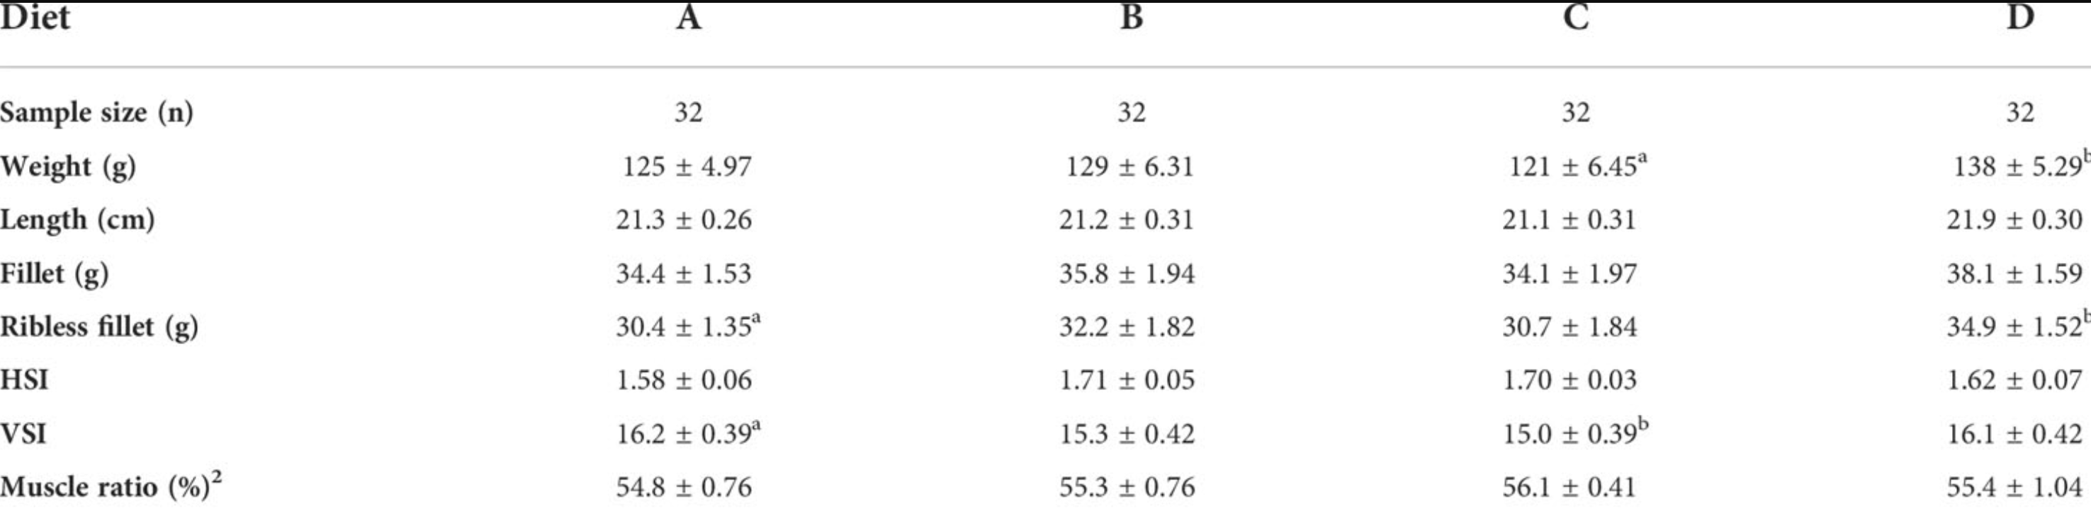
PROBIOTICS (0)
Bacillus subtilis probiotic supplementation
Notes:
Another hot topic is the use of probiotics,. They whould enhance everything. Growht rates, microbilom diversity,
confusing

Slide 22

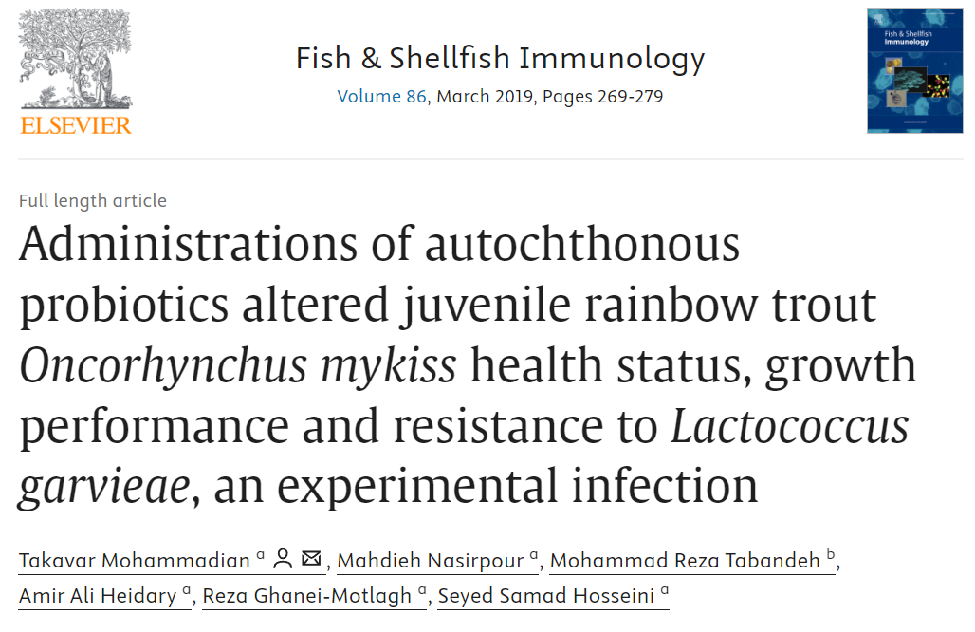
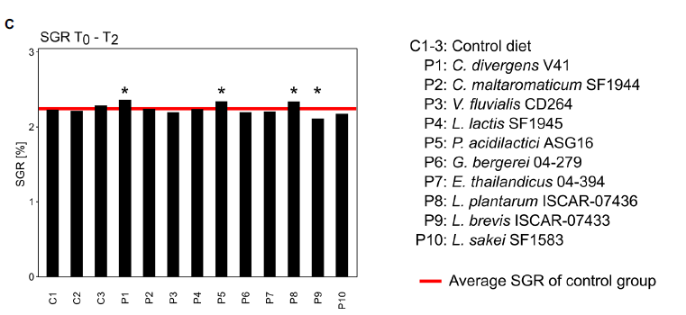
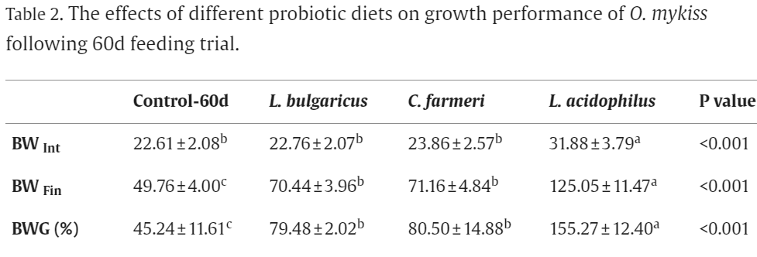

PROBIOTICS (0+)
Specific growth rates (SGR) of the different treatment groups entire 8-week growth period Asterisks above bars indicate significant difference of the control groups (46 fish per group) to the treatment group based on one-sample t-tests (p < 0.05).
(? fish per group)

Slide 23
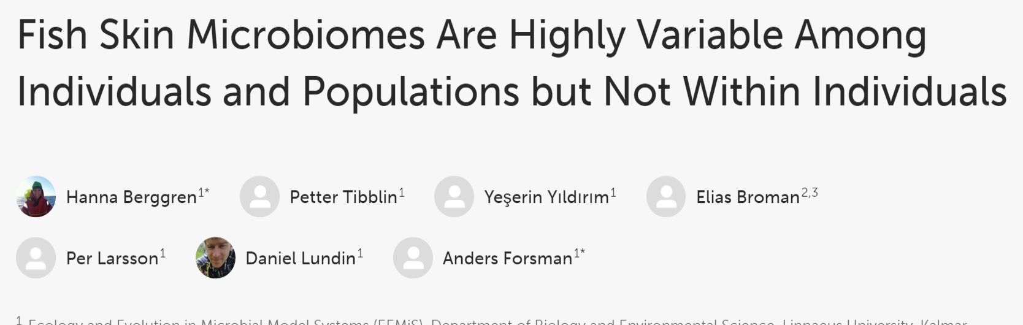
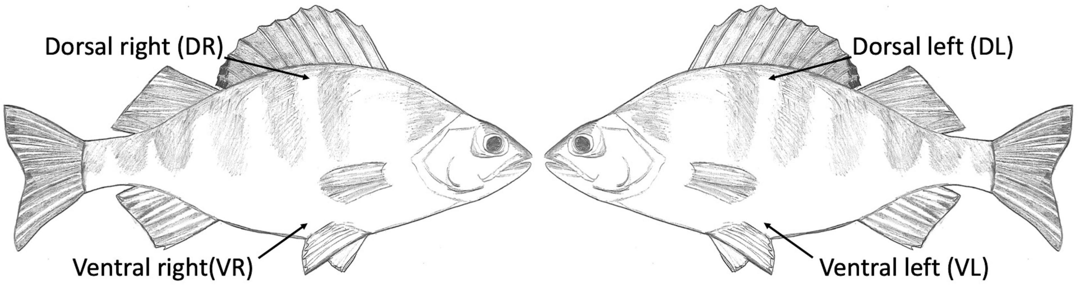
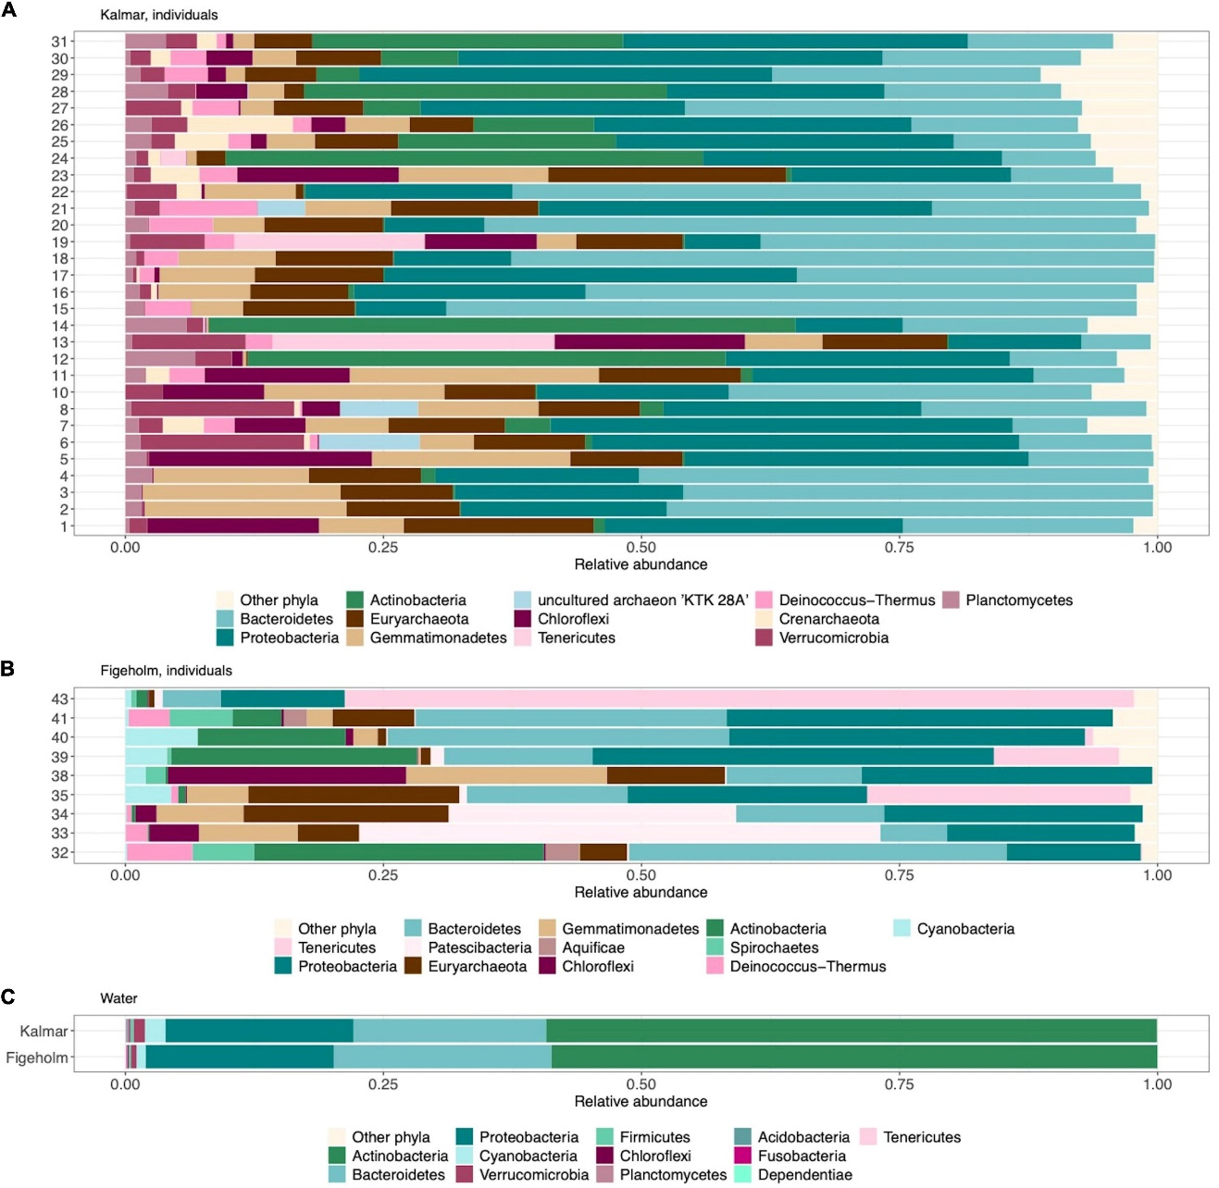

FISH SKIN MICROBIOME
. Body sites of Perca fluviatilis that were sampled to characterize variation in skin-associated microbiomes
Comparison of phylum-level composition in fish skin microbiome and bacterioplankton communities, ordered by increasing relative abundance from left to right. The 12 most abundant phyla based on relative abundance among fish skin microbiome
.
Notes:
Two environmental sites in Norway, These authors got different results than the others having lowest bacterial diversity in lake water, whreas the higher was on fish. Which makes big sense allover, due to low trophy of lake water.
no differences on composition of microbiome within one fish
Hierarchical levels of fish skin microbiome richness representing host individuals, populations, and regional scales

Slide 24



MICROORGANISMS PROTECT FISH
Arthrobacter sp. skin isolates, a Psychrobacter sp. strain, and a combined skin aerobic bacterial sample inhibit the growth of Saprolegnia australis and
Mucor hiemalis, two important aquatic fungal pathogens.
Confocal microscopy image of a rainbow trout skin horizontal cryosection scanned dorsoventrally after staining with oligoprobe by FISH and scanned from above. Bacteria are shown in green.
In vitro inhibition assays of Mucor hiemalis and Saprolegnia australis by different rainbow trout skin bacterial isolates
Notes:
Here is onother study focusing on rainbow trout fish skin

Slide 25







SPECIES COMPOSITION AT DIFFERENT SITES
Notes:
Composition of the bacterial microbiomes of rainbow trout at different body sites. (a) Bar chart of the relative abundance of phyla present at each site and
in each individual fish sampled.

Slide 26




BIOFILTERS IN RAS
Much higher waiting bacterial diversity than recorded by standard next generation sequencing.
Bacteria waiting for suitable condition.
dominant bacterial families (b) at weeks 1–7

Slide 27
CONCLUSIONS
Microbiome studies have a great potential to improve aquaculture, however the selection of beneficial strains requires detailed microbiological approach (namely cultivation and testing of single bacterial strains).
The parameter that governs the factors influencing the origin and conservation of the gut microbiota follows a chaotic model.
Probiotics are a good way to keep and enhance the fish immunity, whereas their dietetic advantage is questionable.
There is probably much higher diversity of bacteria just waiting for suitable conditions in aquaculture systems – are they going to be GOOD or BAD?

Slide 28

THANK YOU FOR YOUR ATTENTION

Slide 29
Nature x artificial environment (RAS)
Phytoplankton (associated bacterial communities)→zooplankton→ fish (vitamin D, C, A, B) →human
B12 (cobalamin) Proteobacteria, Actinobacteria, and Firmicutes groups.
Gut microbes can synthesize certain essential vitamins and nutrients that fish cannot produce on their own. For example, the microbiota in fish can synthesize B-vitamins (such as B12, thiamine, and riboflavin), which are important for metabolic processes
Notes:
Poor growth, Anemia, impaired nerve function, Deformities, weak immune responses

Slide 30

Vitamins

Slide 31

cyanotoxins
and
decomposition

Slide 32




Slide 33

Main primary producers in waters
Cyanobacteria
Algae
Mosses and plants
(Spermatophytes)

