Slide 1



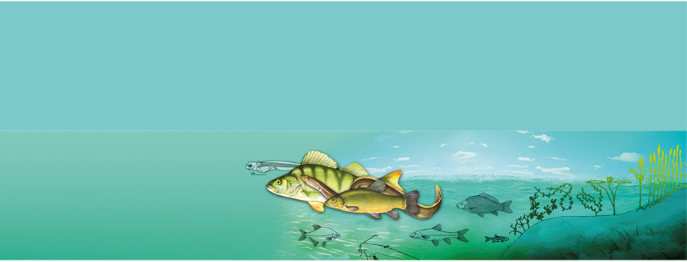
Innovations in Fisheries and Aquaculture as a Key Component of Sustainable Aquafood Systems
FAO Workshop 2024
Effect of Fulvic Acid on Skin Immunological Alteration
Dr. Thora Lieke
24.10.2024

Slide 2
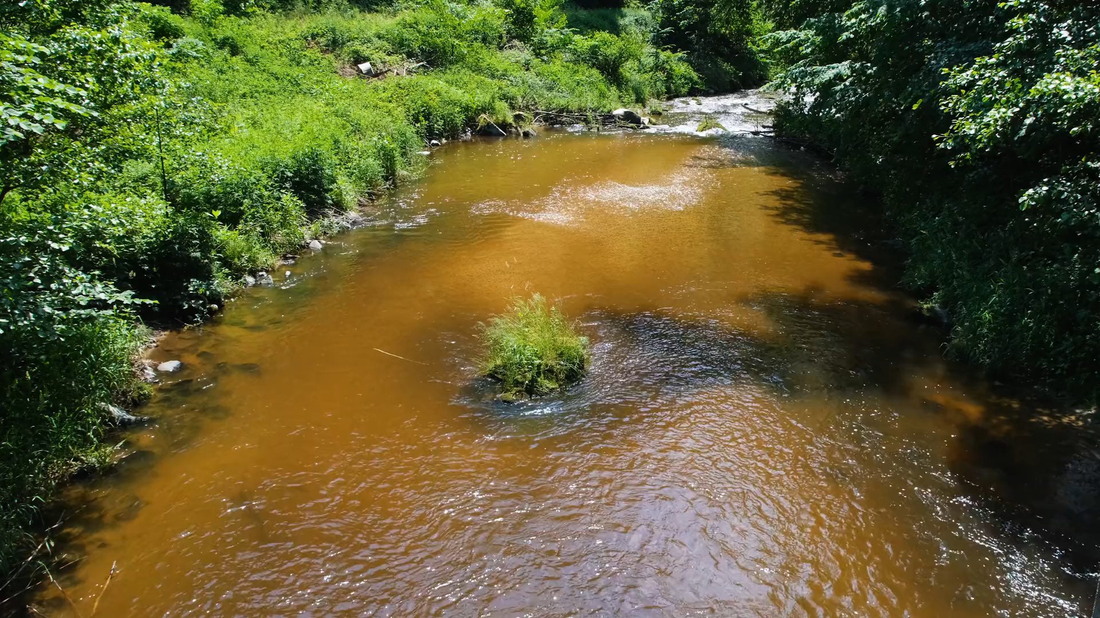
Learning from Nature
53 % of fish from aquaculture
  Spreading of diseases
  Treatment emergency
Natural Waters contain Dissolved Organic Carbon (DOC)
  Up to 95 % Humic Substances

Slide 3
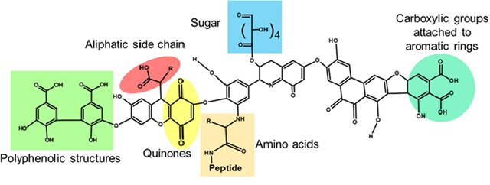
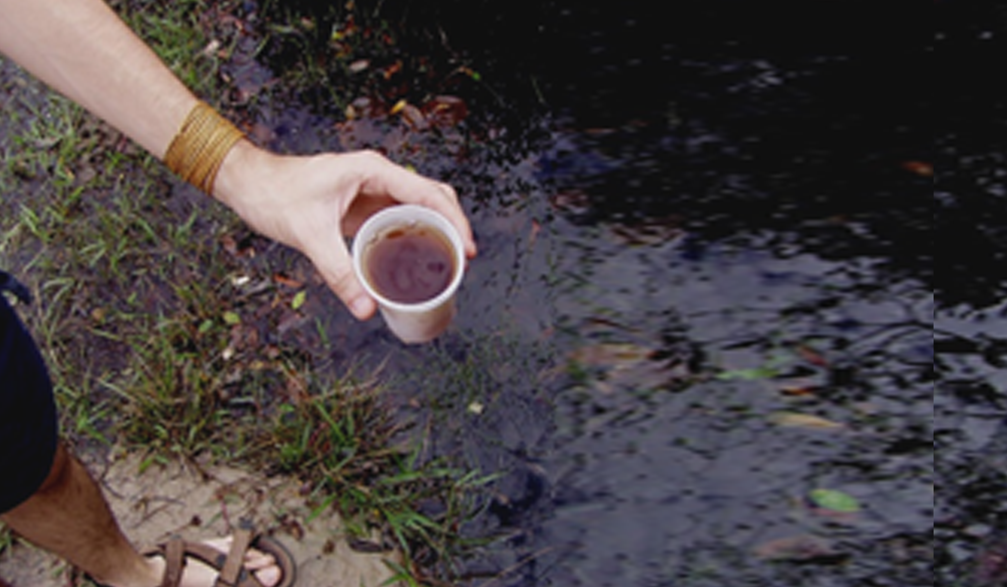
Humic substances - A controversial group of substances
Degradation of organic material
Highly diverse Structures
Humic substances
Fulvic acids Humic acids Humins
Color
Solubility
Molecular Size
Cross epithelia
Notes:
Alternating C-double bounds

Slide 4
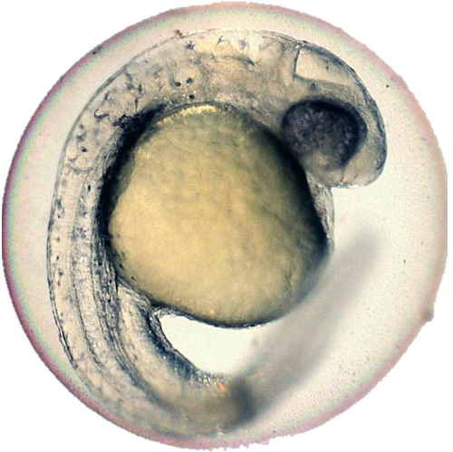
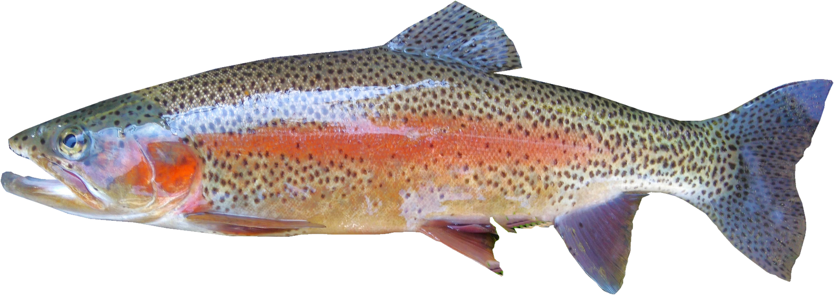
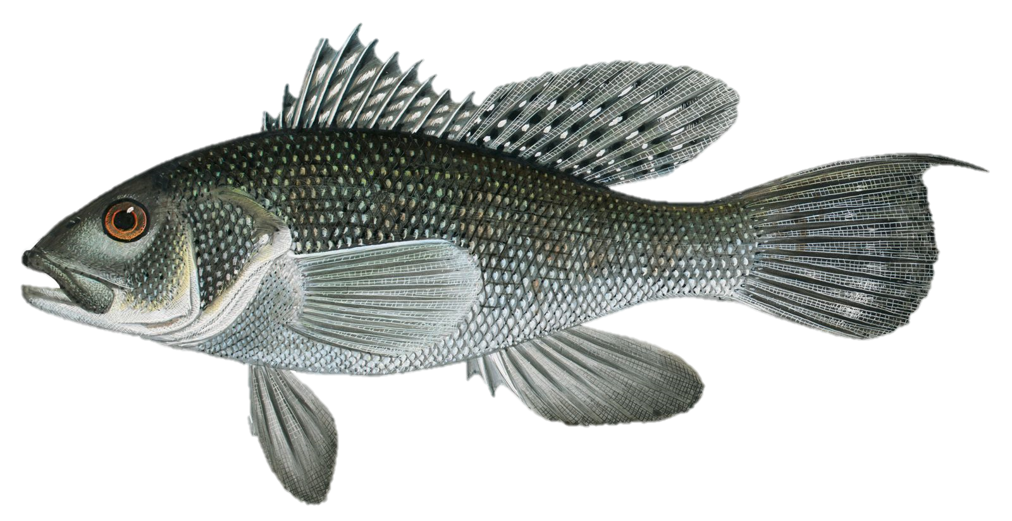
Previous results on larvae and juvenile fish
Low-middle Concentrations
Increased growth and development
Anti-inflammatory
Stimulated systemic immune response
High Concentrations
Strong oxidative stress
Cell- and tissue damage
Increase inflammations
Notes:
Systemic immune response helps defeat when pathogen has invaded; stimulating mucosal immune response to prevent invasion at all

Slide 5
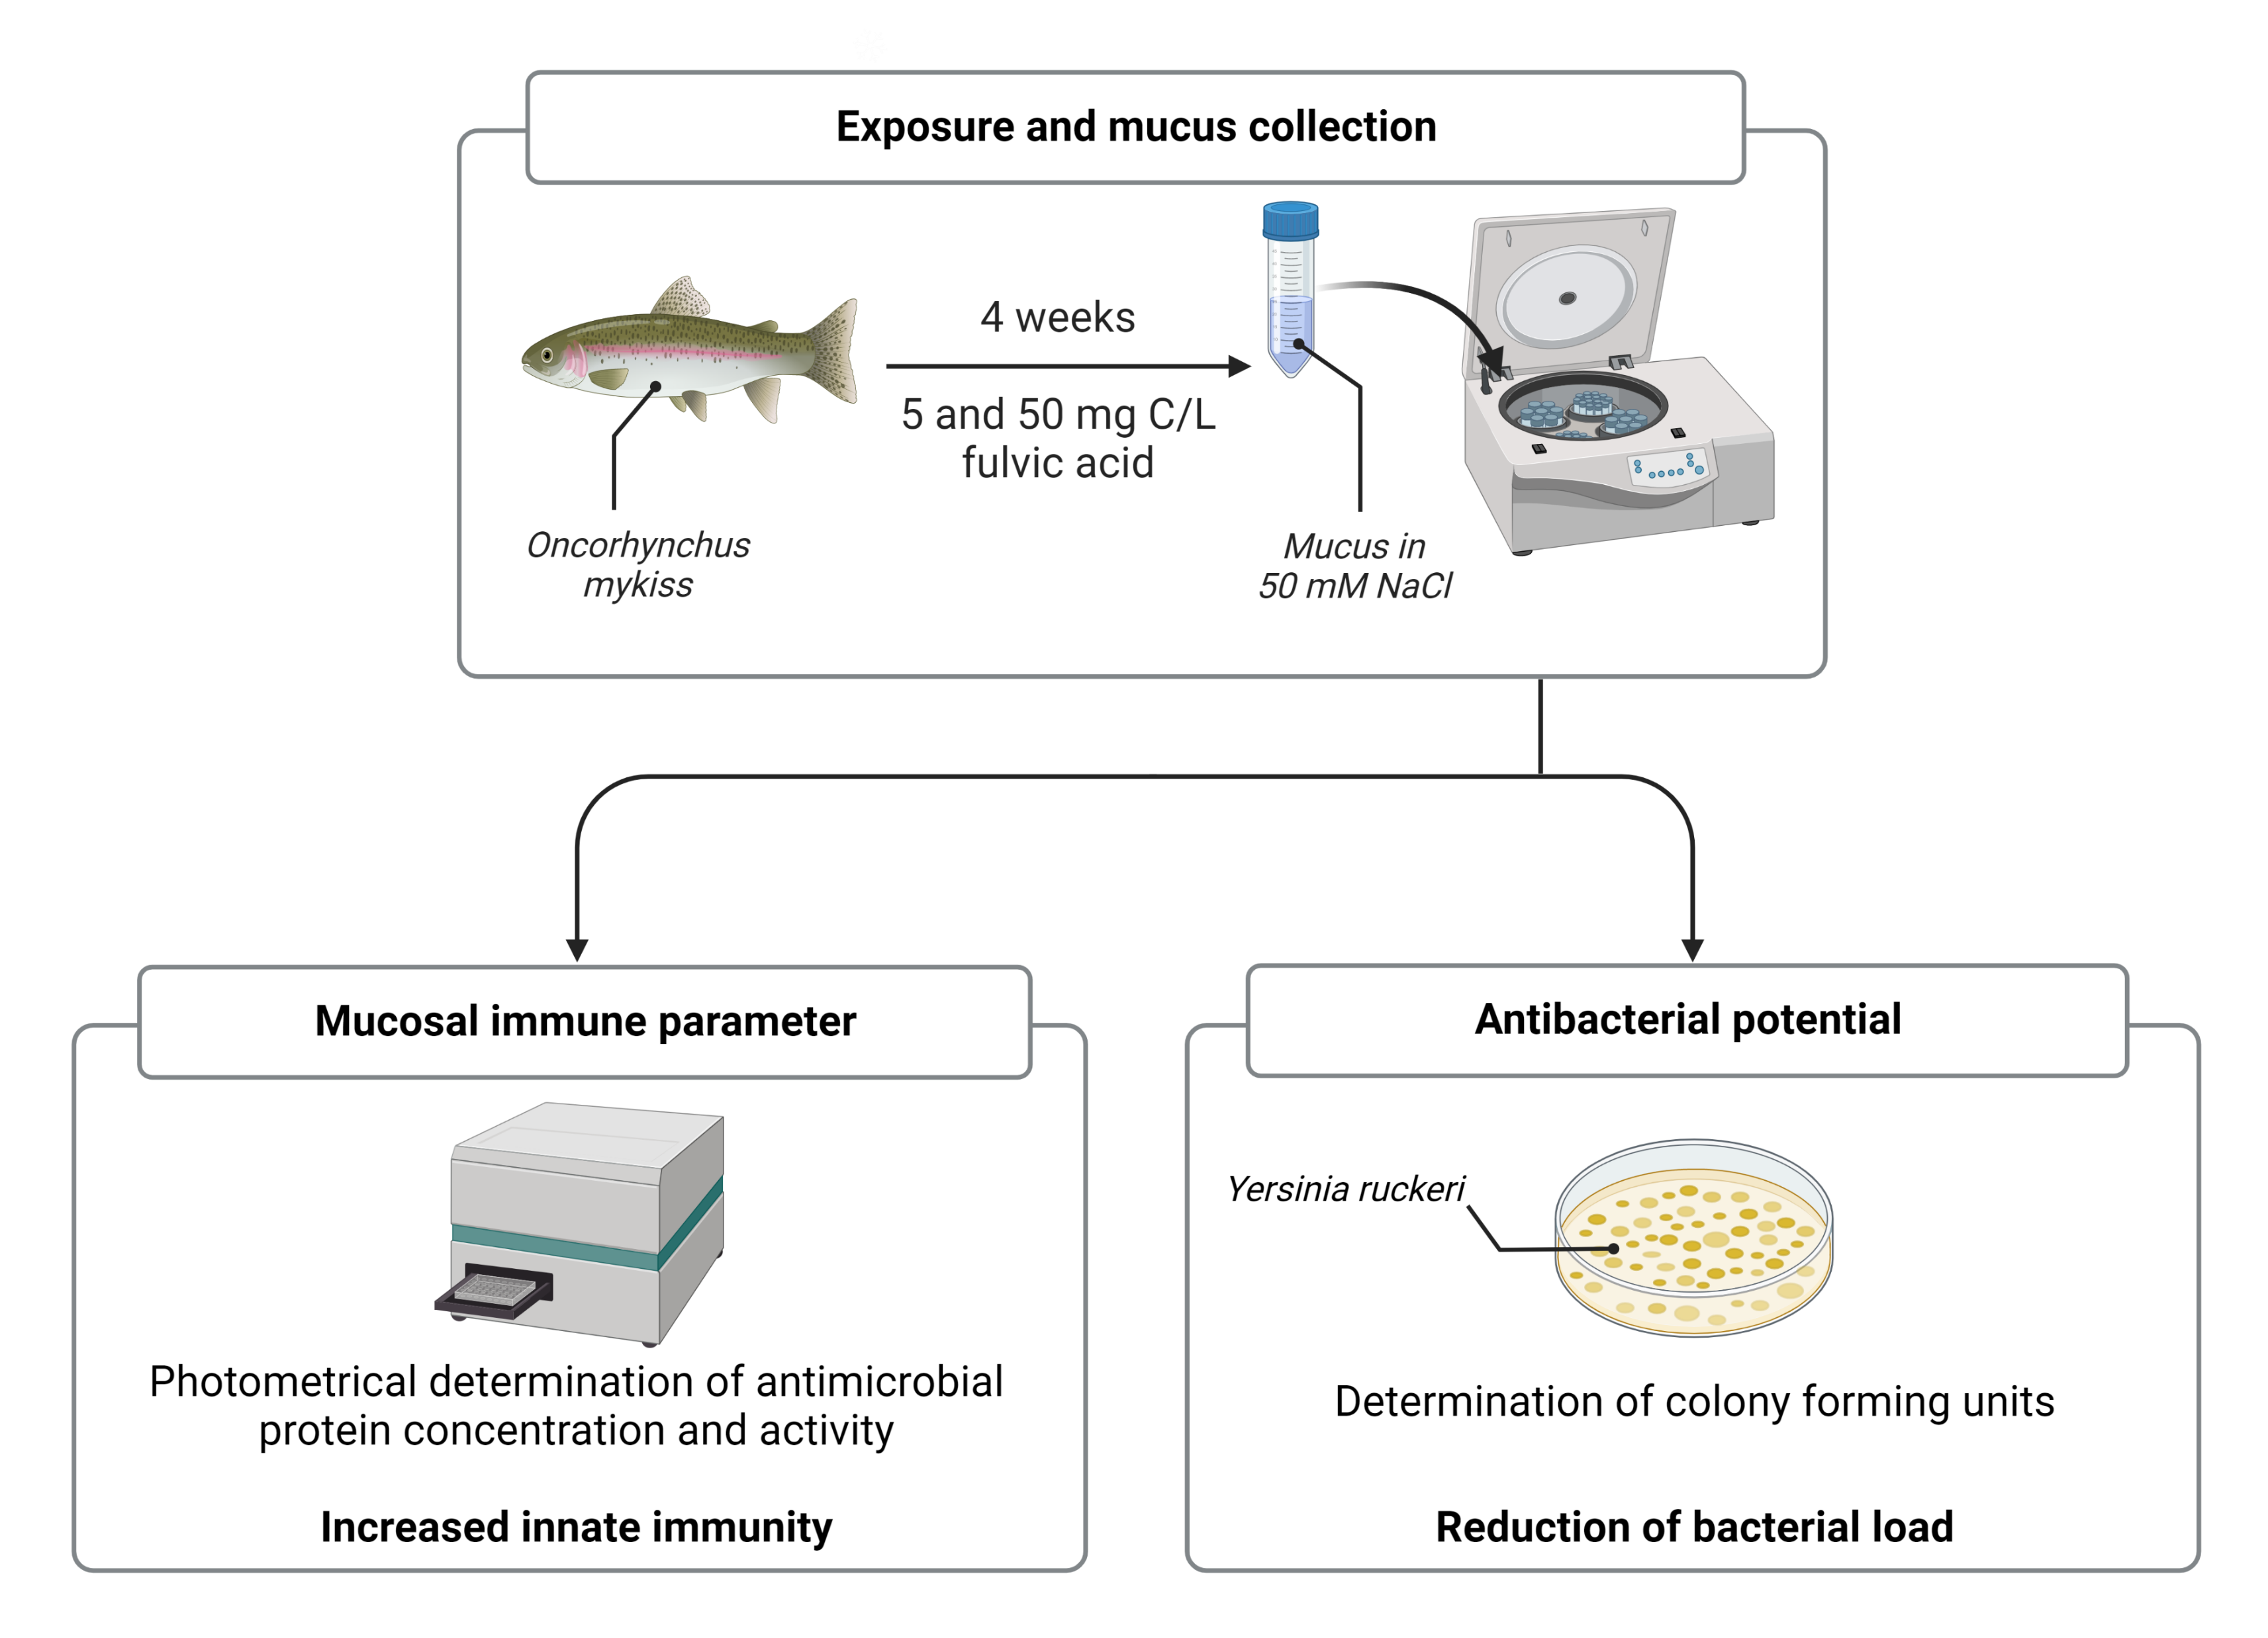
Can Fulvic Acid prevent Infections?

Slide 6
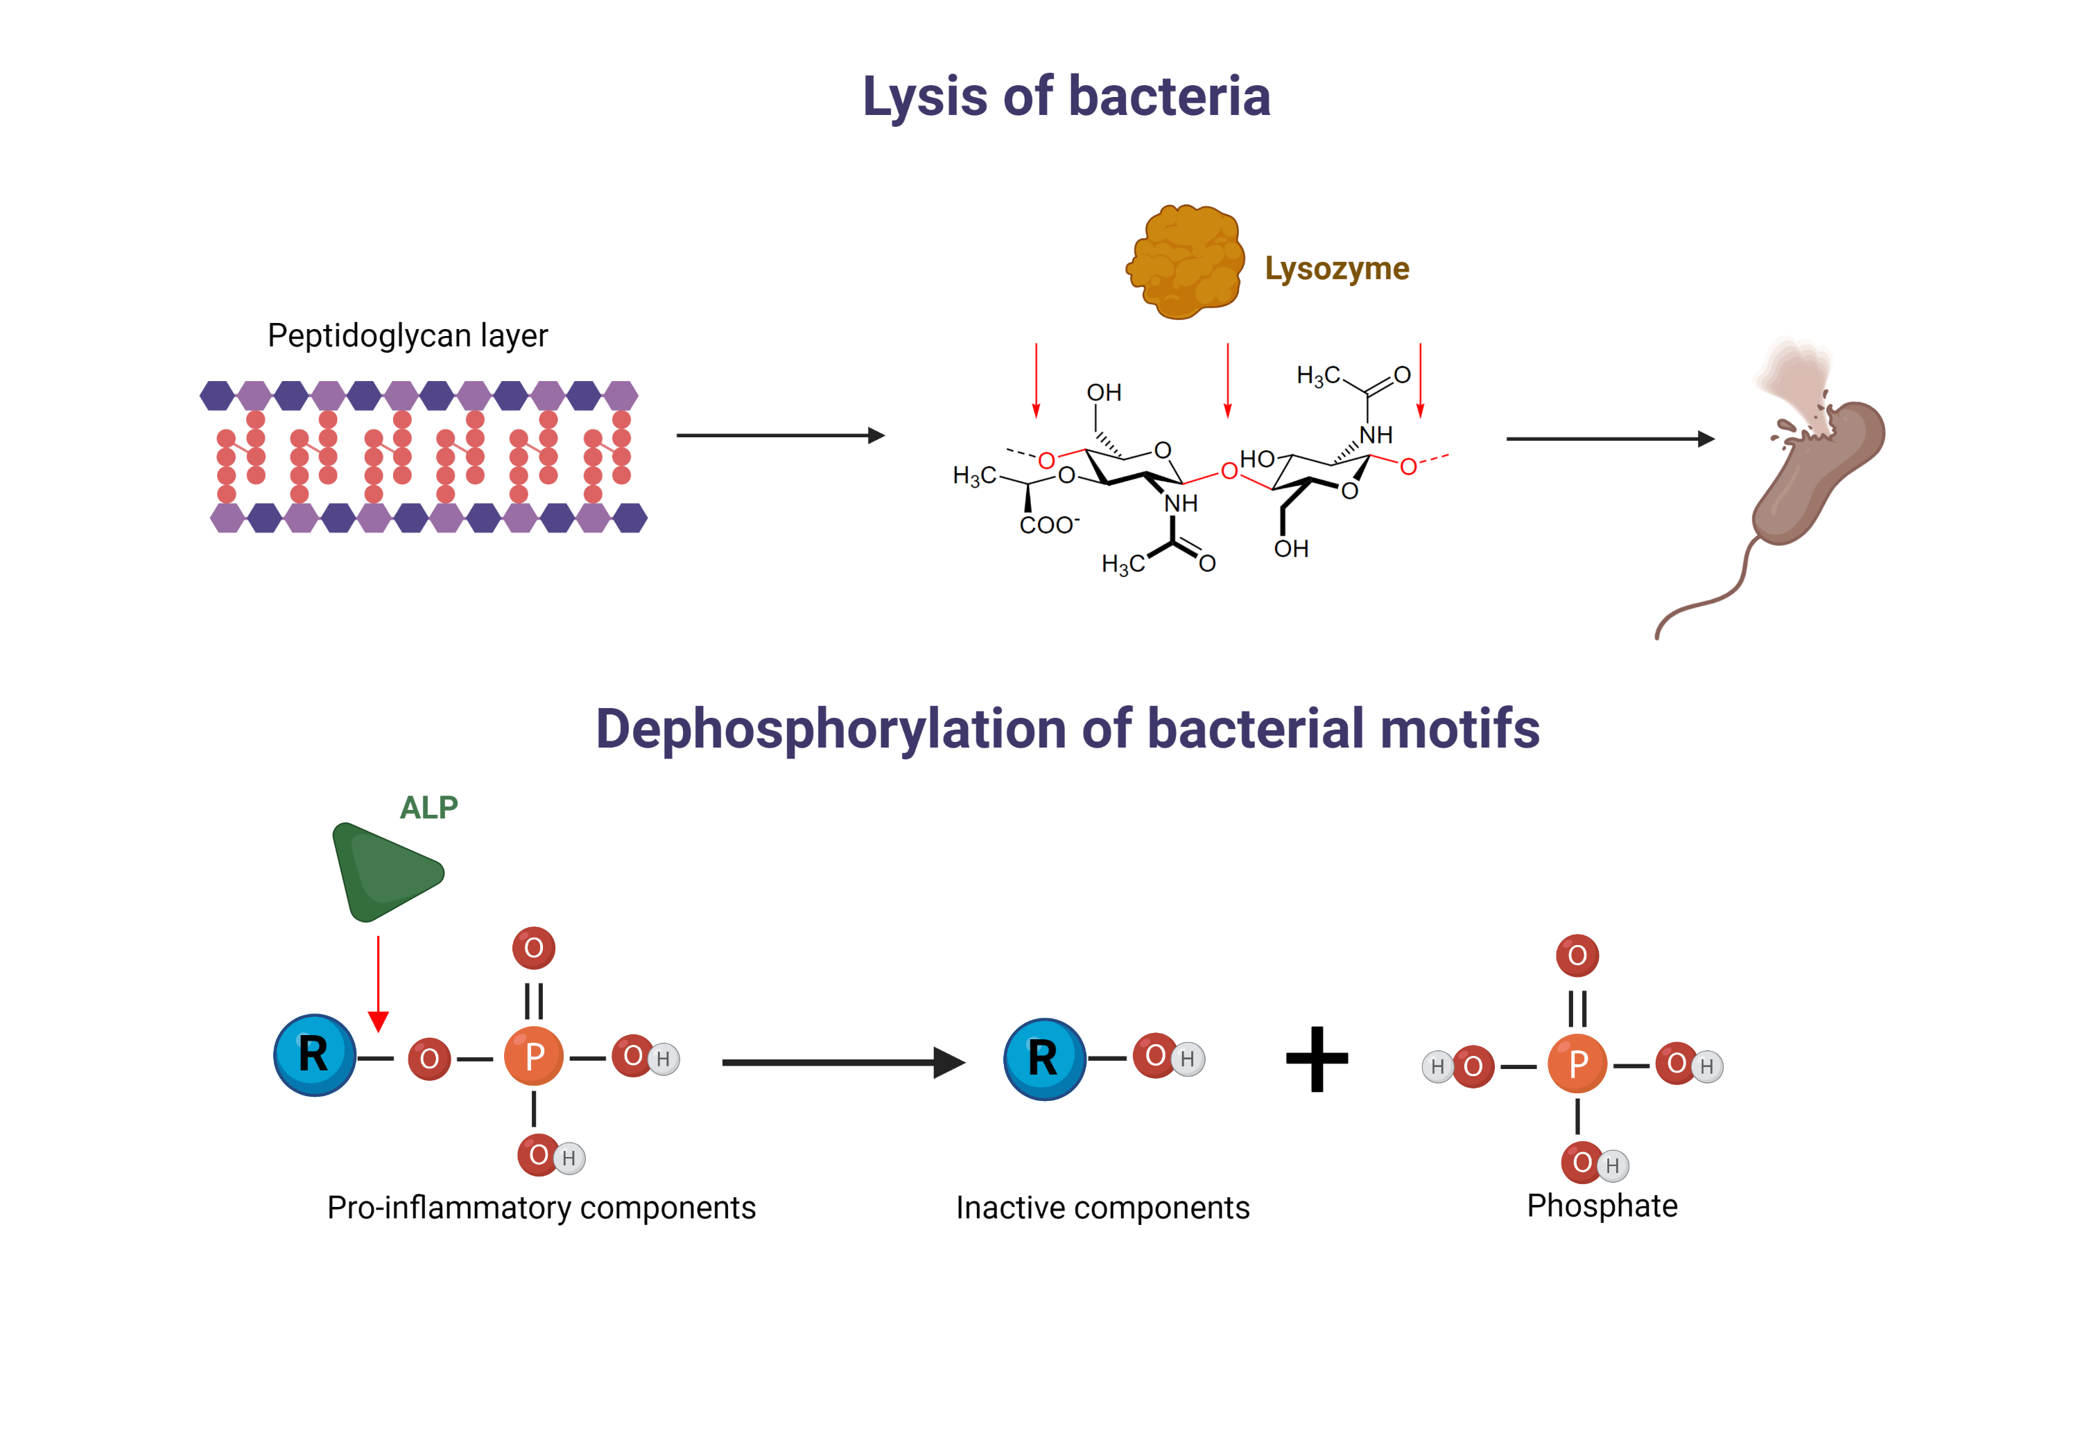
(Alkaline Phosphatase)
Notes:
ß1-4 glycosidic bond
Not too much is known about the mucosal alkaline phosphatase yet.

Slide 7
(Alkaline Phosphatase)
(LPS, flaggelins, DNA CpG motifs)
Notes:
ß1-4 glycosidic bond
Not too much is known about the mucosal alkaline phosphatase yet. Among the most important functions is the dephosphorylation of pro-inflammatory bacterial components such as LPS, flaggelins, DNA CpG motifs. The dephosphorylation inactivates the pro-inflammatory motifs, thus they cannot elicit pro-inflammatory response pathways such as NF-kB pathway

Slide 8
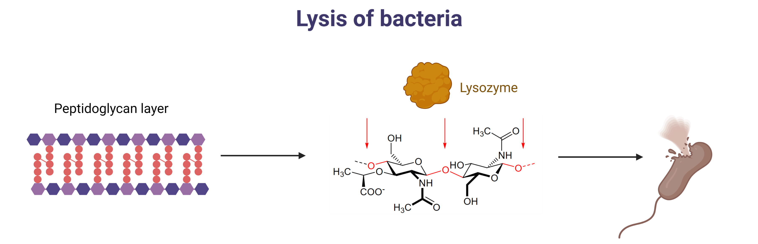
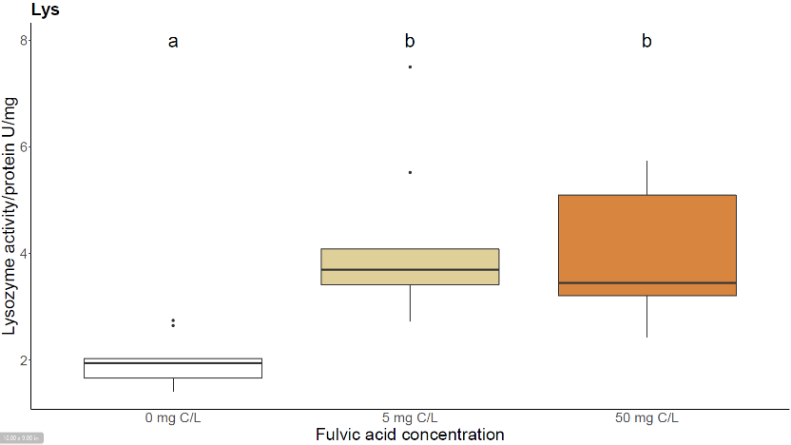
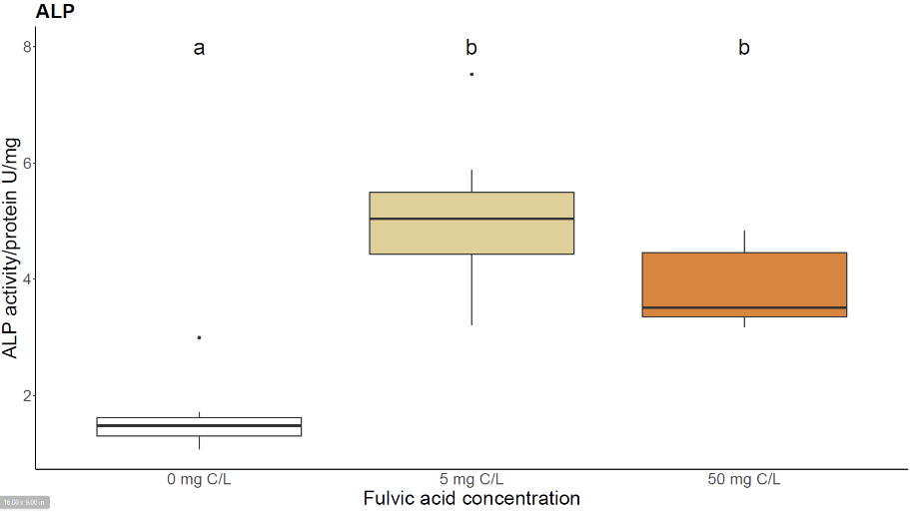
Stimulation of major innate immune defenses
~ 2x higher lysozyme activity
~ 1.5-2x higher ALP activity

Slide 9
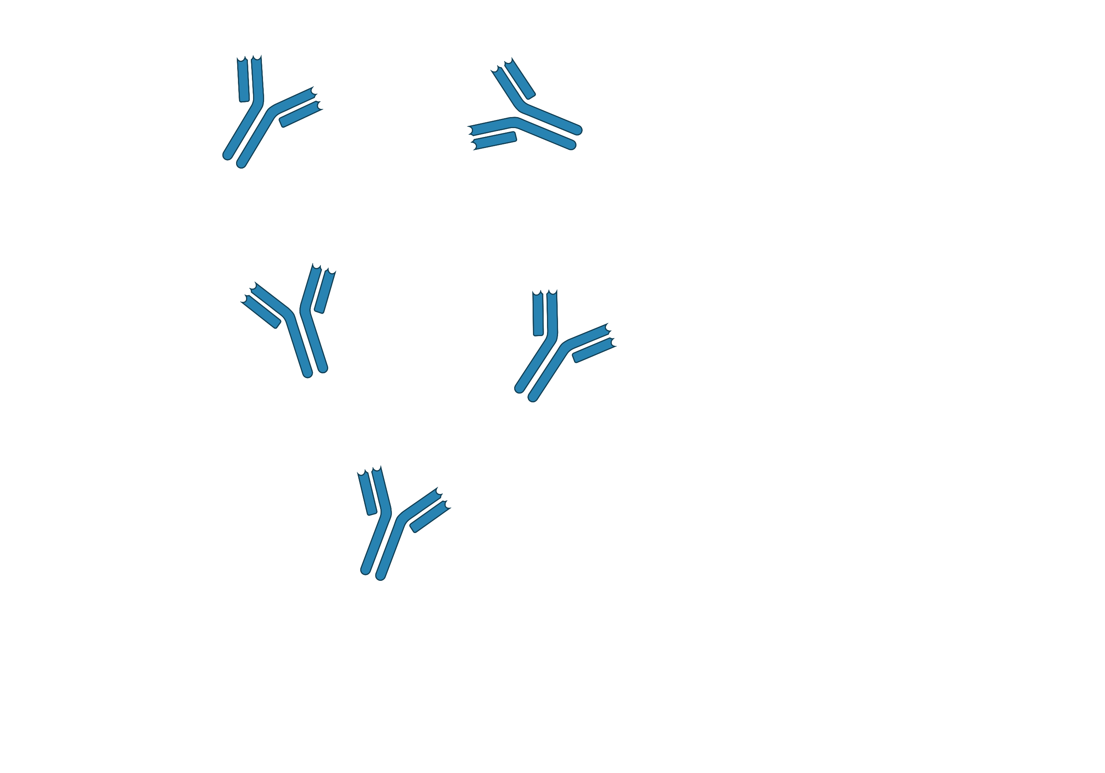
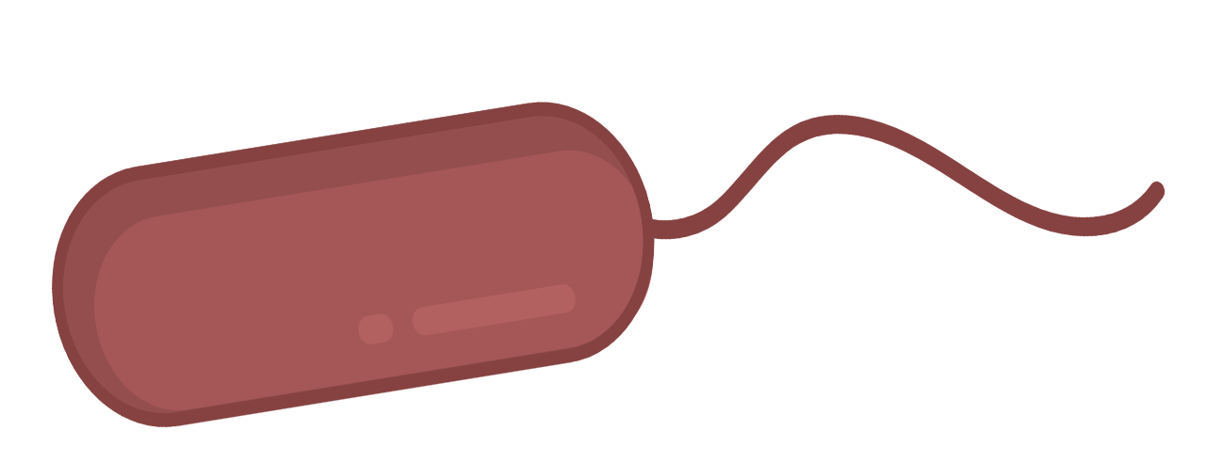
Bridge between Innate and Adaptive Immunity
Secreted immunoglobulins
Notes:
Another important part of the mucosal immune response are antibodies or immunoglobulins, wich are secreted by b cells.

Slide 10
Bridge between Innate and Adaptive Immunity
Notes:
They can recognize and detect anitgens such as pathogens

Slide 11
Bridge between Innate and Adaptive Immunity

Slide 12
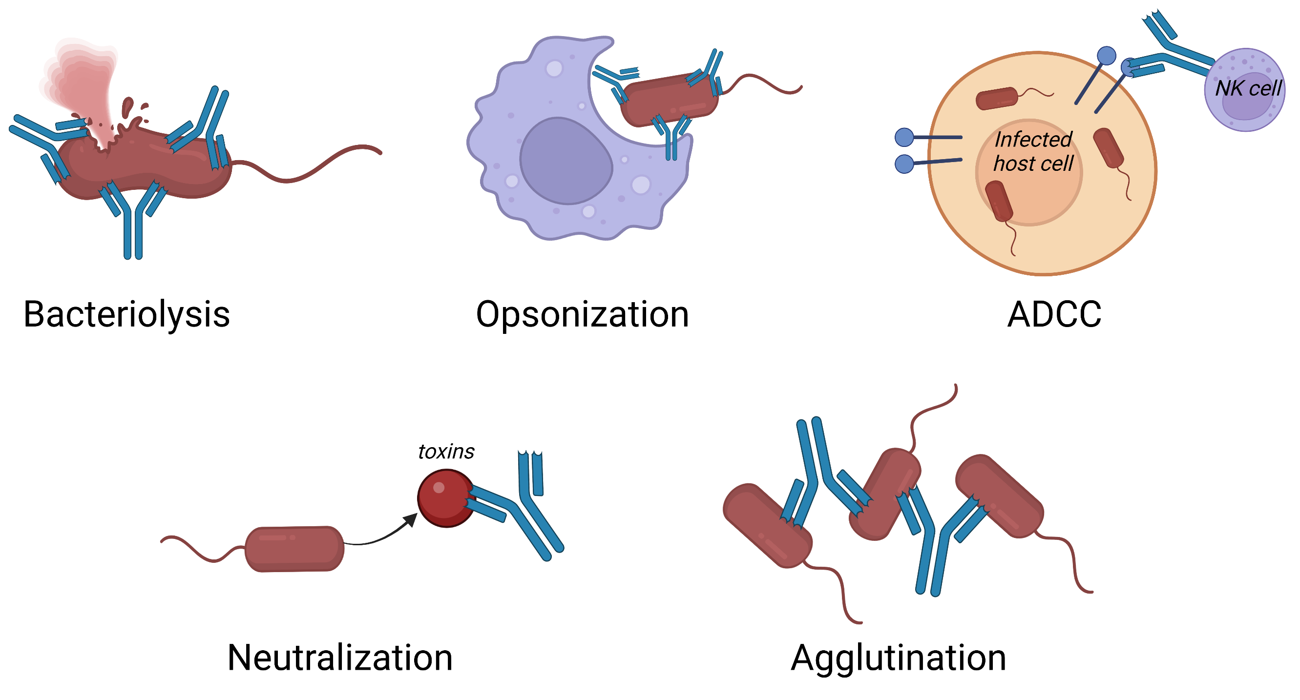
Bridge between Innate and Adaptive Immunity
(Antibody Dependent Cell mediated Cytotoxicity )
Notes:
Target antigen for lysis, opsonization, and antibody dependent cell mediated cytotoxicity (ADCC), also involved in the neutralization agglutination (leading to ops or ADCC)

Slide 13
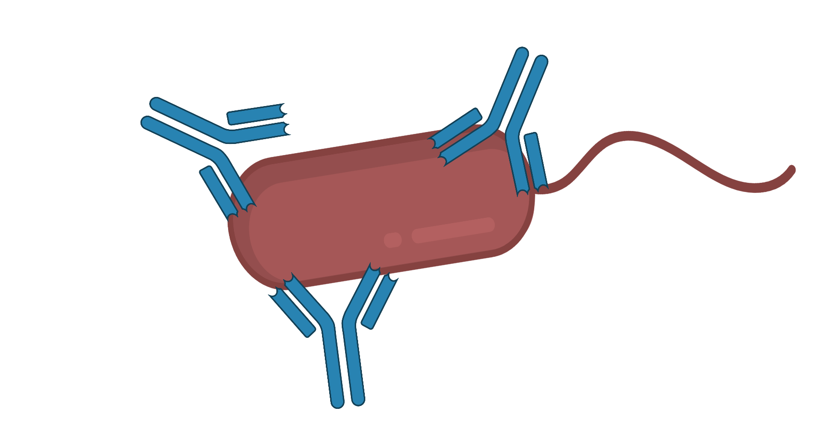
Increased immunoglobulin content
+75 % Ig
Notes:
Overall protein and albumin similar between groups; IG higher in 50 group

Slide 14
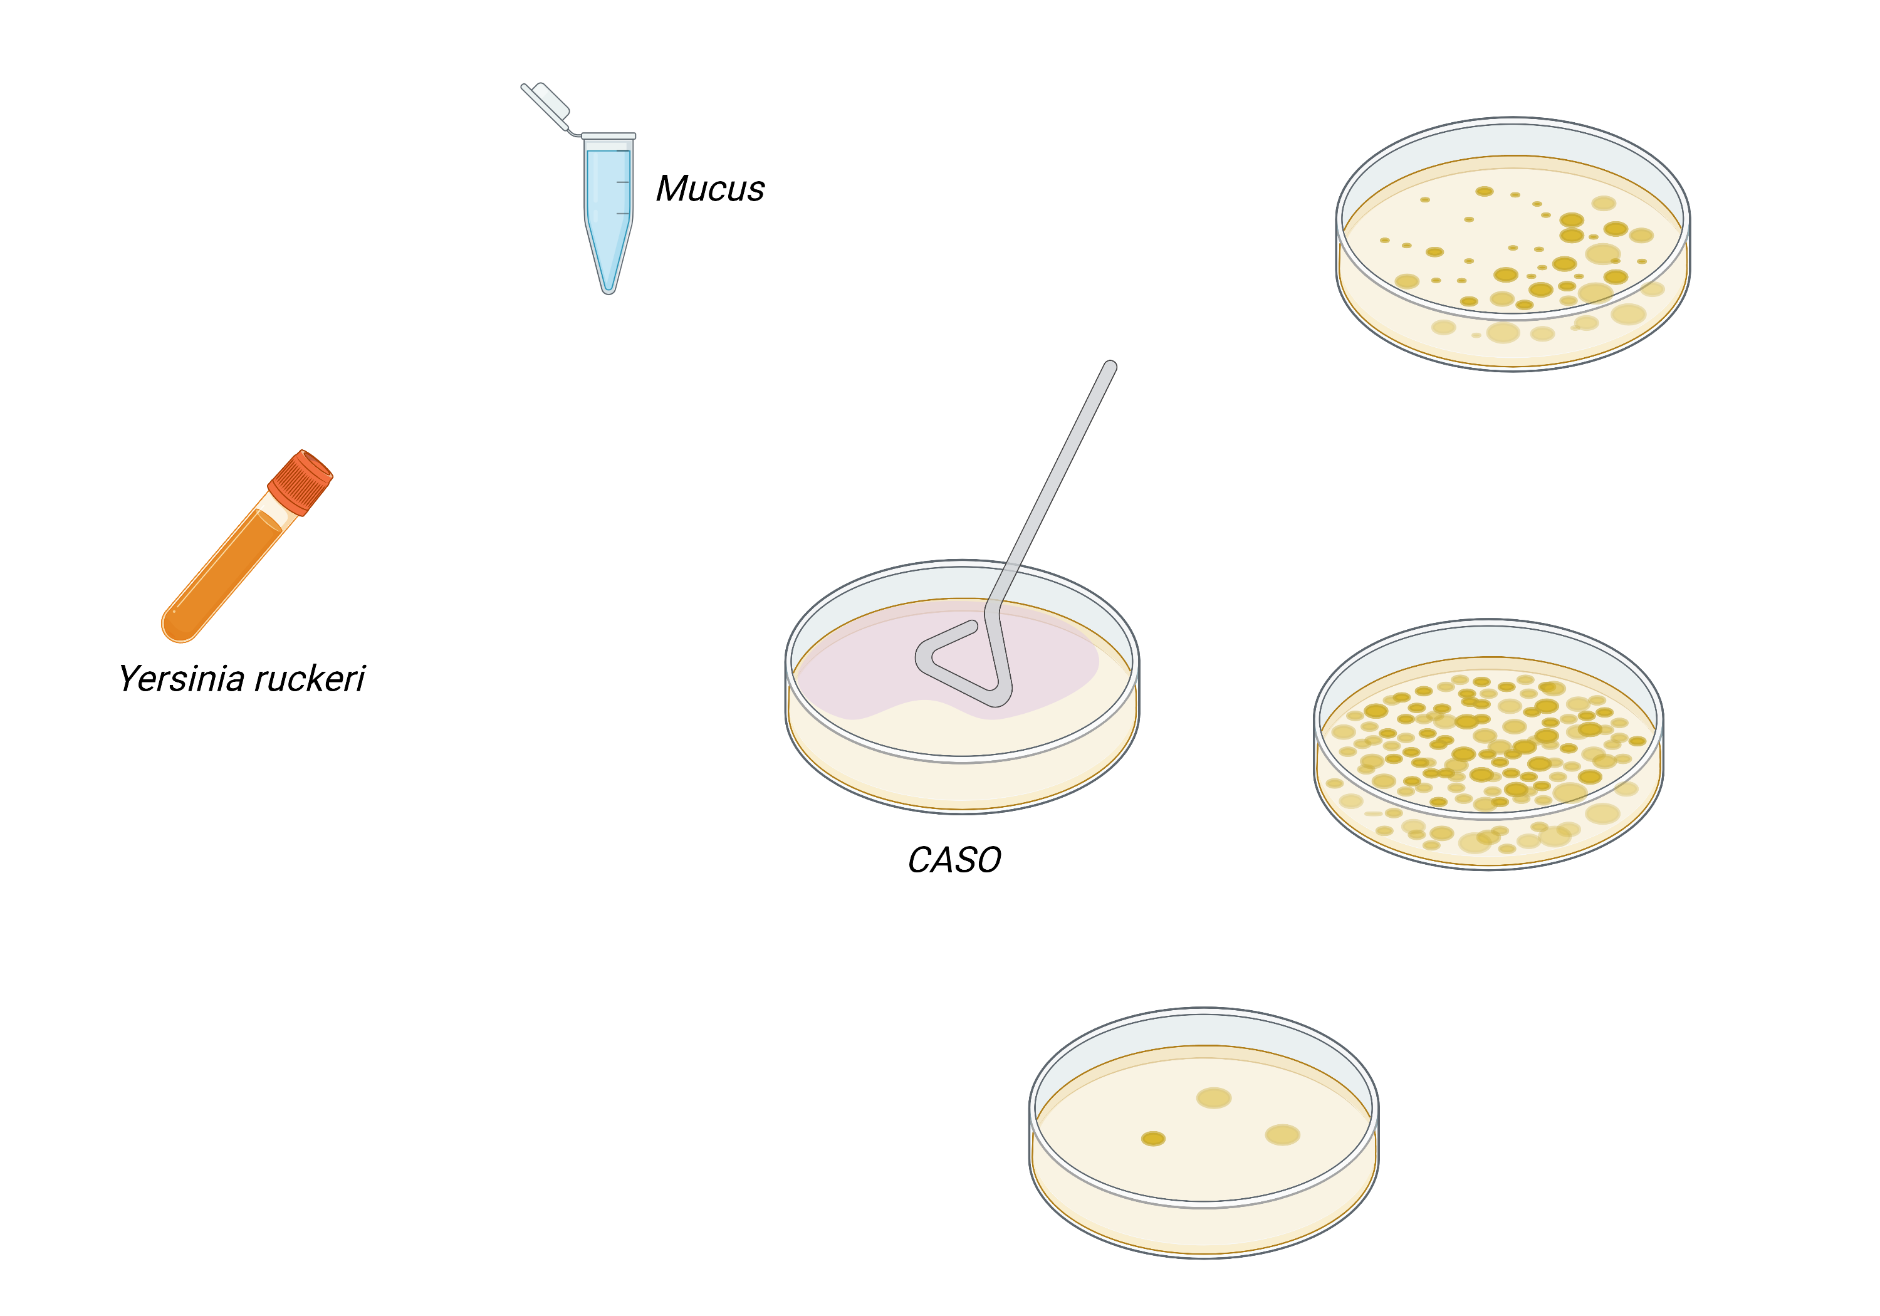

Effect against bacteria
(Enteritic redmouth disease)

Slide 15
Effect against bacteria

Slide 16
Effect against bacteria

Slide 17

Effect against bacteria
48 h @17 °C
3 different Yersinia concentrations
3 technical repeats per mucus sample
4 times repeated fish
1255 Plates in total
Sasha Behrens
(IGB)

Slide 18
Decreased bacterial load
- 79 %
- 86 %
Mio CFU/mL

Slide 19
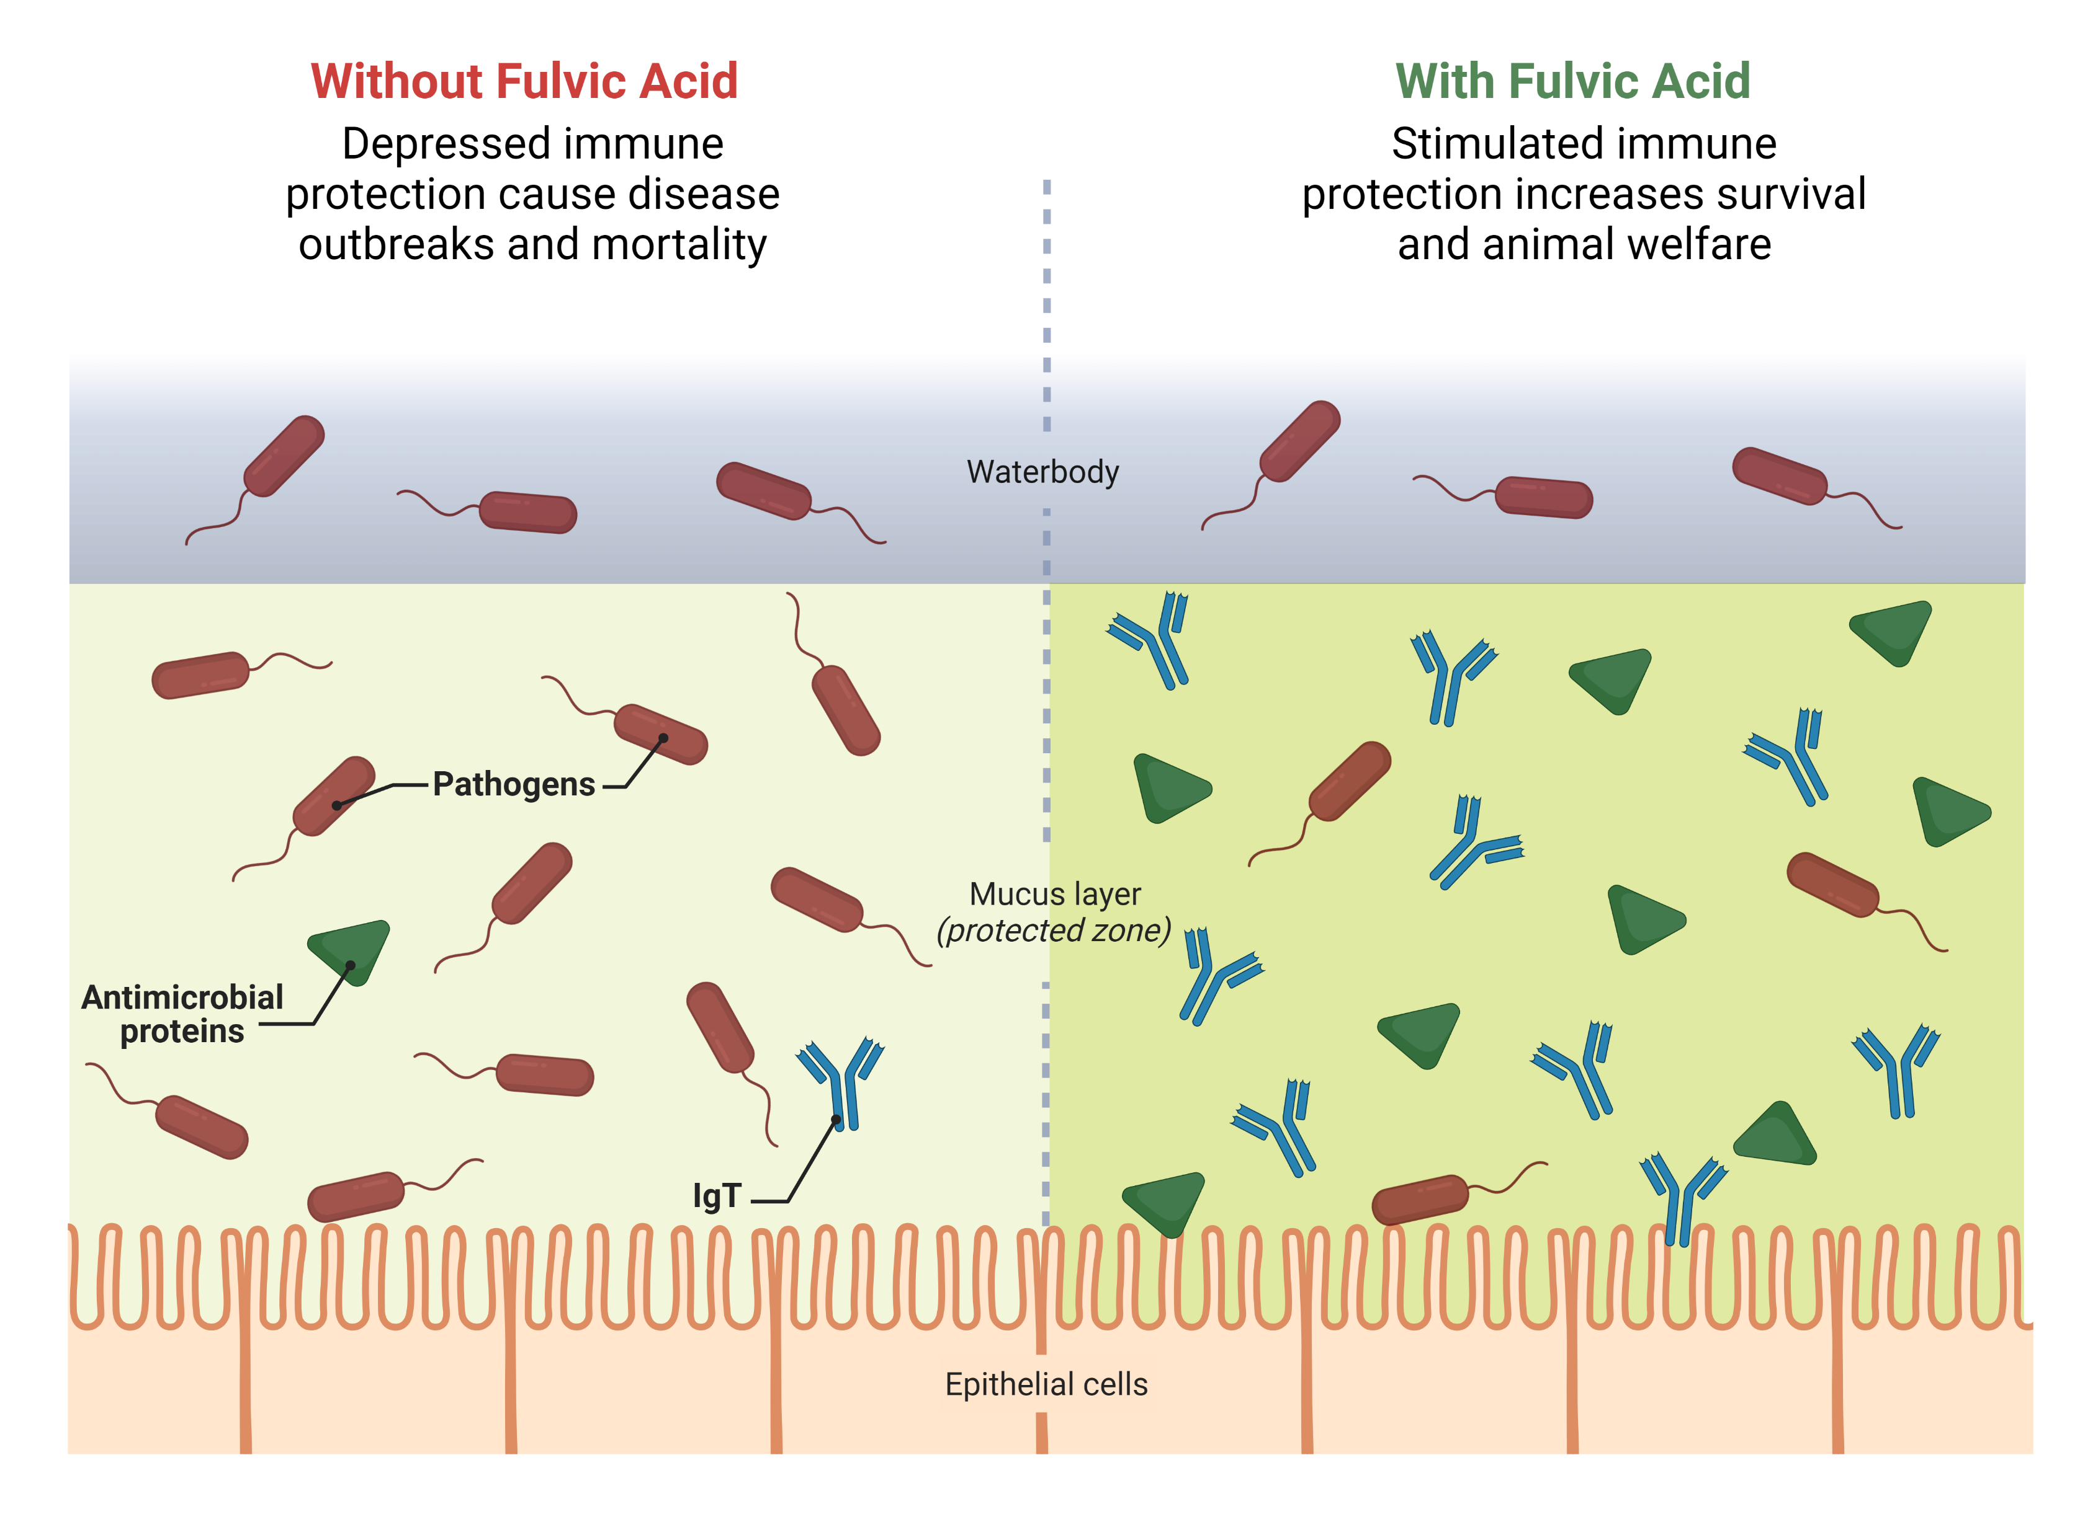
Summary

Slide 20
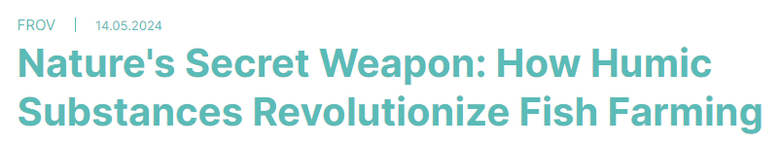





Thanks a lot for your attention
https://www.frov.jcu.cz/en/science-and-research/research-in-spotlight/
tajna-zbran-prirody-jak-huminove-latky-zasadne-meni-chov-ryb-2
Thora Lieke
tlieke@frov.jcu.cz
0000-0002-4345-1712

